Slide 1

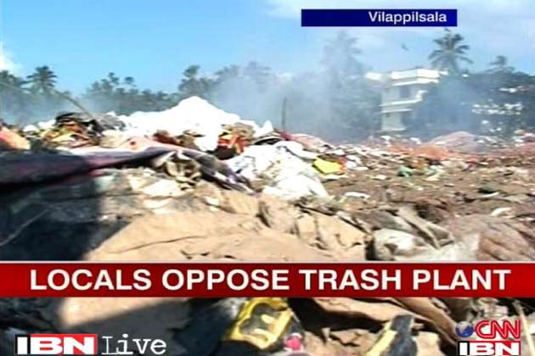
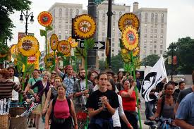
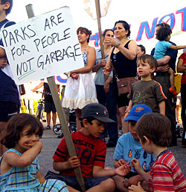
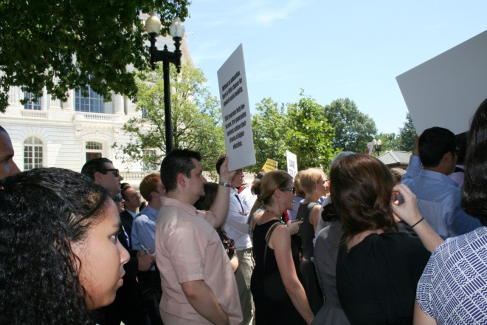
Become a Science
Public Policy Analyst

Slide 2
Steps of the Public Policy Analyst (PPA)
Define the Problem
Gather the Evidence
Identify the Causes
Examine an Existing Policy
Develop Solutions
Select the Best Solution
  Effectiveness vs. Feasibility

Slide 3

1. Define the problem
The problem that needs to be addressed is the overproduction of garbage at Proctor High School,
Utica, New York.

Slide 4

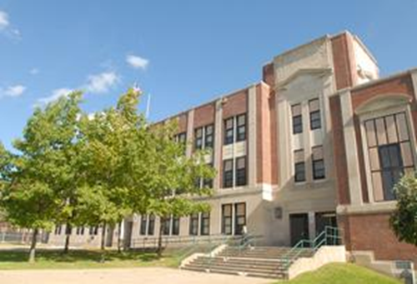
2. Gather evidence
The U.S. is the #1 trash-producing country in the world.
We produce1,679 lbs./person/yr.
We generate 40% of the world's waste with only 5% of the population.

Slide 5
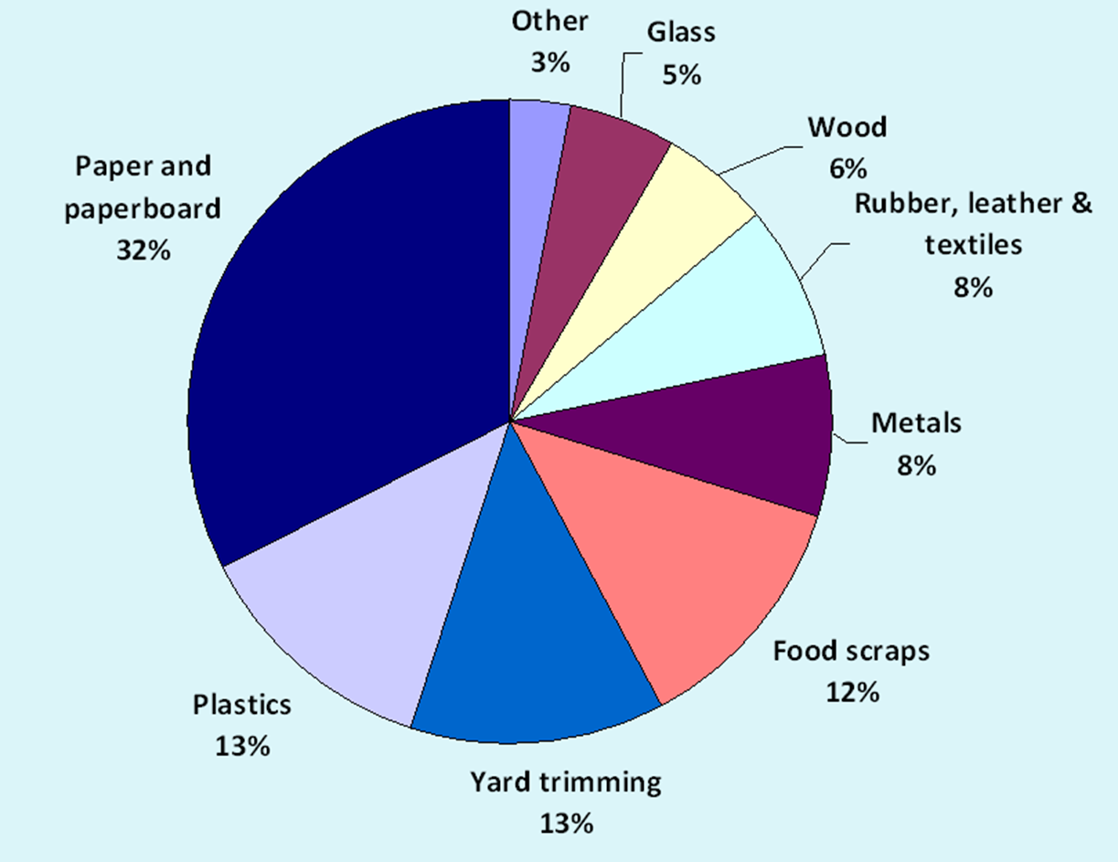
What are we throwing away?
MUNICIPAL
SOLID WASTE IN 2011
254.1 million tons

Slide 6
What do we do with all of it?
:Bury It: which requires space, landfills, off gassing, leaching control, and monitoring 30 years after the landfill is closed
Burn It: which requires special air quality equipment, produces hazardous ash, that goes into a landfill
Recycle: reclaim recyclable materials but this does cost money

Slide 7
3. Identify causes
Garbage includes plastic bottles, used electronics, Styrofoam, plastic food wrappers, used batteries, magazines and computer paper.
(things that do not decompose well)
Recycling bins not available in the classrooms, halls or cafeteria.

Slide 8
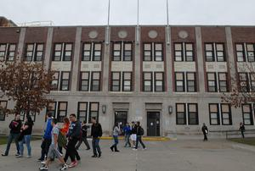
4. Evaluate a policy
UTICA CITY SCHOOL DISTRICT
BOARD POLICY MANUAL-
*SECTION 5000
BUSINESS OPERATIONS

Slide 9
SUPPORT OPERATIONS (5007)
ENERGY CONSERVATION AND RECYCLING OF SOLID WASTE
I. The Board of education recognizes the importance of energy conservation and is committed to the analysis, development, and initiation of conversation measures throughout the District for the purpose of reducing energy consumption.
II. Recycling
The district will develop a program for the source separation and segregation of recyclable or reusable materials in the District. This District-wide recycling plan shall include:
1. A conservation education program to teach students about their social responsibility for preserving our resources, and involvement of all students and personnel in a comprehensive effort to reduce, reuse and recycle waste materials;
2. A concerted effort to purchase recycle items and biodegradable rather than non-biodegradable products;
3. Separation of waste into appropriate categories for the purpose of recycling, including mercury-added consumer products; and
4. A cooperative effort with community recycling programs.

Slide 10
5. Develop solutions
Rethink-what we purchase as a consumer
Reduce-amount of waste
Reuse-all possible materials
Recycle-as many materials as we can

Slide 11
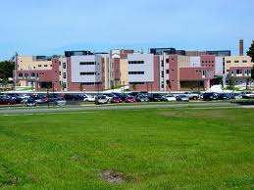
6. Select best solution
Recycle-as many materials as we can

Slide 12
7. Benefits & Costs
Less use of landfills.
Cleaner air, less ground water pollution from leaching, and less health problems due to rodents and scavengers.
Increasing land values and aesthetic appeal at Proctor HS due to less dumpsters.
Cost? Zero dollars!

Slide 13
Zero money? WHY?
The city of Utica provides recycling bins free of charge.
Custodians are still required to remove waste but garbage is routed to the dumpster and recyclables into containers for pick-up.

Slide 14
9. Political Strategies
Ask the principal, superintendent or school board to comply with recycling laws and board policy.
Write a letter to the editor of the newspaper exposing lack of recycling in our school.
Form a Green Team of student volunteers who will handle recycling once a week.

