Slide 1
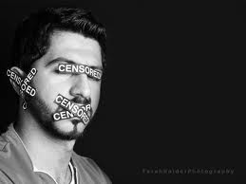
Censorship
is the controlling/elimination of speech or other public communication which may be considered objectionable, harmful, sensitive, or inconvenient as determined by a government, media outlet, or other controlling body

Slide 2
The Catholic Church banned texts they did not agree with, accurate or not.

Slide 3
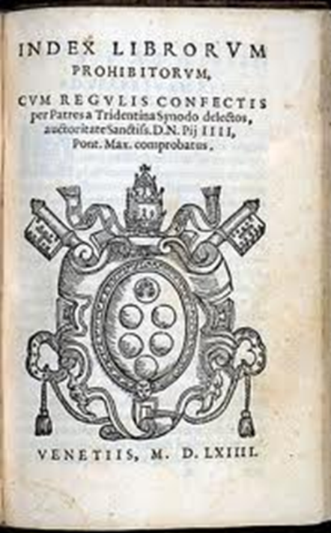
The Church began to make judgments on ideas, philosophies, behaviors, and books that were contrary to Christian faith and morals.
The Index of Forbidden Books, or Index Librorum Probibitorum in 1557 by Pope Paul IV
Gelasius in 496 listed heretical and apocryphal books banned by previous Popes

Slide 4
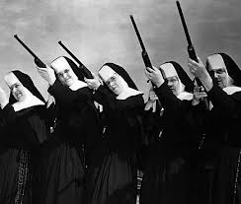
The Catholic Church wanted to protect and preserve the faith of its followers
They did not want to lose power and authority over their followers

Slide 5
Evaluate the Policy
In groups of four, re-read the PowerPoint and fill in the worksheet evaluating the Catholic church’s policy of censorship from 1557-1966.

Slide 6
Comparatve Analysis
In the same groups, fill out this worksheet comparing The Catholic Church’s policy of Censorship in the 1500’s to Adolf Hitler’s policy of Censorship in Germany in the 1930’s & 1940’s
Be prepared to share your answers with the other groups.

Slide 7
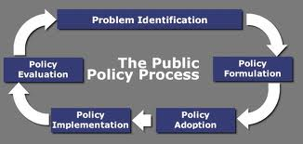
The Public Policy Analyst

