Slide 1
Poster Project
Piet Mondrian
Steps towards making an effective poster.

Slide 2
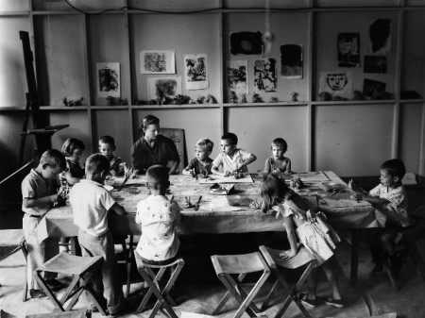
Respecting Art Room Class Time
Why is it important to be in art class?
Define the problem

Slide 3
When are students missing art room class time the most?
Beginning of class?
During class?
End of class?
The whole class?
Gather the evidence

Slide 4
Why are students missing art class time?
Parents didn’t bring them on time.
Students consistently have to go to band during art time.
Have to go work with their special needs counselor.
Homeroom teacher wants to talk to the student during art.
Homeroom teacher bring students late and/or picks them up early.
Students are going to the bathroom/drink.
Other reason?
Identify the Causes

Slide 5
What has been the policy for missing class?
What has ben the current punishment (if any) for missing art room class time?
Examine an Existing Policy

Slide 6
The most important step: what can we do to help fix this problem?
Develop Policy Solutions

Slide 7
Here is where it gets fun.
Using the format of a poster how can we make everyone in the school more aware of how important it is to be in art class? The class will be broken up into groups of 3 or 4 to work together to create these posters.
Select the Best Solution

Slide 8
Designing the Poster

Slide 9
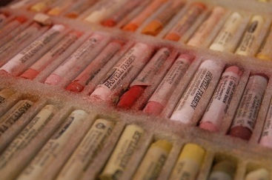
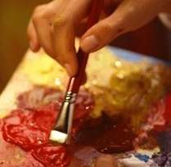
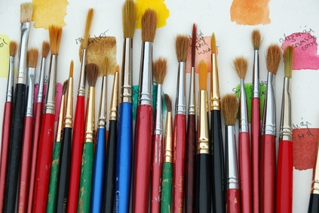
Think about materials

Slide 10
Work
To accomplish your group’s goals
Together
Keith Haring

Slide 11
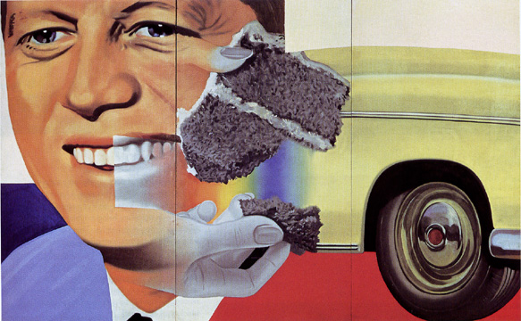
Plan the composition/ layout
James Rosenquist

Slide 12
How will you include Text?
Robert Indiana
Tim Rollins KOS

Slide 13
Work carefully and thoughtfully
Chuck Close

Slide 14
Think about how far away people will view the poster.
Chuck Close

Slide 15
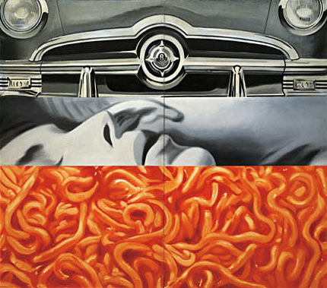
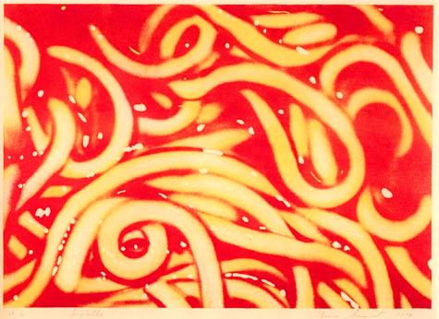
View your work from a distance
James Rosenquist

Slide 16
Carefully decide what works
Chuck Close

Slide 17
Assessment of the project
Students will view all the work hung on the walls and will discuss the posters that work best.
Tim Rollins KOS

Slide 18
Displaying the art
Students will hang their work in the hallways of the school. The art teacher will document attendance before and after this project happens.

Slide 19
Present your work neatly and carefully
James Rosenquist

Slide 20
Tom Montague
Most Holy Rosary
Tmontague@syrdiocese.org
Process
Define the problem
Gather the evidence
Identify the Causes
Examine an Existing Policy
Develop Policy Solutions
Select the Best Solution

