Slide 1
Technology Report
Kiymara Van Duyne
PS 194 Countee Cullen
kvanduyne@schools.nyc.gov

Slide 2
Introduction
The society we live in depends heavily on technology. The way the we communicate in school and at home. It is easy to think that everyone has access to technology all the time. However, we know that this is not always true. There are plenty of schools and homes that not have adequate access to technology.

Slide 3
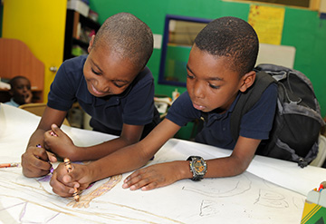
Task
You and your classmates are a part of a Technology Crew! Each Technology Crew has four members. Your job is to research the reasons why technology is not accessible to all scholars and brainstorm one way that technology could be more easily accessible between home and school.

Slide 4
Process
As a group define the problem with access to technology.
Use the resources and your ow research to gather evidence to support your thinking
identify causes for the lack of access of technology
Discuss an existing policy related to technology and the ease of access for scholars.
Brainsotrm with your group solutions to bridging the technology gap for schoalrs.
Agree to select the best solution and report your findings

Slide 5
Resources
Bergen, D. (March 07, 2000). Technology in the Classroom. Childhood Education,
76, 2, 116-18.
http://www.c2sdk.org/services_techaccess.html
https://www.theatlantic.com/education/archive/2014/12/what-happens-when-kids-dont-have-internet-at-home/383680/
http://neatoday.org/2016/04/20/the-homework-gap/
https://www.theatlantic.com/education/archive/2013/11/more-than-half-of-us-public-schools-dont-have-adequate-wireless-access/281410/

Slide 6
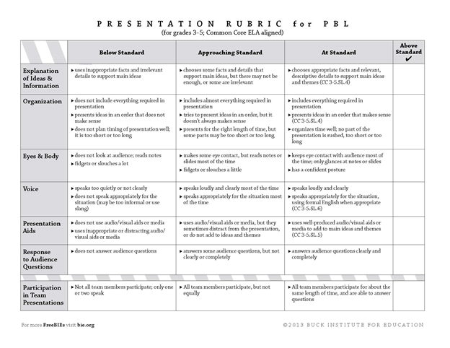
Evaluation
You will be evaluated on your oral presentation and your written presentation.

Slide 7
Conclusion
Following the rubric and the Six Steps to the PPA, as a crew you will create an oral and written presentation. The presentation and written assignment must be a collaboration of the entire crew.

Slide 8
Common
Core Standards
CCSS.ELA-LITERACY.SL.5.1
Engage effectively in a range of collaborative discussions (one-on-one, in groups, and teacher-led) with diverse partners on grade 5 topics and texts, building on others' ideas and expressing their own clearly.
CCSS.ELA-LITERACY.SL.5.1.A
Come to discussions prepared, having read or studied required material; explicitly draw on that preparation and other information known about the topic to explore ideas under discussion.
CCSS.ELA-LITERACY.SL.5.1.B
Follow agreed-upon rules for discussions and carry out assigned roles.
CCSS.ELA-LITERACY.SL.5.1.C
Pose and respond to specific questions by making comments that contribute to the discussion and elaborate on the remarks of others.
CCSS.ELA-LITERACY.SL.5.1.D
Review the key ideas expressed and draw conclusions in light of information and knowledge gained from the discussions.
CCSS.ELA-LITERACY.SL.5.2
Summarize a written text read aloud or information presented in diverse media and formats, including visually, quantitatively, and orally.
CCSS.ELA-LITERACY.SL.5.3
Summarize the points a speaker makes and explain how each claim is supported by reasons and evidence.
Comprehension and Collaboration:

Slide 9
Common
Core Standards
CCSS.ELA-LITERACY.SL.5.4
Report on a topic or text or present an opinion, sequencing ideas logically and using appropriate facts and relevant, descriptive details to support main ideas or themes; speak clearly at an understandable pace.
CCSS.ELA-LITERACY.SL.5.5
Include multimedia components (e.g., graphics, sound) and visual displays in presentations when appropriate to enhance the development of main ideas or themes.
CCSS.ELA-LITERACY.SL.5.6
Adapt speech to a variety of contexts and tasks, using formal English when appropriate to task and situation. (See grade 5 Language standards 1 and 3 here for specific expectations.)
Presentation of Knowledge and Ideas:

