Slide 1
The effectiveness of peer tutoring to increase academic achievement
Stephanie Maxy
Notes:
NOTE:
To change the image on this slide, select the picture and delete it. Then click the Pictures icon in the placeholder to insert your own image.

Slide 2
What is Classwide Peer Tutoring (CWPT)
The Classwide Peer Tutoring (CWPT) is a teaching strategy that involves the whole class to be engaged in the process of learning and/or practicing a particular academic skill, in a fun way.
Can be use in many different subject: reading teachers may use CWPT to help students master their sight words or spelling. Math teachers may use CWPT to master math facts.
Whichever subject CWPT is used in, it incorporates one student playing the role of a “tutor” and another student playing the role of a “tutee”.

Slide 3
Problem Statement
Admitting any misunderstanding during whole group instruction takes a lot of courage. Students tend to keep quiet and shy away from asking questions that would clarify their thinking. There are many reasons for this. Some students feel embarrassed to admit their misunderstanding in front of others, some students give up as a result of feeling completely lost, and others want to give themselves more time to make sense of the problem at hand before seeking assistance. Unfortunately, those who find themselves in such situations, are usually the lower achieving students. As a result, One of the best instructional strategies to implement is the peer tutoring strategy.

Slide 4
Research Questions
What is the effect of peer tutoring on students’ literacy development?
How can peer tutoring be implemented within the classroom?
How can peer tutoring be implemented outside the classroom?

Slide 5
Data Sources
Pre & Post Test
Checklist
Teacher Observations
F & P Assessment

Slide 6
How is classwide peer tutoring effective?
Led to students doing better on standardized testing
Led to students needing less special educational services
Fewer students dropping out of high school
Provides immediate feedback
Helps to increase students’ academic and social skills

Slide 7
How is Classwide Peer Tutoring (CWPT) Beneficial for Teachers?
Provides data to create next steps for students
Does not take to much time to prepare
Not much resources are required

Slide 8
How is Classwide Peer Tutoring (CWPT) beneficial for students?
Takes the pressure off of them when they do not understand something as oppose to putting them on the spot
They are learning in a fun way

Slide 9
What does Classwide Peer Tutoring (CWPT) look like?

Slide 10
Pre- Test Post- Test
F & P Assessment

Slide 11
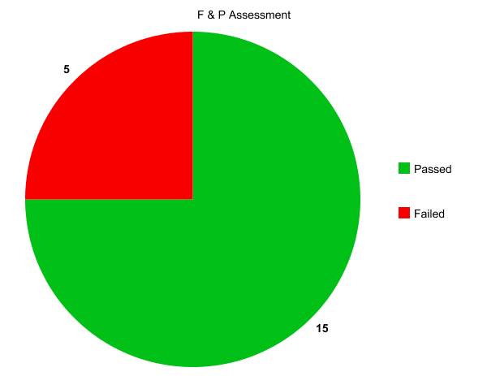
Reading Test
Pre- Test Post- Test (After 10 week period)

