Slide 1
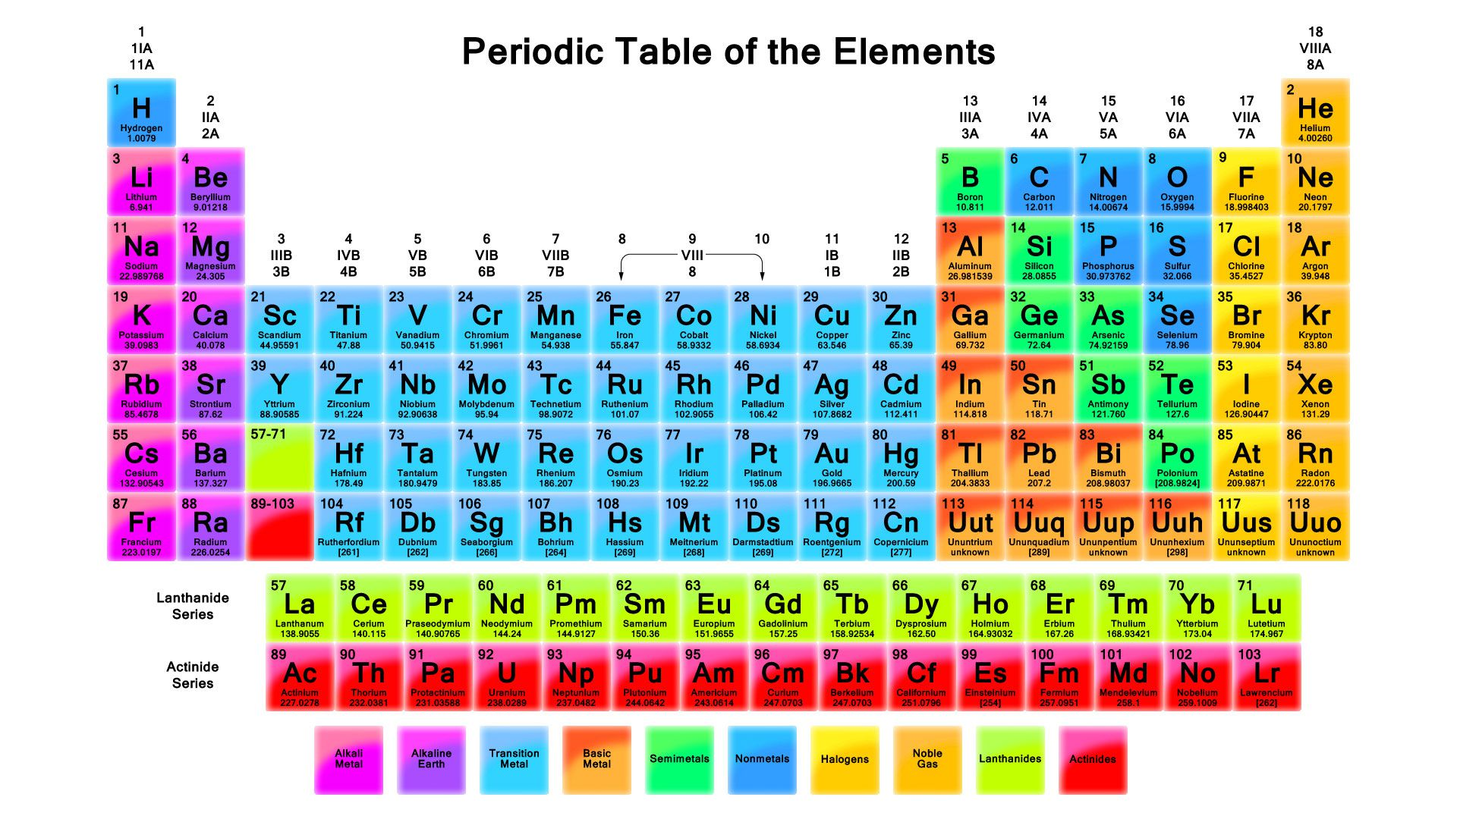
Periodic Table
Ali Fischer
Grade 7

Slide 2
Introduction
What is the periodic table?
How does the periodic table affect your daily life?
How do the elements interact to cause change(s)?
How are the elements in the periodic table grouped?

Slide 3
The purpose of the periodic table is to group and organize all of our chemical elements so we can better understand their interactions and chemical behaviors

Slide 4
Task
Students will be split into groups of 3-4 to research various elements from the periodic table
Students will begin by reviewing the atom and getting a better understanding of protons, neutrons, and electrons
Students will then do a worksheet that helps them understand what parts of an element are displayed on the periodic table and what each part means
-atomic number, atomic mass, protons, electrons, neutron

Slide 5
Process
https://www.thoughtco.com/how-to-use-a-periodic-table-608807
https://www.ptable.com/
http://sciencespot.net/Media/atomsfam.pdf
Atoms Family
Science Matters: Solid, Liquid, or Gas

Slide 6
Evaluation
Students will submit a project on an assigned element, the rubric will look to see that they understand that element and what it’s chemical formula is, what group it belongs to, the # of protons, neutrons, electrons it has, how it is used, what objects it is commonly found in, etc.

Slide 7
Standards
P-PS1-1. Ask questions and use observations to test the claim that different kinds of matter exist as either solid or liquid. [Clarification Statement: Emphasis should be on observing and describing similarities and differences between solids and liquids based on their physical properties. Solids and liquids can be compared and categorized (sorted) based on those properties.]
PS1.A: Structure and Properties of Matter (NYSED) Different kinds of matter exist and many of them can be either solid or liquid. Matter can be described, categorized, and sorted by its observable properties. (P-PS1-1)

Slide 8
Standards
K-PS1-1. Plan and conduct an investigation to test the claim that different kinds of matter exist as either solid or liquid, depending on temperature. [Clarification Statement: Emphasis should be on solids and liquids at a given temperature and that a solid may be a liquid at higher temperature and a liquid may be a solid at a lower temperature.] [Assessment Boundary: Only a qualitative description of temperature, such as hot, warm, and cool, is expected] The performance expectation
PS1.A: Structure and Properties of Matter Different kinds of matter exist and many of them can be either solid or liquid, depending on temperature. Matter can be described and classified by its observable properties. (K-PS1-1)

