Slide 1
NYC SchoolFood
Are NYC SchoolFood lunches meeting the standards for our students?

Slide 2
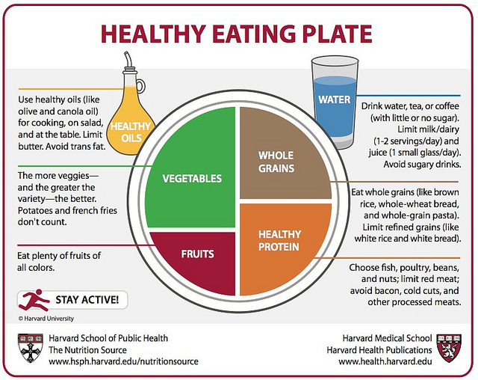
School
Food Healthy Eating Plate
Step 4 of the PPA: Examine Existing Policy

Slide 3
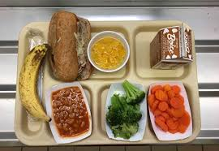
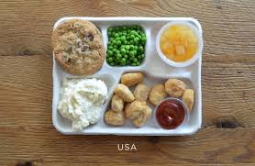
Healthy Eating Plates
All SchoolFood Lunches should include fruit, vegetables, a healthy protein, and whole grains

Slide 4
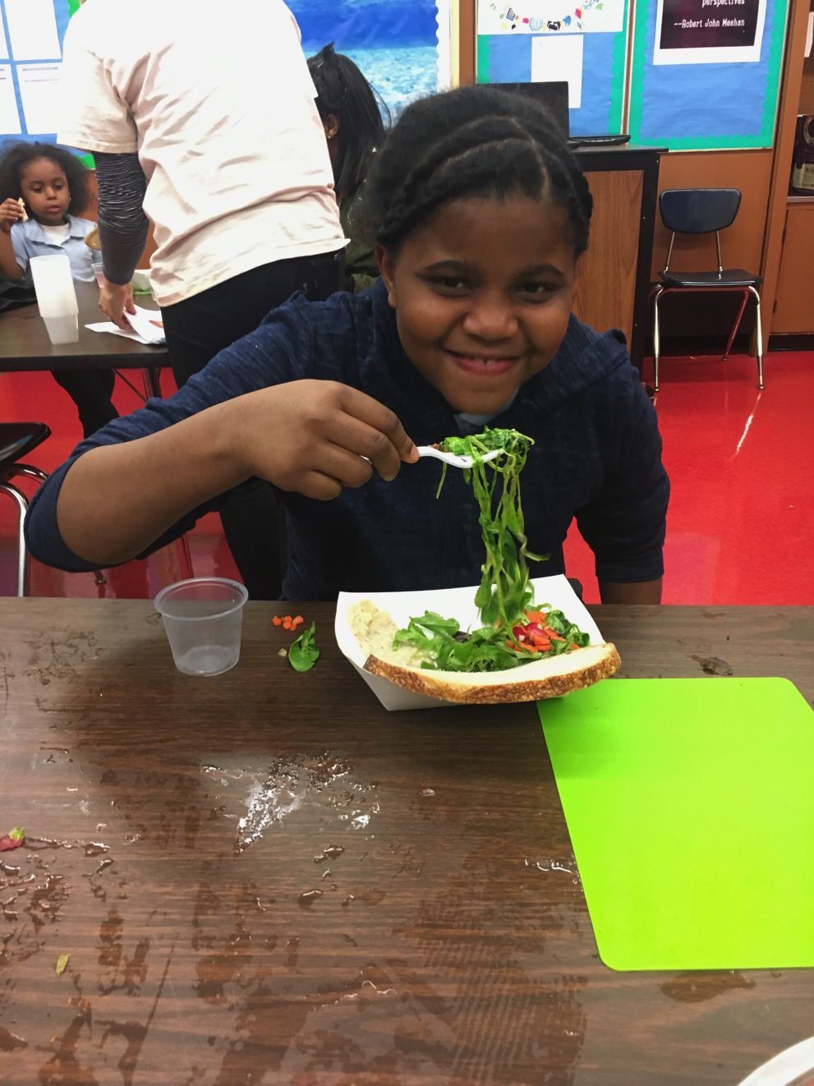
Benefits of a healthy SchoolFood lunch
Free or reduced lunch reduces food insecurity.
Low-income students who eat both school breakfast and lunch significantly better overall diets than students who do not.
Receiving free or reduced school lunches reduces poor health by at least 29%
Meeting students nutritional needs lead to a better learning environment
Students have Increased attendance
Students receive breakfast, lunch and snacks during the school day
Frac.org

Slide 5
Effects of a unhealthy school lunch
Foods that are high in sodium, sugar and fat create obesity and nutrient deficiency in children
Students with deficiencies can have lower attendance and test scores than classmates who eat a balanced diet
Obesity in children can lead to lower self-esteem and create other issues for children in the future
Step 1 of the PPA: Define the Problem

Slide 6
What can be done to help?
Start a school garden
Students who are able to grow their fruits and vegetables have a connection to their food
Offer healthy cooking classes to parents and families
Ban junk food
Create a list of appropriate snacks with the school community
Taste tests with students
Introduce new foods for students to try
Step 5 of the PPA: Develop Policy Solutions

