Slide 1
Childhood Obesity
Ms. Zayas
I.S. 52
mrs.zayas@inwood52.org

Slide 2
PUBLIC POLICY ANALYST
A public policy is a government action usually intended to deal with a social problem. Every day policies are enacted in your school, city, state, country and throughout the world that will affect your life. We are going to use the Public Policy Analyst steps to understand what causes childhood obesity. This lesson will focus on steps 1 and 2 of the PPA.
Notes:
c

Slide 3
PUBLIC POLICY ANALYST
STEP 1: DEFINE THE PROBLEM
STEP 2: GATHER THE EVIDENCE
STEP 3: IDENTIFY THE CAUSES
STEP 4: EXAMINE THE EXISTING POLICY
STEP 5: DEVELOP NEW SOLUTIONS
STEP 6: SELECT THE BEST SOLUTION
http://flippedtips.com/plegal/tips/welcome.html

Slide 4
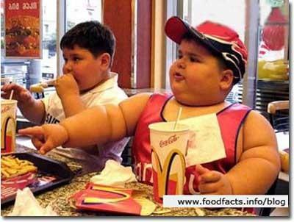
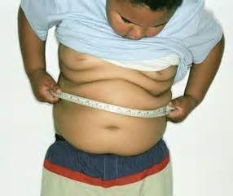
STEP 1: DEFINE THE PROBLEM
1. Look at the pictures
2. What word comes to mind?

Slide 5
OBESITY
A person is considered to be obese if they are more than 20 percent over their ideal weight. That ideal weight must take into account the person's height, age, gender, and build.

Slide 6
Step 2: GATHER THE EVIDENCE Overweight/Obesity Measurements
Body mass index (BMI) is a measure used to determine childhood overweight and obesity. It is calculated using a child's weight and height. BMI does not measure body fat directly, but it is a reasonable indicator of body fatness for most children and teens.
A child's weight status is determined using an age- and sex-specific percentile for BMI rather than the BMI categories used for adults because children's body composition varies as they age and varies between boys and girls.

Slide 7
Discuss and Share

Slide 8
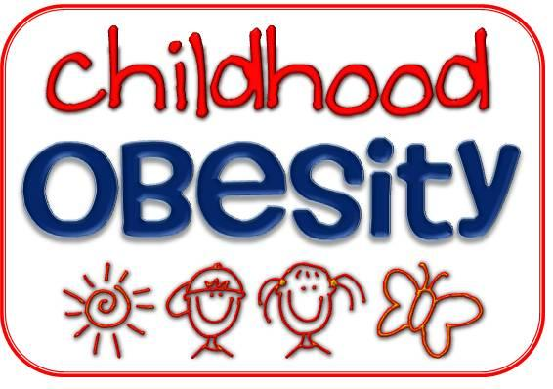
STEP 3: IDENTIFY THE CAUSES
Read and discuss:
What causes childhood obesity?
http://www.cdc.gov/obesity/childhood/problem.html

Slide 9
Students will generate questions based upon what they have read.

Slide 10
Students will conduct a survey in school using the questions they generated.

Slide 11
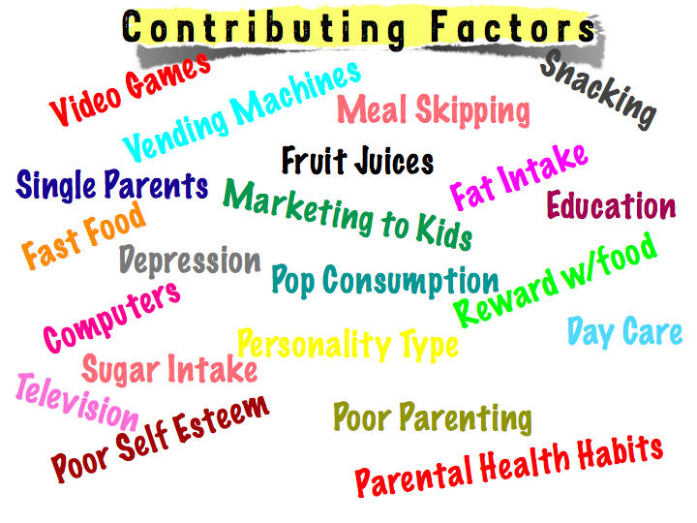
List Your Findings

