Slide 1
Child Obesity
A Growing Epidemic
Public Policy Analyst
Jeannie Wong
Our Lady Queen of Martyrs
jeanniewong5@gmail.com

Slide 2
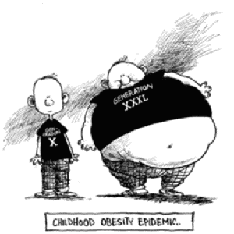
Which child do you think will run faster on a race? Turn and talk to your partners and explain.

Slide 3
Steps of the Public Policy Analyst
Step 1: Define the Problem
Step 2: Gather the Evidence
Step 3: Identify the Causes
Step 4: Examine an Existing Policy
Step 5: Develop New Solutions
Step 6: Select the Best Solution
Feasibility vs. Effectiveness
http://flippedtips.com/plegal/tips/welcome.html

Slide 4
What is Obesity?
It is a medical condition in which too much body fat accumulates in the body and is stored there.
“Obesity” and “overweight” are both terms used to label a weight that is greater than what is considered healthy.
Obesity is linked to a number of health risks, including heart disease and diabetes.

Slide 5
Causes & Incidence
Why are so many children obese in the USA?
According to: www.ncbi.nlm.nih.gov/pubmedhealth
*When children eat more than they need, their bodies store the extra calories in fat cells to use for energy later. If this pattern continues over time, and their bodies do not need this stored energy, they develop more fat cells and may develop obesity.

Slide 6
*Infants and young children are very good at listening to their bodies’ signals of hunger and fullness. They will stop eating as soon as their bodies tell them they have had enough.
*But sometimes a parent tells them they have to finish everything on their plate. This forces them to ignore their fullness and eat everything that is served to them.
*These learned habits lead to eating no matter if we are hungry or full. Many people have a very hard time breaking these habits.

Slide 7
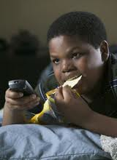
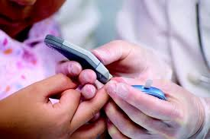
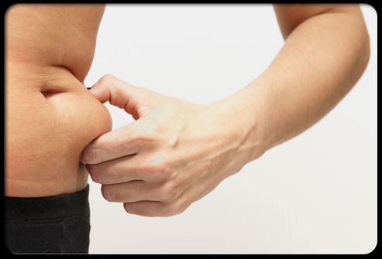
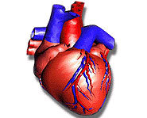
Diabetes
Obesity
Heart disease
Overweight
High blood pressure
Let’s watch a video to be more aware of this disorder.
http://www.cbsnews.com/video/watch/?id=682161n

Slide 8
What are some of the reasons for this disease?
1.) Junk Food
2.) _____________________
3.) _____________________
4.) _____________________
The children will define obesity using:
http://flippedtips.com/plegal/tips/worksheet1.html

Slide 9
*What emotional problems arise from childhood obesity?
http://www.cdc.gov/healthyyouth/obesity/facts.htm
http://www2.aap.org/obesity/SoundAdvice/audio/Hassink/HassinkComplete.mp3
http://mollenfoundation.org/2011/04/childhood-obesity-emotional-effects-and-sedentary-lifestyles/
http://www.betterhealth.vic.gov.au/bhcv2/bhcarticles.nsf/pages/Obesity_in_children

Slide 10
Conditions that result from OBESITY The children will complete:
http://flippedtips.com/plegal/tips/worksheet2.html

Slide 11
Child Obesity Facts
*Childhood obesity has more than doubled in the past 30 years.
*The percentage of children aged 6–11 years increased from 7% in 1980 to nearly 18% in 2010.
*The percentage of adolescents aged 12–19 years who were obese increased from 5% to 18% over the same period.
*In 2010, more than one third of children and adolescents were overweight or obese.

Slide 12
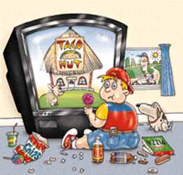
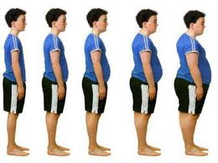
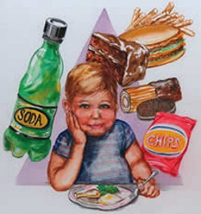
The children will work on:
http://flippedtips.com/plegal/tips/worksheet3.html

Slide 13
Youth in America today lack regular physical exercise
Including:
Running
Swimming
Walking
Bike riding
Jumping rope
Weight training
Playing sports

Slide 14
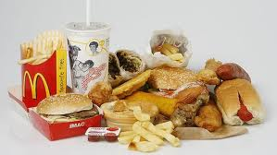
Poor Nutrition Habits also contributes to the problem of OBESITY
Including:
Eating Fast Foods – Fried Foods
Diet High In Salt
High Amounts of Sugar
High Fructose Corn Syrup
Trans Fat
Over Eating
Not eating regularly – 3x’s a day

Slide 15
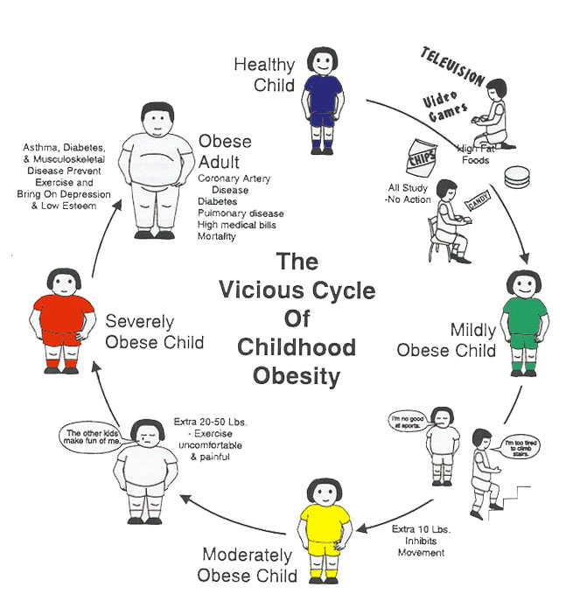
The students will work on:
http://flippedtips.com/plegal/tips/existing.html

Slide 16
Existing Policies on Obesity
What are some actions taken in the prevention of childhood obesity?
http://www.ncsl.org/issues-research/health/childhood-obesity-2005-policy-options-nutrition.aspx
http://www.obesitycampaign.org/
http://www.letsmove.gov/about

Slide 17
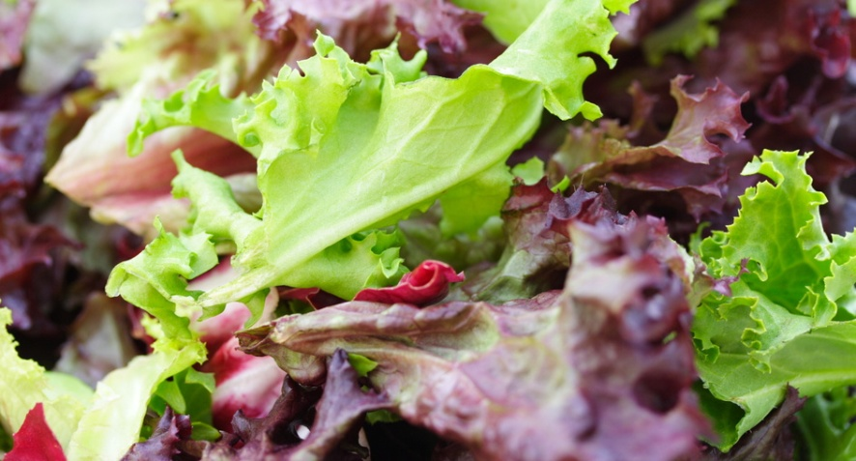
What are the best ways to deal with this issue?
Based on the information you just learned, what are some things we can do to be more aware of the foods we eat and have a more active life style? Answer this question by doing the following:
*Create an educational poster that highlights what you can do to live a healthier life style and the benefits of such a life style.

