Slide 1
A View of Bullying in Literature
by Ms. D. Saville
Our Lady Queen of Martyrs School
savilledulce@gmail.com
Notes:
Our Lady Queen of Martyrs School
savilledulce@gmail.com

Slide 2
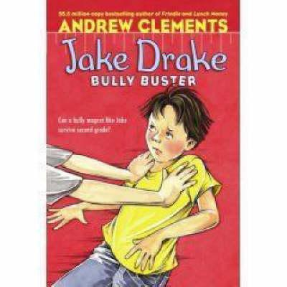
Have you ever experienced bullying?
These books, both written in first person, offer different perspectives on bullying. They both are written from a child’s point of view; the first as
victim and the second as bully.
Notes:
These books, both written in first person by children your age, offer different perspectives on bullying.

Slide 3
Introduction
We will be examining both of these books in class. Click on the following links to read a brief summary of each book and to preview a set of discussion questions to get you started THINKING about this topic!
http://www.witsprogram.ca/pdfs/schools/b
ooks/jake-drake-bully-buster/jake-drake-bully-buster.pdf
http://www.witsprogram.ca/schools/books/each-kindness.php?source=book-lists

Slide 4
Public Policy Analyst
You will be completing tasks on the following:
Defining the problem
Gathering evidence
Identifying causes
Examining existing policies
Developing solutions
Selecting the best solution

Slide 5
Task 1 and 2: Gathering Evidence
Discuss with students in your group different examples of bullying you have experienced.
Gather evidence by having each person in your group tell when they have been bullied or when they felt they have bullied someone.
After discussion time is over, each member must complete the following worksheet describing in detail one example of bullying.
http://flippedtips.com/plegal/tips/worksheet2.html

Slide 6
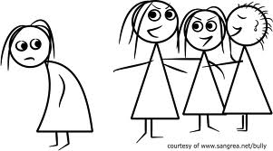
Task 3: Identifying Causes
Consider what you think might have caused
the characters Link and Chloe to act as bullies. Cite evidence from each book that show clues as to why they may have acted this way.
Click on the following link and write down your ideas on the worksheet provided.
http://flippedtips.com/plegal/tips/worksheet3.html

Slide 7
Task 4: Examining Existing Policies
What are ways that you deal with bullying at school?
How effective are the strategies you’ve used?
Are they similar or different from the ones used by the characters in the book?
Give one example and explain if it worked or not on the worksheet provided on this link.
http://flippedtips.com/plegal/tips/worksheet4.html

Slide 8
Task 5: Developing Solutions
Jake offers his solutions as a bully buster.
Do you think he finally found the best solution to bullying?
The teacher has a special way of showing her students the effects of acts of kindness. What effect did this have on Chloe’s bullying?
What is your opinion on these?
Record your ideas on the following sheet:http://flippedtips.com/plegal/tips/worksheet5.htmlTask 5:

Slide 9
Task 6: Selecting Best Solution
Now is your chance to become a bully buster!
To conclude rejoin your group to summarize by listing three solutions you’ve discussed and then decide on the BEST SOLUTION using the check off boxes on
http://flippedtips.com/plegal/tips/worksheet6.html

Slide 10
Conclusion
Apply what you’ve learned by composing a three paragraph essay stating your opinions on bullying. Begin with a catchy introduction. Explain what you believe would be the best way to deal with bullies. Be sure to give three strong reasons why you feel this way. Examine strategies used by the characters in both books and make connections with similar problems you’ve experienced. Use linking words and phrases. Write a conclusion to summarize your ideas.

Slide 11
Common Core Standards
RL4.6 Compare and contrast point of view from different stories including differences between first and third person narrations.
SL4.1 Work collaboratively with a partner or in groups building on ideas of others and self.
W4.1 Write an opinion piece by introducing topic clearly, stating opinion and organizational structure with reasons and information (details), grouping related ideas by linking opinion and reasons using linking words or phrases (for instance, in order to), proving conclusion related to opinion.

Slide 12
RESOURCES
http://flippedtips.com/plegal/ltginwood3/ltg.htm
http://www.witsprogram.ca/pdfs/schools/b
ooks/jake-drake-bully-buster/jake-drake-bully-buster.pdf
http://www.witsprogram.ca/schools/books/each-kindness.php?source=book-lists
https://www.google.com/search?q=free+images+on+bullies&biw=1093&bih=534&tbm=isch&tbo=u&source=univ&sa=X&ei=qigJVPqcFsb2yQSI-oD4Cw&ved=

