Slide 1

GREENHOUSE GAS EMISSIONS THE CAUSE OF GLOBAL WARMING?
Maria Rojas
August 28, 2014
MRojas2@schools.nyc.gov

Slide 2
PPA SUMMARY
The Public Policy Analyst (PPA) is designed to help students to maximize their participation in government as responsible citizens. As a public policy analyst, you and your class will develop the following policy skills, learning how to:
Identify the nature of a social problem
Gather evidence to support the existence of the problem
Determine the causes and factors contributing to the problem
Evaluate the existing policy
Develop public policy alternatives
Determine the best public policy solution to the problem
http://flippedtips.com/plegal/ppas/welcome.html

Slide 3
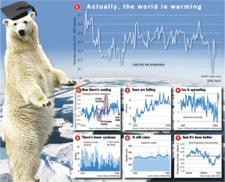
Step1: Defining the Problem
The problem that needs to be addressed is greenhouse gas emissions causes global warming.

Slide 4
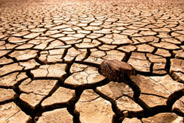
Step 2: Gathering the Evidence
Global temperature rise
All three major global surface temperature reconstructions show that Earth has warmed since 1880.⁵ Most of this warming has occurred since the 1970s, with the 20 warmest years having occurred since 1981 and with all 10 of the warmest years occurring in the past 12 years.⁶ Even though the 2000s witnessed a solar output decline resulting in an unusually deep solar minimum in 2007-2009, surface temperatures continue to increase.
Climate change: How do we know? http://climate.nasa.gov/evidence/

Slide 5
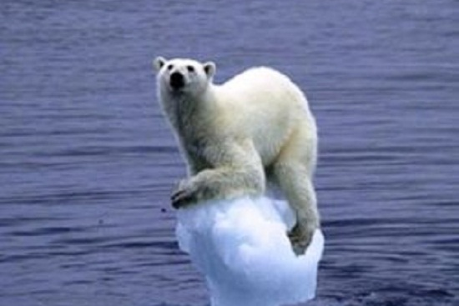
Step 2 Continues: Gathering The Evidence
How do we know the Earth's climate is warming?
Many lines of scientific evidence show the Earth's climate is changing. This page presents the latest information from several independent measures of observed climate change that illustrate an overwhelmingly compelling story of a planet that is undergoing global warming. It is worth noting that increasing global temperature is only one element of observed global climate change. Precipitation patterns are also changing; storms and other extremes are changing as well.
Global Climate Change Indicators http://www.ncdc.noaa.gov/indicators/

Slide 6
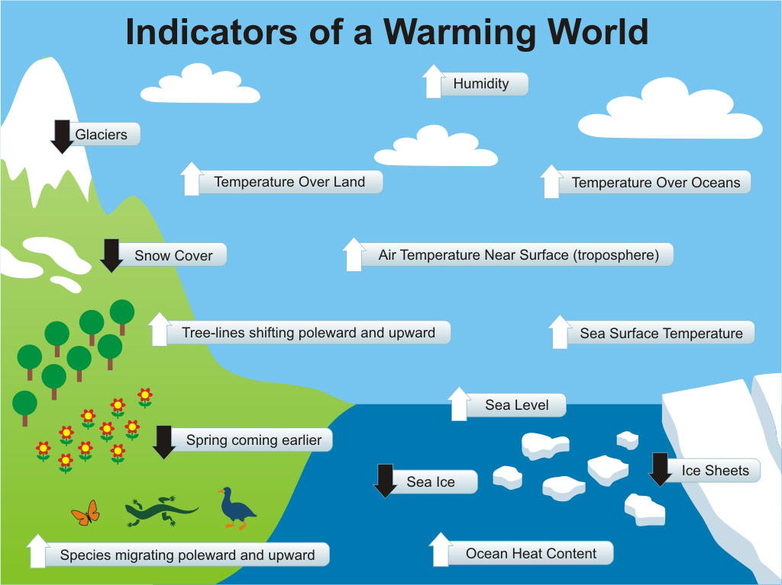
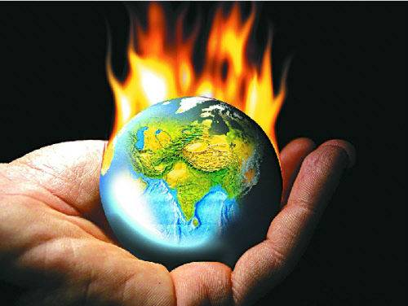
Step 2 Continues: Gathering the Evidence
Global Warming Fast Facts
Industrialization, deforestation, and pollution have greatly increased atmospheric concentrations of water vapor, carbon dioxide, methane, and nitrous oxide, all greenhouse gases that help trap heat near Earth's surface.
National Geographic New http://news.nationalgeographic.com/news/2004/12/1206_041206_global_warming_2.html

Slide 7
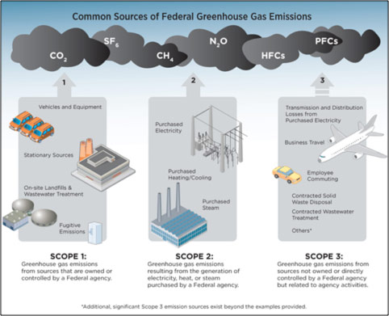
Step 3: Identify the Causes
  Task 1: Use the following hyperlink to identify the causes of greenhouse gas emissions.
  http://www.epa.gov/climatechange/ghgemissions/sources.html
  Task 2: Use worksheet 3 to record the causes of greenhouse gas emissions.
  http://flippedtips.com/plegal/tips/worksheet3.html

