Slide 1
N.Y.C. and Climate Change
Luisa Padilla-Korber
IS 52, M.
650 ACADEMY
New York, New York 10034
2014-2015
mrs.padilla@inwood52.org

Slide 2
Public Policy Analyst (PPA)
Step 1- Define the problem
Step 2- Gather the evidence
Step 3- Identify the causes
Step 4- Evaluate an existing policy
Step 5- Develop solutions
Step 6- Select the best solution (feasibility vs. effectiveness)
http://flippedtips.com/plegal/ppa/intro.html

Slide 3
Step 1
Define the Problem.

Slide 4
New Yorkers are not prepared for the effects of climate change.

Slide 5
Greenhouse gases (GHG) are trapped in the atmosphere.
        coal
        oil
        natural gas
These contribute to global warming.

Slide 6
Step 2
Gather the Evidence

Slide 7
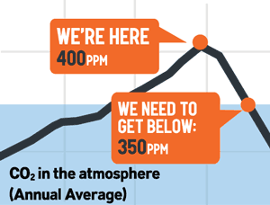
“If humanity wishes to preserve a planet similar to that on which civilization developed and to which life on Earth is adapted, paleoclimate evidence and ongoing climate change suggest that CO2 will need to be reduced from [current levels] to at most 350 ppm.”
Dr. James Hansen
350.org/about/science

Slide 8

“New Yorkers are facing the risks of rising sea levels, …”

Slide 9
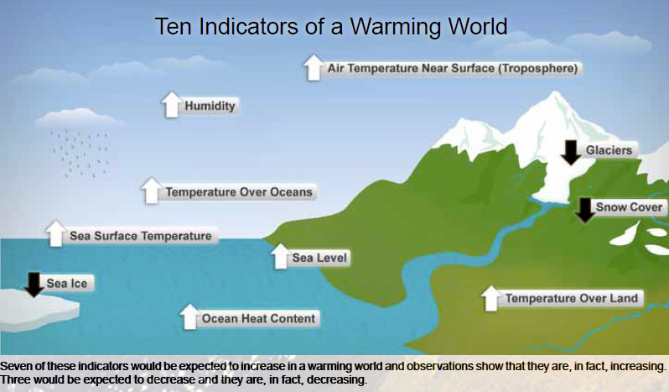
“…increased temperatures and heat waves, …”

Slide 10

flooded subway tunnels from Hurricane Sandy, in NYC in 2012
…and increasing frequency of intense storms.”

Slide 11
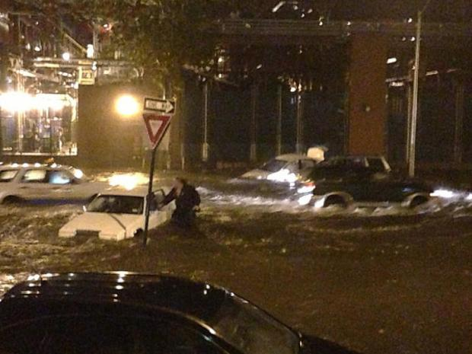
Homes and neighborhoods destroyed, 18 deaths, emergency generators in hospitals flooded, schools & transportation & businesses closed – NYC 2012

Slide 12
“The damage caused by Hurricane Sandy in 2012 provided tragic evidence of these risks. Almost 2 years later, we are still recovering. Globally, rising sea levels will flood coastlines, droughts will disrupt livelihoods, and storms and other extreme weather will threaten lives and economic development….
Inaction is not an option.”
Mayor Bill de Blasio at the U.N. Summit on September 21, 2014

Slide 13
Step 3
Identify the causes

Slide 14
The Causes of Climate Change
Agribusiness
Deforestation
Burning of fossil fuels
(coal, oil, gas)
Industry
Transportation
Housing
Worksheet 3

Slide 15
Step 4
Evaluate an existing policy

Slide 16
“80 by 50”
Mayor de Blasio has made a commitment to reducing NYC’s greenhouse gas (GHG) emissions by 80% by 2050.
NY Times Article: Mayor de Blasio Takes On Climate Change

Slide 17
Step 5
Develop solutions

Slide 18
List 3 ways to reduce greenhouse gases in New York City.
Then discuss your ideas with a partner.
How would you implement them?
What are the benefits and possible difficulties?
Listen to your partner’s feedback.
Worksheet 5

Slide 19
Step 6
Select the best solution
feasibility
effectiveness

Slide 20
Your Task:
Write Mayor de Blasio a letter about your best idea to reduce how New York City is adding to climate change.
Your address
City, State, zip code
Today’s date
Mayor Bill de Blasio
City Hall
New York, NY 10007

Slide 21

Introduction- Tell how you feel about climate change.
Body- Explain your Idea
How would you Implement it?
What are the Benefits?
Do you foresee any difficulties?
Closing

Slide 22

or
Make a poster that will increase awareness in your community of the causes of climate change.

Slide 23
Mission Impossible
?

Slide 24
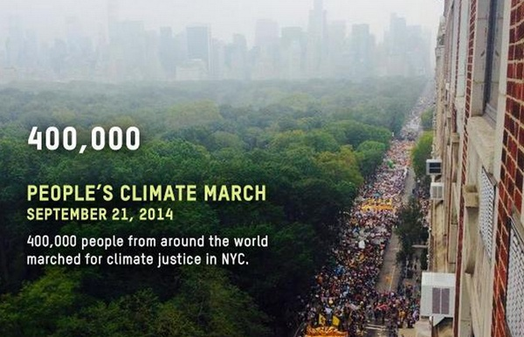
To change everything we need everyone

Slide 25

What will you do?

