Slide 1
Low Student Math Scores
Cecilia Nuevo
ms.nuevo@inwood52.org

Slide 2
The Public Policy Analyst (PPA) is designed to help students to maximize their participation in government as responsible citizens. As a public policy analyst, you and your class will develop the following policy skills, learning how to:
Identify the nature of a social problem
Gather evidence to support the existence of the problem
Determine the causes and factors contributing to the problem
Evaluate the existing policy
Develop public policy alternatives
Determine the best public policy solution to the problem

Slide 3
Public Policy Steps
Define the problem
Gather evidence
Identify causes
Evaluate a policy
Develop solutions
Select best solution

Slide 4
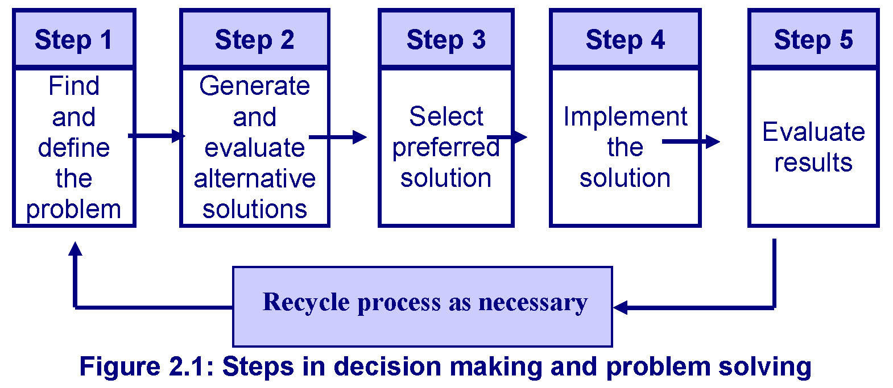
Students will focus on:
Defining the problem
Gathering evidence
Identifying causes

Slide 5
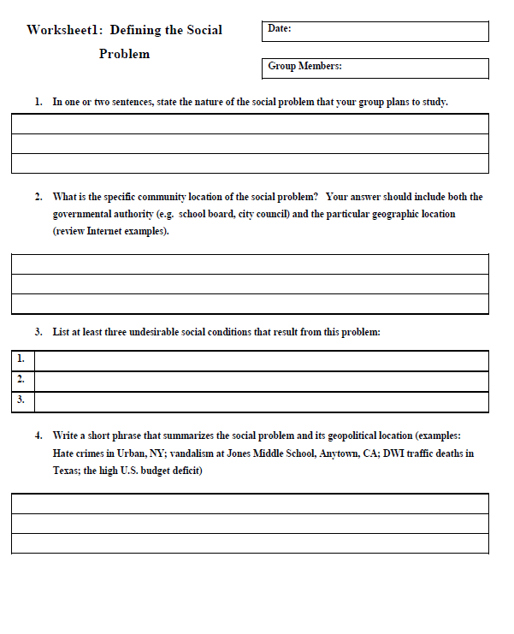
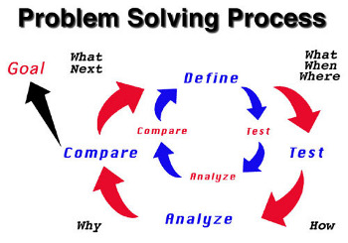
Defining the problem
Students will work together to define the problem that we identified as why students’ scores math scores are low using worksheet 1.

Slide 6
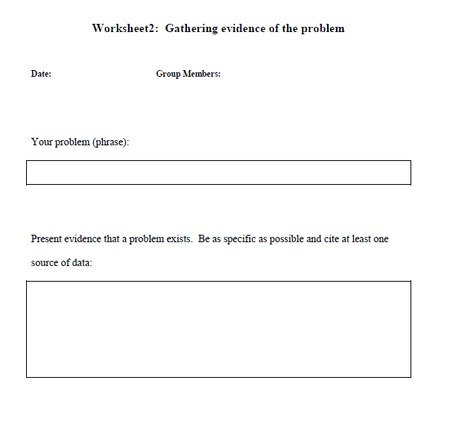
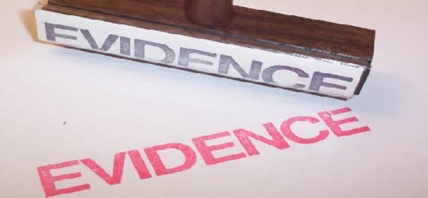
Gathering evidence (cont.)
Students will then fill in worksheet 2 with their findings.
This will help them become as specific as necessary.

Slide 7
Identify Causes
Students will use the following articles to identify a major cause that affects students’ math scores.
http://www.nytimes.com/2012/05/17/education/up-to-15-percent-of-students-chronically-skip-school-johns-hopkins-finds.html?_r=0
http://www.childtrends.org/?indicators=student-absenteeism
http://nces.ed.gov/pubs2009/attendancedata/chapter1a.asp
http://epa.sagepub.com/content/31/4/392.short
http://www.education.com/reference/article/why-students-struggle-mathematics/
http://jeb.sagepub.com/content/28/3/269.short
http://eric.ed.gov/?q=absences+and+math+scores&id=EJ866928
http://eric.ed.gov/?q=absences+and+math+scores&id=EJ988295

Slide 8
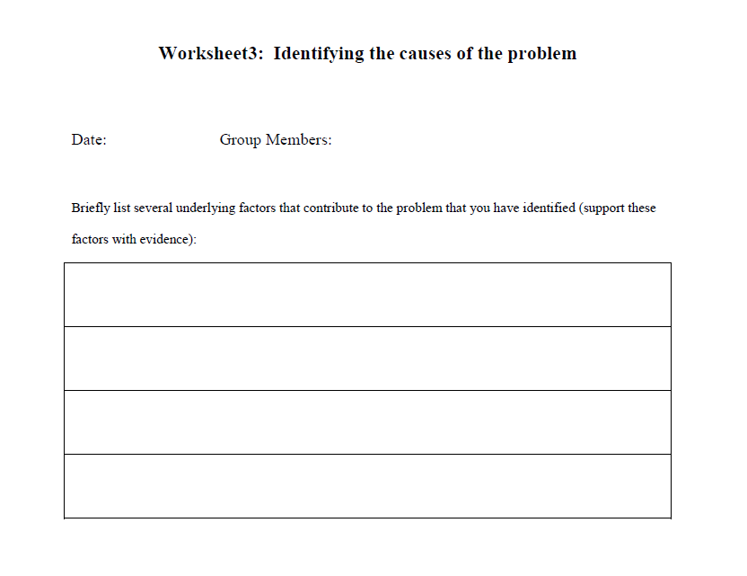
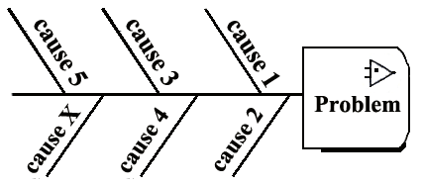
Identifying causes
Students will find the causes to the problem of how absenteeism affects math scores by filling in worksheet 3.

Slide 9
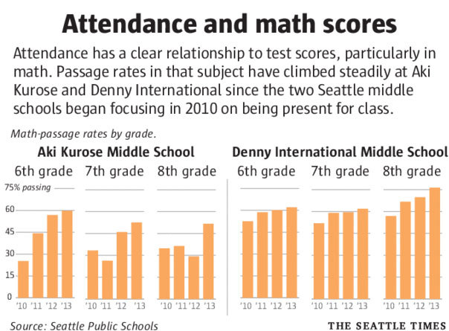
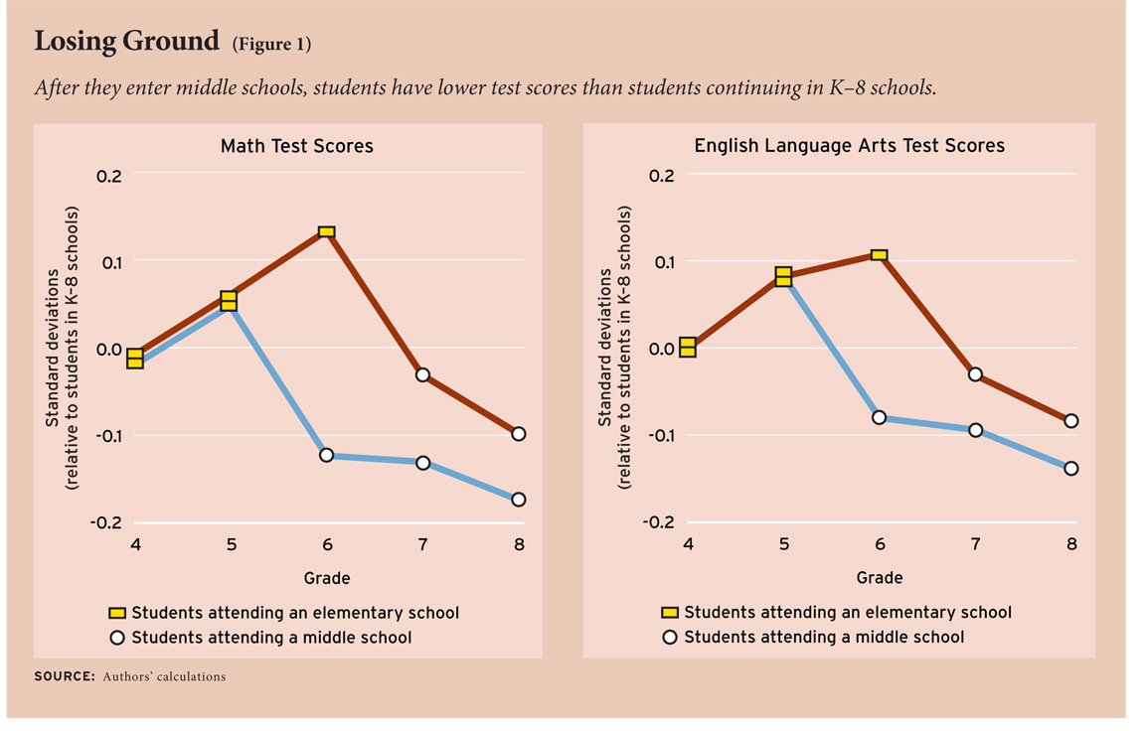
Identifying causes (cont.)
Students will try to find graphs from different schools that display reasons as well as if there is any correlation between absences and a drop in the math scores.

