Slide 1
Achieving Excellence in Performance
Natasha Bracey
I.S. 52M
Ms.bracey@inwood52.org

Slide 2
defining the problem
In the performing arts, there is a “pride” that is a part of our core as performers and for the performance. This pride is necessary to achieve excellent performances.
Currently, the chorus is not performing well.

Slide 3
Gathering Evidence
The focus of this Power Point is step 2 of the PPA: gathering evidence.
Choral students will work together to gather evidence about quality performances and share the information.

Slide 4
What makes a good performance? Link #1
http://youtu.be/3d5Sg03vpt4
Show choir performance

Slide 5
What makes a good performance Link #2
http://www.hpcstorm.org/vimages/shared/vnews/stories/52114c2063b04/Choir%20handbook.pdf
Read Choir Philosophy and Goals link from High Plains Community Schools.

Slide 6
What makes a good performance link #3
https://www.youtube.com/watch?v=6QftiLGMZ78
Carmel Middle School performance

Slide 7
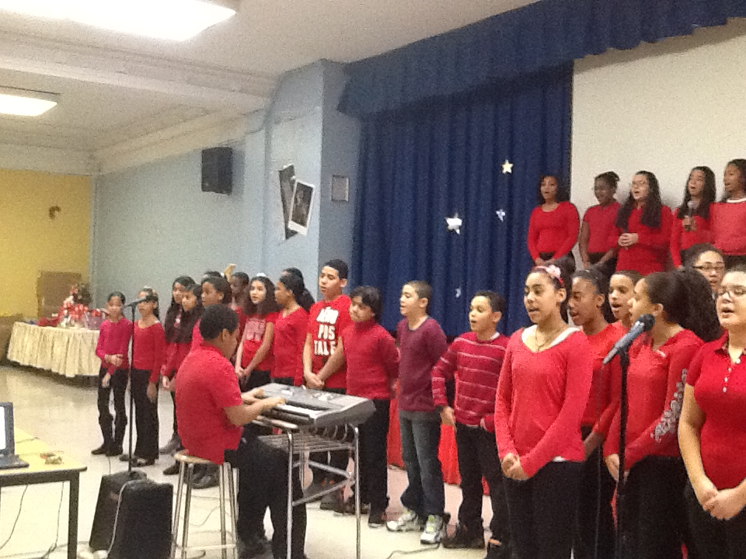
Example of our chorus

Slide 8
Worksheet Activity
http://www2.maxwell.syr.edu/plegal/TIPS/worksheet2.html
Use this link for the Worksheet 2: Gathering evidence of the problem and complete the activity in groups.

Slide 9
Final Activity
Create a chart listing the good qualities that the chorus should have that will ensure them in performing well.
Share-out with the class

