Slide 1
Ocean Pollution: Dumping
Filomena H. Borrero
August 28, 2014
Ms.borreo@inwood52.org

Slide 2
PPA SUMMARY The Public Policy Analyst (PPA) is designed to help students to maximize their participation in government as responsible citizens. As a public policy analyst, you and your class will develop the following
Identify the nature of a social problem
Gather evidence to support the existence of the problem
Determine the causes and factors contributing to the problem
http://flippedtips.com/plegal/ppas/welcome.html

Slide 3
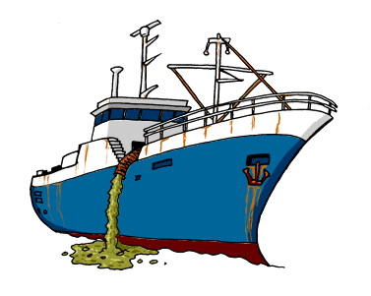
Step 1: Defining the Problem
The problem that needs to be addressed is dumping garbage in the ocean.

Slide 4
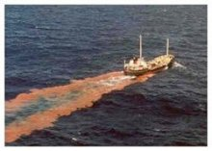
Step 2: Gathering the Evidence
Dumping
A portion of the billions if not trillions of tons of trash produced each year finds its way into ocean waters. This comes as no surprise to anyone who has seen plastic bottles and other waste floating onto the beaches. Trash is often dumped from ships and offshore drilling rigs directly into the sea. Aside from trash, industrial waste is one of the major issues when it comes to ocean dumping. These toxic chemicals, including radioactive chemicals, are a death sentence for ocean life forms.
http://greenliving.lovetoknow.com/Types_of_Ocean_Pollution

Slide 5
Our deep sea garbage dump
A massive study of the Pacific Ocean floor shows it’s a huge underwater garbage dump.
On over 18,000 hours of footage from deep sea remotely operated vehicles, researchers at Monterey Bay Aquarium Research Institute (MBARI) looked at seafloor as deep as 13,000 feet and found manmade trash items in every place they looked.
Deep sea vehicles viewed dive sites all along the West Coast from the Gulf of California to Vancouver Island and all around the Hawaiian Islands, with the worst accumulation of plastic, metal, fishing debris, and other trash in Monterey Canyon off the California coast
http://www.dailymail.co.uk/news/article-2349062/Our-deep-sea-garbage-dump-18-000-hours-footage-shows-Pacific-seafloor-heaped-man-trash.html#ixzz3EAID8IqG

Slide 6
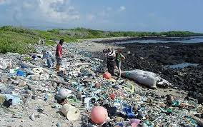
Great Pacific Garbage Patch - Ocean Pollution Awareness
The Great Pacific Garbage Patch is a massive dump of floating garbage in the Pacific Ocean. We contribute to it everyday by littering and using un-biodegradable materials. Our trash is taken downstream from rivers into the ocean, where currents sweep it to the closest patch.
https://www.youtube.com/watch?v=1qT-rOXB6NI

Slide 7
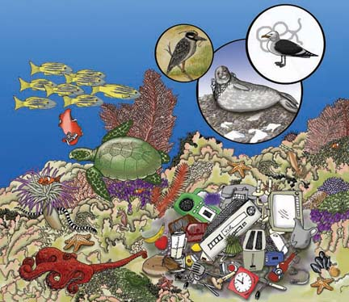
Should we dump our garbage in the ocean?

Slide 8
Step 3: Determine the causes of ocean pollution
Task: To research the causes of ocean pollution
Use the worksheet to gather your information
http://flippedtips.com/plegal/tips/worksheet3.html

