Slide 1
Bullying at the Middle school level
Miguel Benitez
Inwood Intermediate school
mbenite2@schools.nyc.gov

Slide 2
Steps of the ppa
Defining the Problem: We defined the social problem as bringing non-native plants to our community that could be invasive species that lead our native plants to become extinct
Gather the Evidence: Research and present evidence that proves this problem exist. Make sure your sources of information are reliable, and your chosen pieces of evidence are valid and relevant
Identify the Causes: What are the underlying factors that contribute to the problem? Mention and discuss at least two of them.
Evaluating the Existing Public Policies: Is there any existing public policy that addresses this problem? If so, what are the effectiveness, enforcement and public acceptance? What are the disadvantages of this policy? Should this policy be replaced, strengthen or improved? Explain why.
Developing Public Policy Solutions: Propose at least three original/new public policy alternatives. What public agency needs to carry out your proposed action?
Selecting the Best Solution: Using the matrix discussed previously, analyze the effectiveness and feasibility of your three solutions, and then choose the best solution that meets both effectiveness and feasibility.

Slide 3
Step 1: Define the problem
Some students fell threaten in school
Student s are not motivated to come to schools
Students who bullied feel superior to others students
Parents are complaining about their children being bullied

Slide 4
Step2: Gather Evidence
*bullies take the money from other students
*Bullies physically abuse others students
*Bullies are repeatedly offenders
*Bullies verbally abuse others students

Slide 5
Students will focus on step 3 of the PPA: Identify causes
Cooperative learning groups in class to discuss this matter
Identify , study and find a solution to stop bullying in school
Use of social media, internet or existing researches to help find solutions

Slide 6
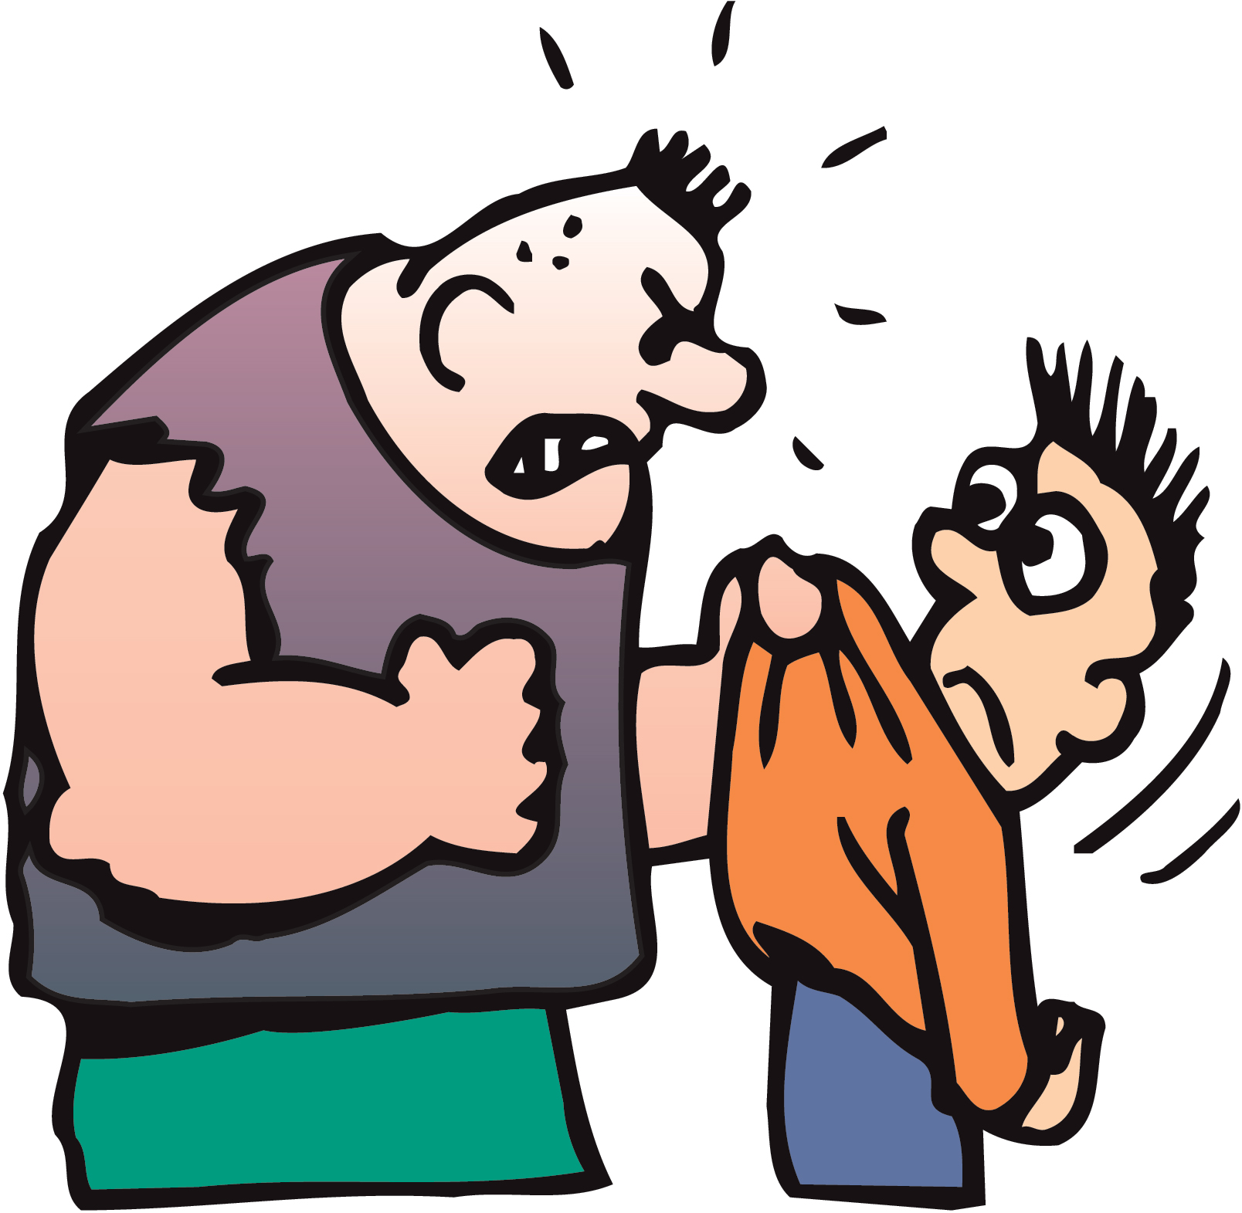
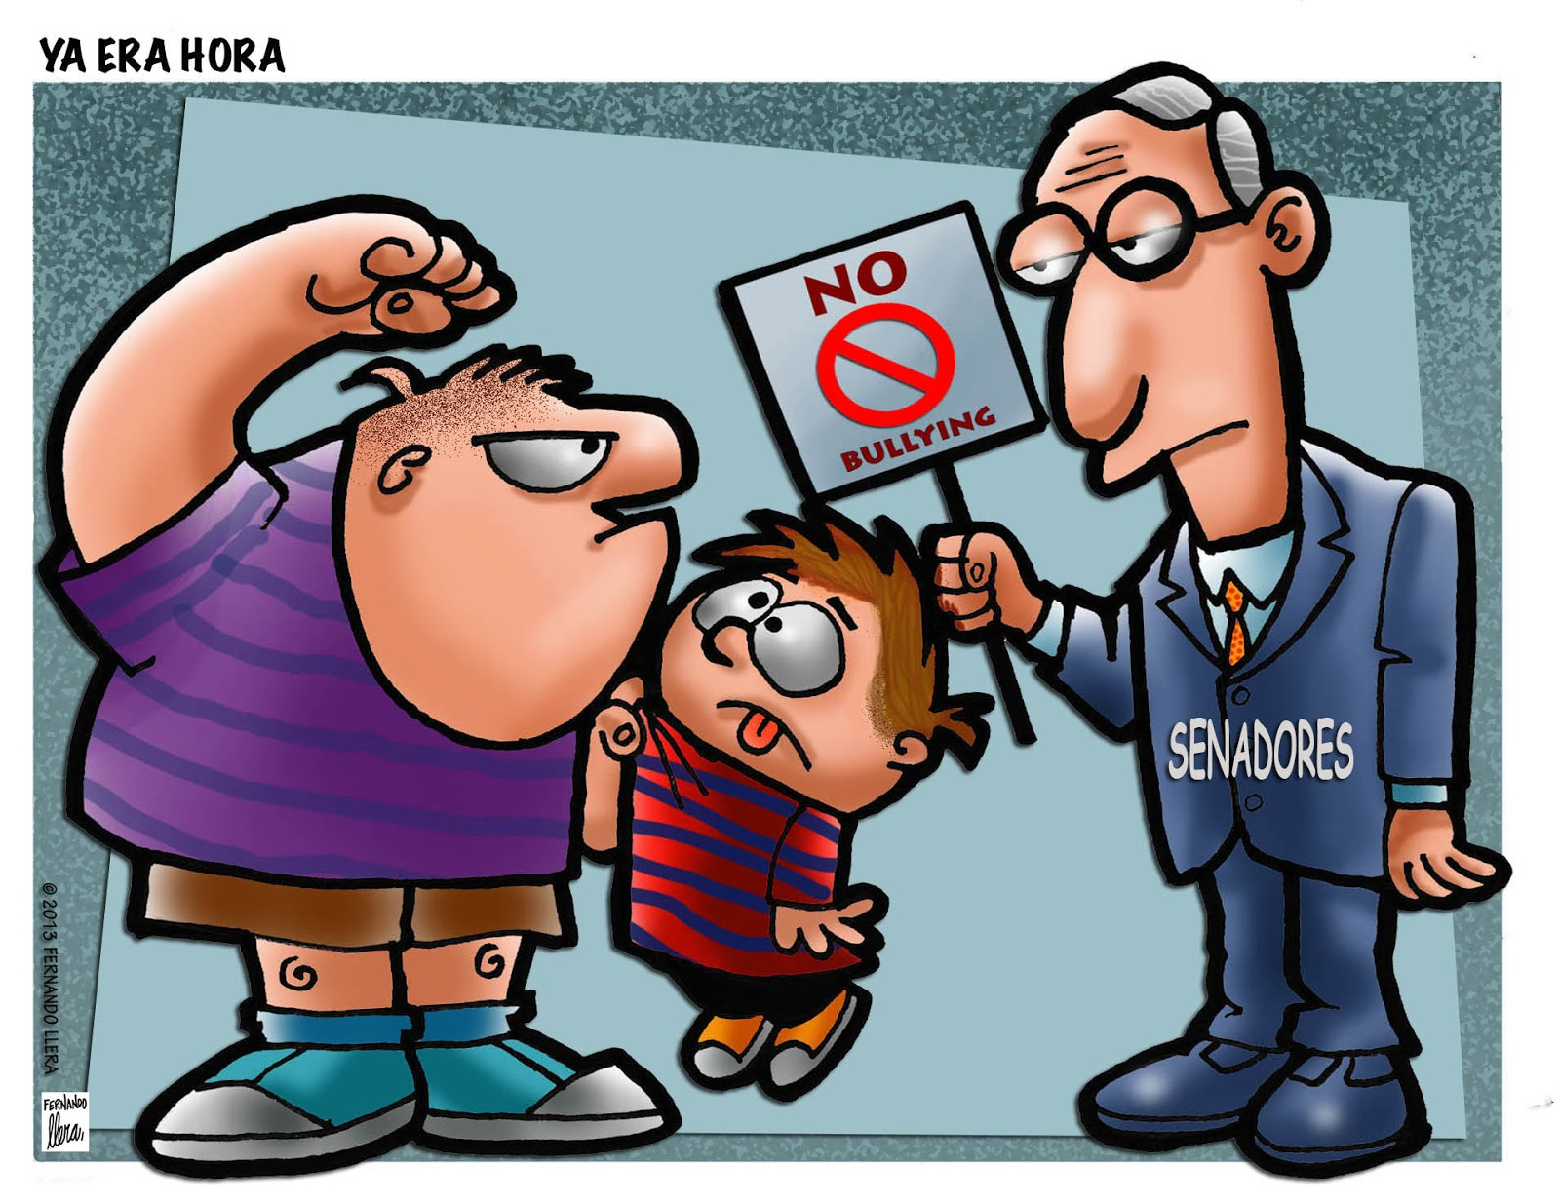
Steps3: Determine the causes

Slide 7
Step 3: Directions to Learning groups Activity
Students will be place in groups of four to five students
Students will be investigating causes of bullying
Every single group will complete given worksheet on Step 3 of the PPA :
Students will be given 10 minutes to discuss possible factors
Each group will be given time to research and preset the worksheet as a group

Slide 8
Step 4: Examine an Existing Policy
http://extension.fullerton.edu/professionaldevelopment/assets/pdf/bullying/bullying_and_middleschool_students.pdf
http://www.masskids.org/index.php/bullying/what-causes-bullying
http://www.ncab.org.au/parents/typesofbullying/
http://www.wikihow.com/Stop-Bullying
All students will go to the following website to complete step 3 worksheet

Slide 9
Shared Assessment
After each group complete their work sheet they will share their knowledge to complete a chart identifying causes and factors of bullying
Teacher will provide the chart paper and necessary materials to complete the chart

