Slide 1
Perceptions of Math
How The United States Views Mathematics Education

Slide 2
Define The Problem
Innumeracy is still socially acceptable on a national level. This is a problem because math has become more necessary as technology rapidly changes. By comparison, our country has a negative attitude towards illiteracy.

Slide 3
Gather The Evidence
On the one end, Americans grade math as the most valuable school subject, above English and Science

Slide 4
Gather The Evidence
On the other end, scholars like Grant Wiggins, Andrew Hacker, and Nicholson Baker have called for the restructuring of math, specifically Algebra 2 and beyond

Slide 5
What Do You Think?
How do you and your fellow students feel about math? Is it important? Why or why not?
Survey the class, then your school about this question.

Slide 6
Identify the causes

Slide 7
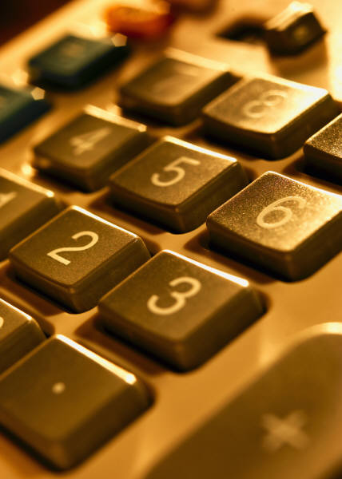
Causes Discussion
What are some causes for how people felt? Ask your fellow classmates to discuss.
If they have a positive experience with math, have them share why too!

Slide 8
Causes Discussion
Use the following worksheet to help you identify some of the causes and work them out with your group
http://www2.maxwell.syr.edu/plegal/TIPS/worksheet3.html

Slide 9
Some causes may include …
Pedagogy
Lack of connections with other subject areas
Some parts of math are too abstract
Rush to get things right and not to gain understanding
Too much testing!

Slide 10
Homework!
Search the words “math is bad” or “math is good” on Google
Pick three separate (and safe) sites to investigate
Look for any points of conversation and any critiques
We will then use the data for the next steps in our project!

