Slide 1
Breakfast: Take It or Leave It?
Lisa Lloyd
P.S. 98M / Third Grade ICT
Lloyd5009@gmail.com

Slide 2
School breakfast is key to future success.
Better attendance.
Higher math scores.
More likely to graduate from high school.
Notes:
Click link and read article. Then review salient points using graphics.

Slide 3
Do we have a problem?
Work with your group to complete worksheet #1.
Notes:
Elicit description of the problem.

Slide 4
Class Poll
I ate a healthy breakfast.
I skipped breakfast.
Notes:
Poll the class and use tally marks to chart results…at numbers to the slide.

Slide 5
What’s your excuse?
Use worksheet 3. With your group list at least 3 reasons why students don’t eat a healthy breakfast.
Notes:
List excuses students give as to why they did not eat a healthy breakfast & add to slide.

Slide 6
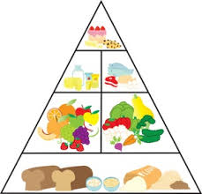
What do you know about school breakfast?
Who can eat it?
When is it served?
Is it a healthy breakfast?
Notes:
Elicit what the students know about the existing school lunch policy.

Slide 7
What can we do to get more students to eat school lunch?
Work with your group to complete Worksheet # 5
Notes:
Challenge students to come up with what they can do to get more students to eat school breakfast…for example making posters, creating flyers for parents to remind them to come earlier…

Slide 8
We could…
Notes:
Students share responses, teacher adds them to this slide…vote for best (feasable/effective) solution.

Slide 9
Let’s do it!
Work with your group to…
Notes:
After voting on best solution, students put their choice into action…

