Slide 1
Keeping the Air Clean in the USA
Identifying the problem, and coming up with solutions!
Mr. Arias - October 20, 2013

Slide 2
The step of the public policy analyst will be used to identify the problem and come up with the solution that is affecting our nation.
We will create public policies that will stimulate a solution to a problem that is becoming detrimental to our society.
Today’s lesson will only focus on the first two steps of the Public Policy Analyst

Slide 3
Step 1: Define the Problem!

Slide 4
What is wrong here?

Slide 5
Which picture describes a healthy air enviroment?
This one
Or This one

Slide 6
Step 2: Gather the Evidence!

Slide 7
In a small group, discuss what impressions these pictures left in you

Slide 9
Step 3: Identify the Causes!

Slide 10
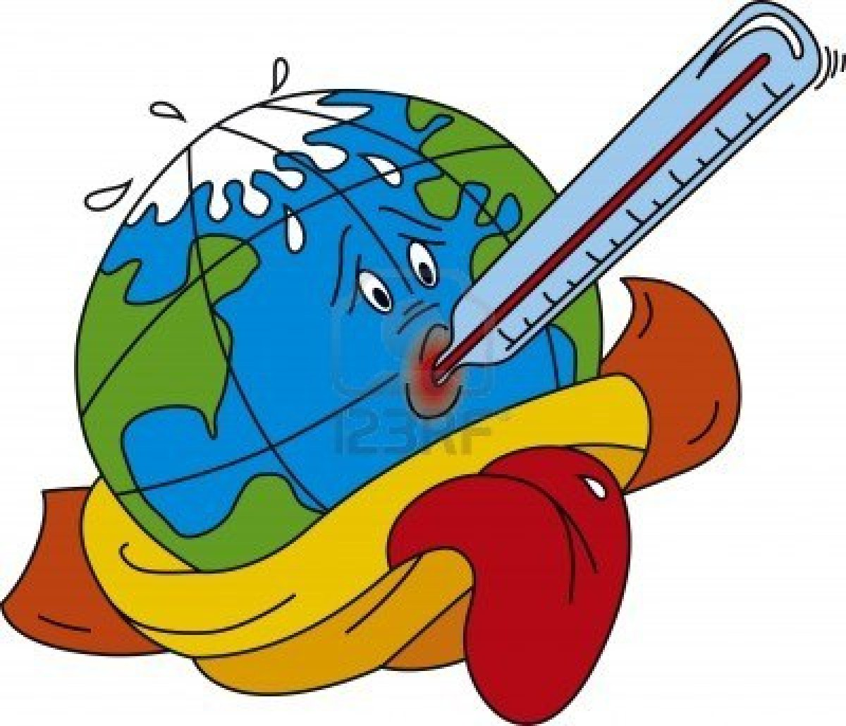
How does CO2 pollution cause the air temperature to change?
Greenhouse – Earthguide

Slide 11
What kind of damages are we causing to our environment and why?

Slide 12
Debate
Most people and businesses know what can affect the environment and can stop polluting the air, however…
What do you think?
Discuss some possible reasons why people and business don’t make an effort in reducing, stopping or using alternative resources that are healthy to our environment.
Discuss!

Slide 13
Complete Step 3 of the Public Policy Analyst:http://www2.maxwell.syr.edu/plegal/TIPS/worksheet3.html
What public policies solutions do you propose that should be implemented in the U.S to avoid air pollution.
Policy 1
Policy 2
Policy 3

Slide 14
Homework!
Research the current clean air act policy in the internet.
Think about how effective the policies are, what changes would you make to make it better?
Students will share their homework which will lead into the completion of Step 4, 5, and 6 of the PPA.

