Slide 1
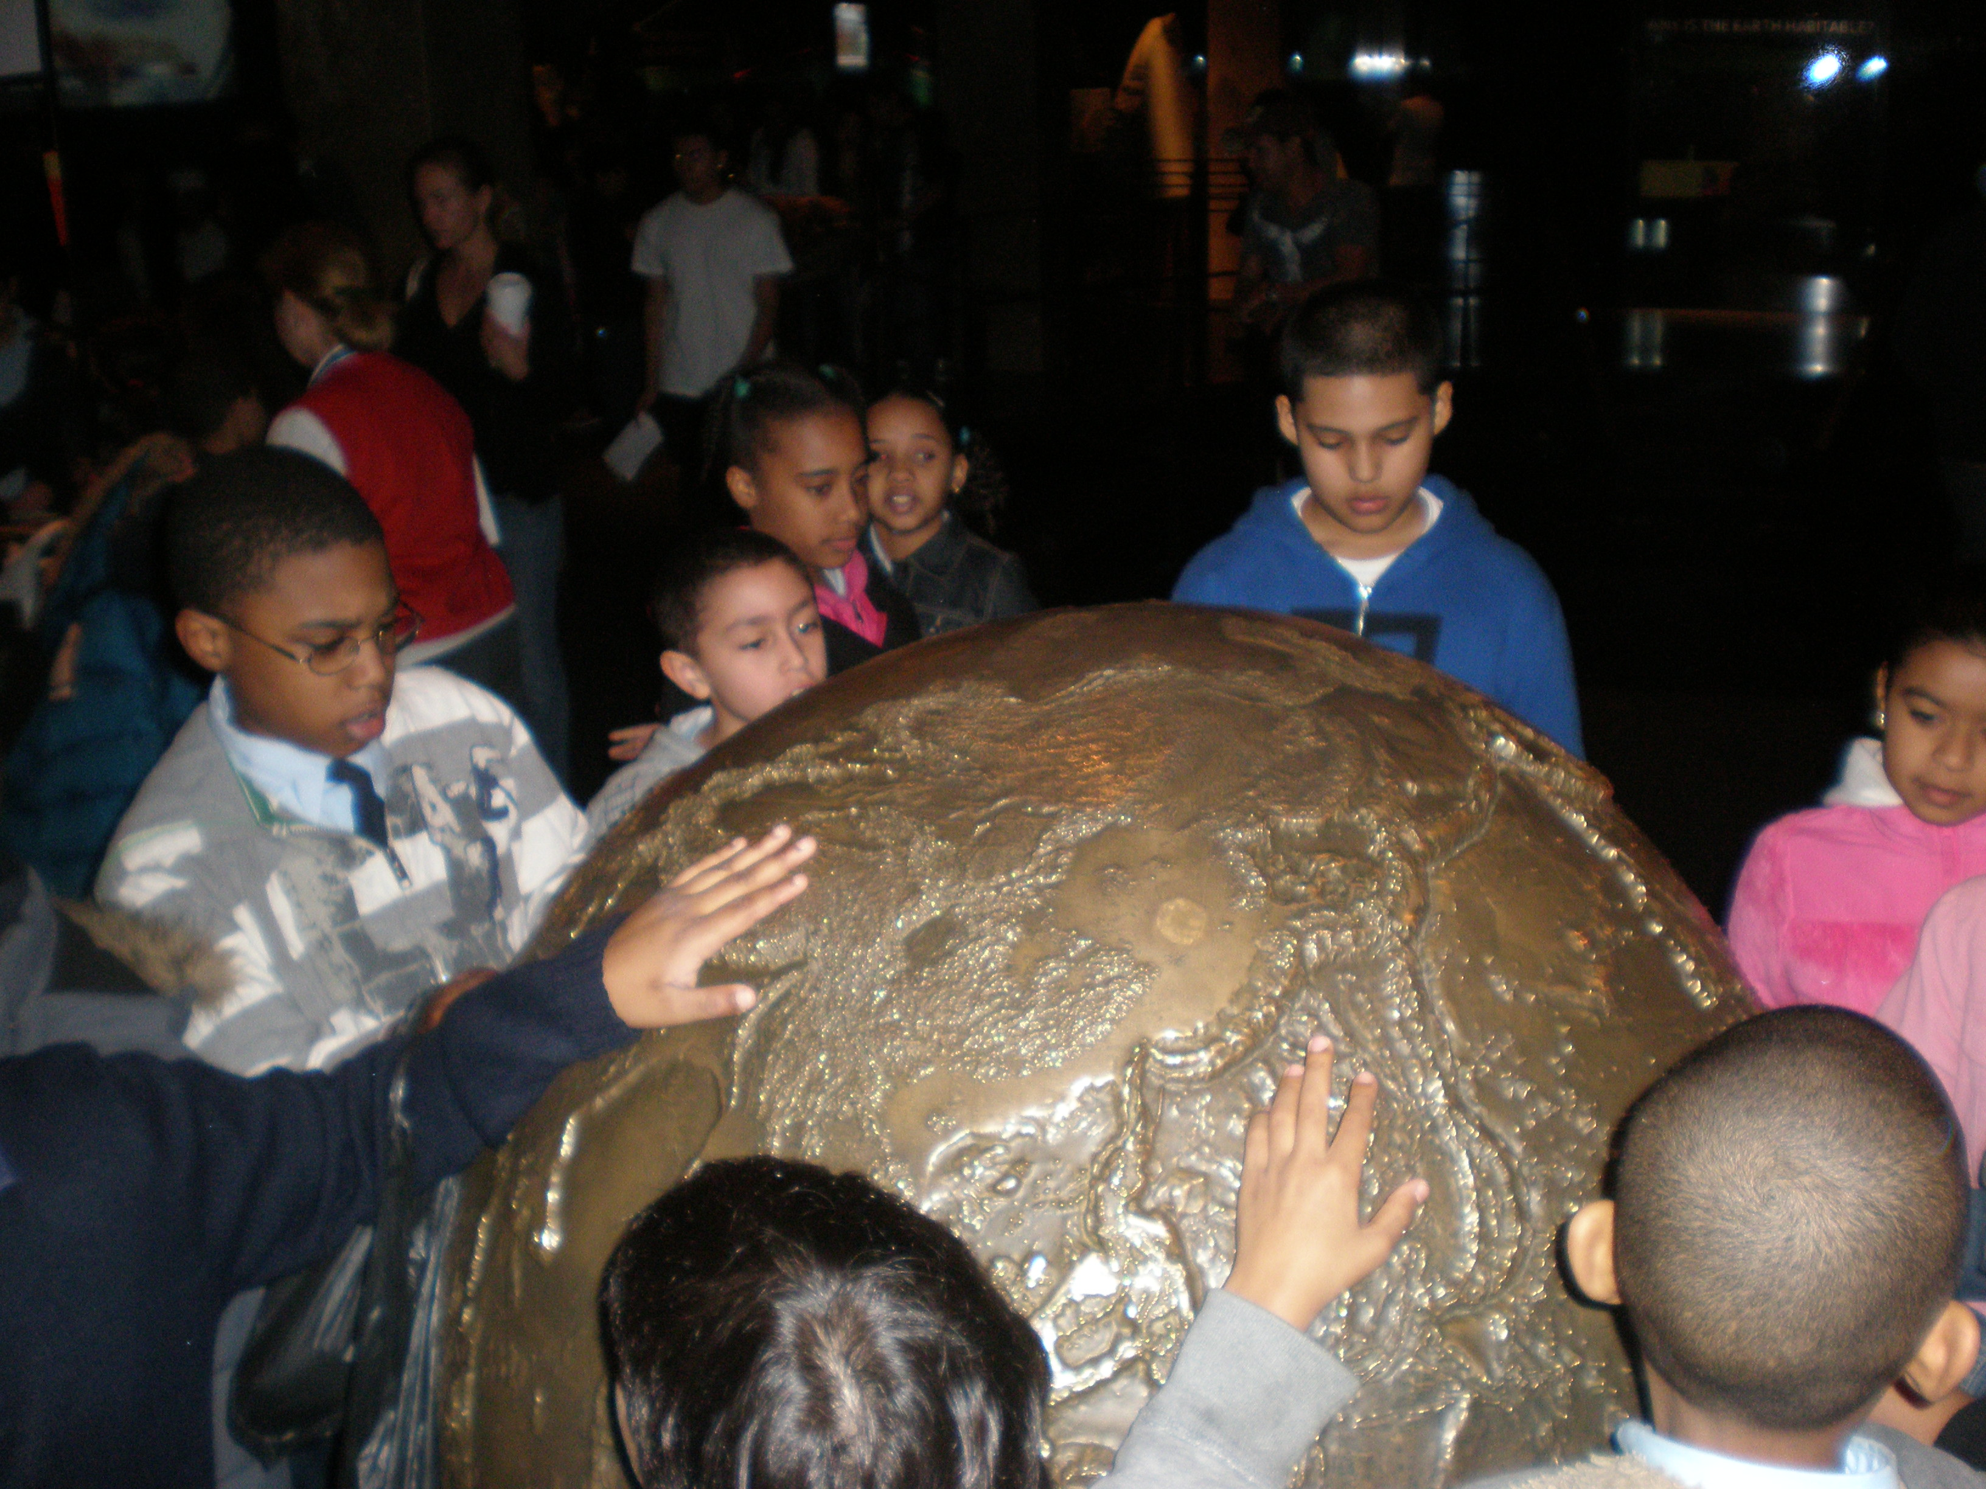
Public Policy Analyst
Mr. Teitter
PS 98M Shorackappock
4th grade
Social Studies/Science

Slide 2
Steps of the PPA
Define the problem
Gather evidence
Identify causes
Evaluate a policy
Develop solutions
Select best solution

Slide 3
Define the problem
Gather evidence
Identify causes
Evaluate a policy
Develop solutions
Select best solution

Slide 4
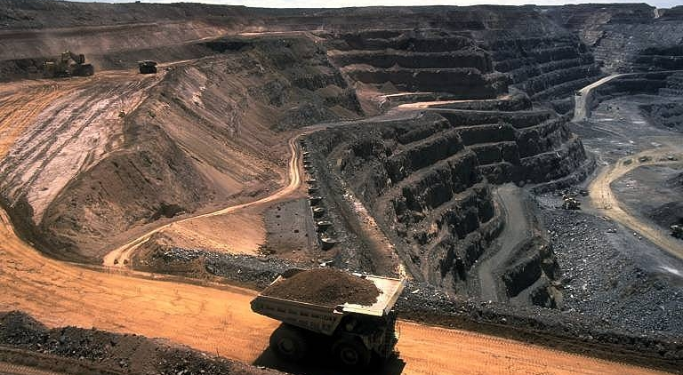
Problem: Coal Mining Companies Are Destroying Environments in the U.S.

Slide 5
Steps of the PPA
Define the problem
Gather evidence
Identify causes
Evaluate a policy
Develop solutions
Select best solution

Slide 6
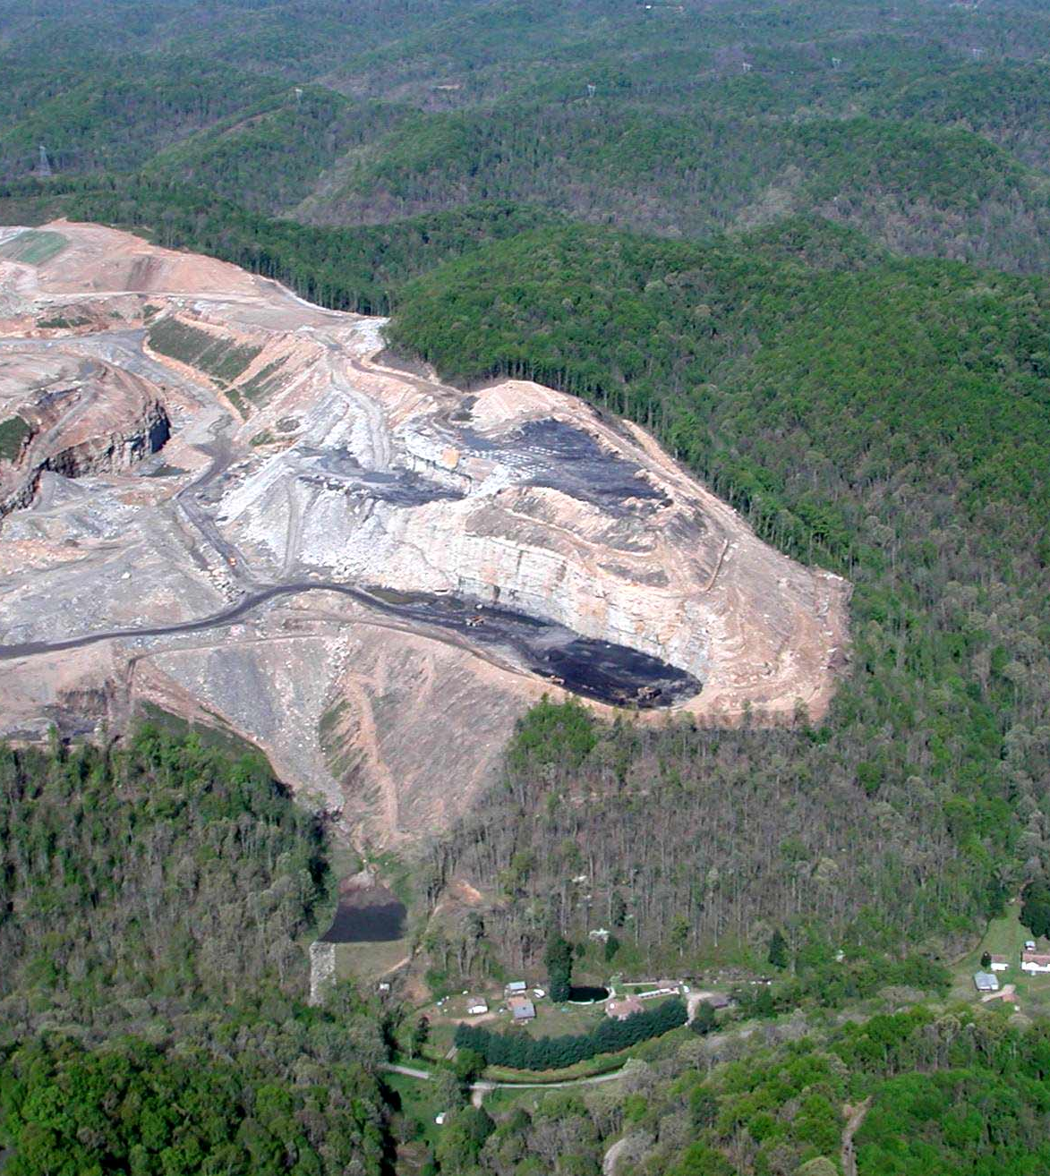
Evidence
Thousands of square miles of mountainous terrain have been scarred by coal strip mining and left unreclaimed.
Erosion increases dramatically when the protective plant cover is removed and the remaining soil is not stabilized.
Many animal species cannot adjust to the changes brought on by the land disturbance involved in coal mining. In cases where an important habitat (such as a primary breeding ground) is destroyed, the species may be eliminated.

Slide 7
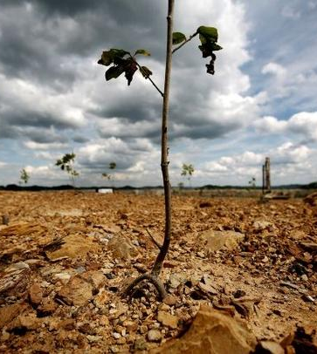
Strip mining eliminates existing vegetation and alters the soil profile, or the natural soil layers.
Mining disturbs and may even destroy the beneficial micro-organisms in the topsoil.
Strip mining can pollute streams and disrupt water supplies.
https://sites.google.com/site/stripmininghandbook/chapter-2-1

Slide 8
Define the problem
Gather evidence
Identify causes
Evaluate a policy
Develop solutions
Select best solution

Slide 9
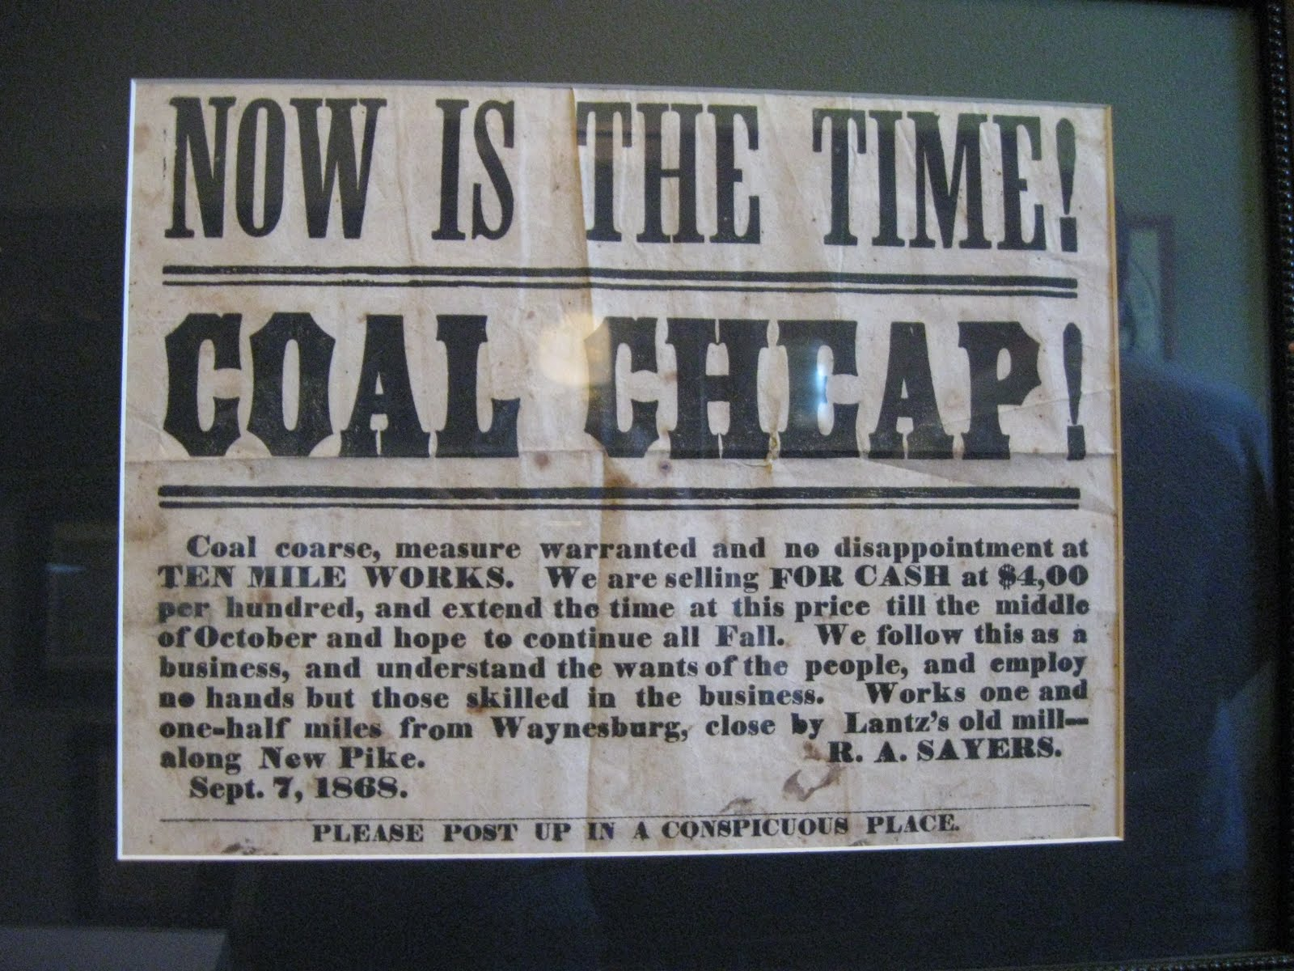
Coal is by far the cheapest source of power fuel per million Btu, averaging less than half the price of petroleum and natural gas.
Source: National Mining Association
The world's iron and steel industry depends on the use of coal.
Source: World Coal Institute
The value of coal produced in the United States each year is nearly $20 billion.
Source: EIA, Annual Energy Review 1999, T.7.8, and T.7.2

Slide 10
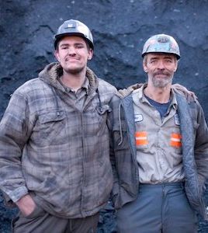
Coal is directly responsible for the existence of more than 90,000 U.S. jobs and nearly one million jobs directly and indirectly.
Source: EIA, Western Economic Analysis Center (WEAC), 1998, p. 17
Coal mining has a combined direct and indirect impact of $161 billion annually on the U.S. economy. This is $596 for every U.S. citizen.
Source: WEAC 1998, p. 17; EIA Annual Energy Review 1998, T.E1

Slide 11

The federal government receives more than $11 billion annually in taxes and fees from the coal industry.
Source: WEAC 1998, p. 1
State and local governments receive nearly $9 billion each year in revenues.
Source: WEAC 1998, p. 1
Developing countries' demand for coal will double through 2020, according to the Energy Information Administration (EIA). Source: EIA, International Energy Outlook 2000, p.171

Slide 12
Tonight’s Homework
Define the problem
Gather evidence
Identify causes
Evaluate a policy
Develop solutions
Select best solution
Either at home or at the library, research current policy that regulates coal mining.
Evaluate the advantages and disadvantages.
Decide whether the current policy needs to be replaced, strengthened, or improved.

