Slide 1
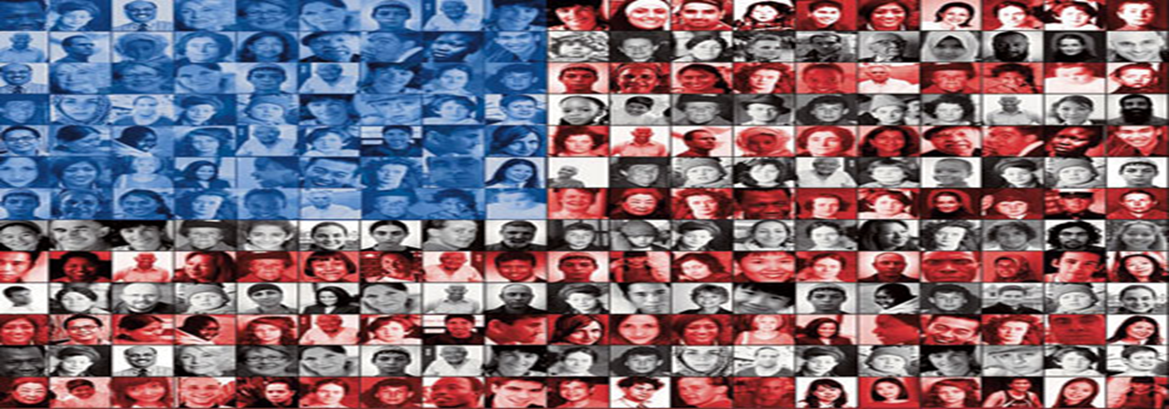
How can we learn to appreciate our similarities and differences through literature?
Teacher: Julia Serewko
School: Our Lady Queen of Martyrs
Email: jserewko@gmail.com

Slide 2
Brainstorm the definition of the phrase “America is a melting pot of heritages”
something that is passed down from previous generations
a tradition
family-members’ culture
Where you come from.
The way you interact with people

Slide 3
Understanding the problem: What issues come about when people do not understand cultures.
Hate
Unequal treatment
Hurtful sayings
Isolation of a people
Stereotyping

Slide 4
How is understanding one’s culture just as important as knowing about the other cultures of the world?
Getting to know your
own personal
Culture
Knowing where you
come from and
the struggles your
family has faced.
Creating a sense of
pride.
An understanding of
who you are.

Slide 5
How is understanding one’s culture just as important as knowing about the other cultures of the world?
The importance of
understanding
a different culture
other than your own
Creating a
understanding
that there are
different
Cultures and that
Is O.K.
Respect for a
culture that is not
yours
A willingness to
learn about others.

Slide 6
A problem we didn’t know existed
The Daring Lesson
( click on the daring lesson to see an example of students treating each other poorly)
How easy was it for the students to turn on each other?
In what ways is this an example of a social problem?

Slide 7
How can we educate?
Working in your groups identify ways to educate others about the differences in culture.
Make sure to include:
1. What causes the problems in understanding culture?
2. Is there a policy to understanding culture; if so what changes should be made to that policy to improve and become more effective.
3. Develop different solutions to educating people in culture.

