Slide 1
SOCIAL SEGREGATION
CREATED BY: P. SAWYERS
IS52M

Slide 2
Social Segregation
AND SCHOOLS IN THE INWOOD AREA OF MANHATTAN

Slide 3
PUBLIC POLICY ANALYST
DEFINE THE PROBLEM
GATHER THE EVIDENCE
IDENTIFY THE CAUSES
EXAMINE THE EXISTING POLICY
DEVELOP NEW SOLUTIONS
SELECT THE BEST SOLUTION
-EFFECTIVENESS VS. FEASIBILITY

Slide 4
THE PUBLIC POLICY ANALYST
In this lesson we will focus on the first two steps of the PPA:
DEFINE THE PROBLEM
GATHERING THE EVIDENCE

Slide 5
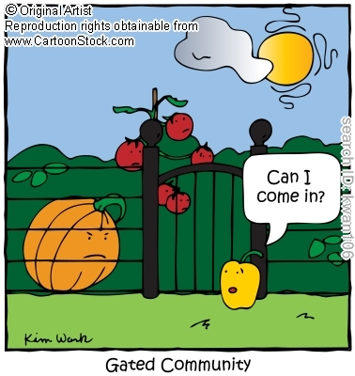
Is this cartoon depicting class and social segregation as they occur in our schools? How?

Slide 6
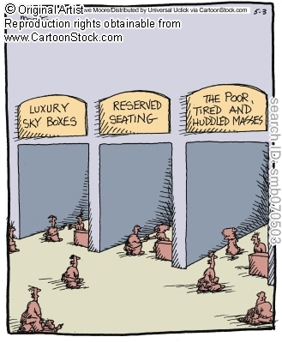
Is this cartoon depicting class and social segregation as they occur in our schools? How?

Slide 7
DEFINING THE PROBLEM
SEGREGATION:
Brainstorm in groups
Groups share definitions
Share

Slide 8
SOCIAL SEGREGATION
WHAT IS YOUR DEFINIFTION?
1.
2.
3.
This is what the dictionary says:
The policy or practice of separating people of different races, classes, or ethnic groups, as in schools, housing, and public or commercial facilities, especially as a form of discrimination.

Slide 9
GATHERING EVIDENCE
What are some examples of social segregation in our school?
Students work in groups of 3 or 4 to complete the chart
Groups share
Example 1
Example 2
Example 3
Example 4

Slide 10
What are some evidences of social segregation in our school?
Complete the chart below
Social segregation in school | Effects on Students

Slide 11
GATHERING EVIDENCE
Using the novel, in groups:
1. Identify at least 2 examples of social segregation in The Outsiders
2. Explain how these examples affect the behaviors, and self esteem of the Greasers’ Gang

Slide 12
What are the effects of social segregation in the outsiders?
In groups of 4 list at least 5 effects and provide text details to support by completing the chart below
EFFECTS of social class and segregation in The Outsiders | TEXT DETAILS
1.
2.
3.
4.
5.

Slide 13
Home Work
What are some examples of Social segregation in our society?
How is this affecting various members of the society?

