Slide 1
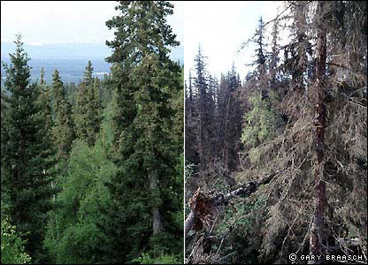
Climate Change in America
Mr. Gaynor
Inwood 52
ELA/Writing

Slide 2
Public Policy Analyst
In an effort to identify and create solutions currently facing our environment and country students will use the steps of the public policy analyst.
Through the use of all the steps of the public policy, students will have the ability to create policies that address the issue.
Today’s lesson will focus on steps 1, 2 and 3.
Define the Problem
Gather the Evidence
Identify the Causes
Examine Existing Policy
Develop Solutions
Select the Best Solution
Effectiveness vs. Feasibility

Slide 3
Step 1
Define the Problem

Slide 4
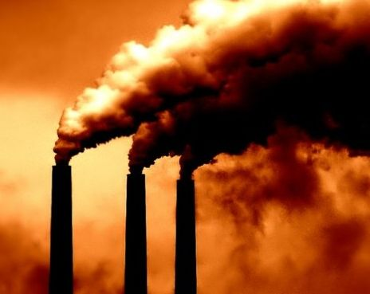
Climate Change….Have you ever seen the atmosphere being polluted in this way before?

Slide 5
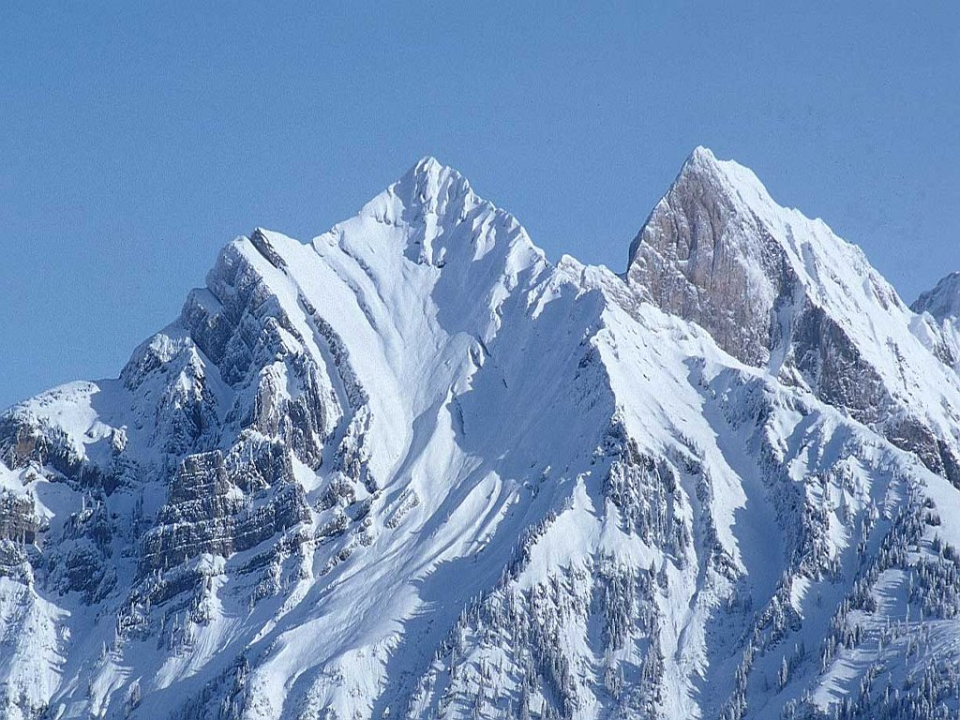
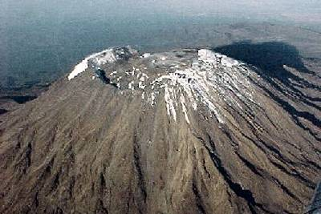
Which picture do you think best represents our current climate conditions?
This One Or….
This One

Slide 6
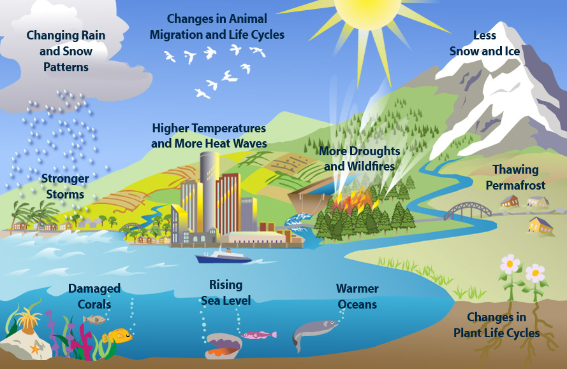
Analyze the image and create a definition of climate change.

Slide 7
Definition of Climate Change
The term climate change is often used as if it means the same thing as the term global warming. According to the National Academy of Sciences, however, “the phrase ‘climate change’ is growing in preferred use to ‘global warming’ because it helps convey that there are [other] changes in addition to rising temperatures.” Climate change refers to any distinct change in measures of climate lasting for a long period of time. In other words, “climate change” means major changes in temperature, rainfall, snow, or wind patterns lasting for decades or longer.
Climate change may result from: natural factors, such as changes in the Sun’s energy or slow changes in the Earth’s orbit around the Sun;
natural processes within the climate system (e.g., changes in ocean circulation);
human activities that change the atmosphere’s makeup (e.g, burning fossil fuels) and the land surface (e.g., cutting down forests, planting trees, building developments in cities and suburbs, etc.).

Slide 8
In groups discuss and share definition of climate change.

Slide 9
Step 2
Gather the Evidence

Slide 10
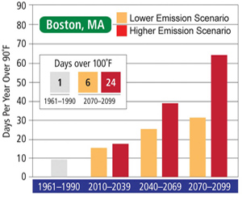
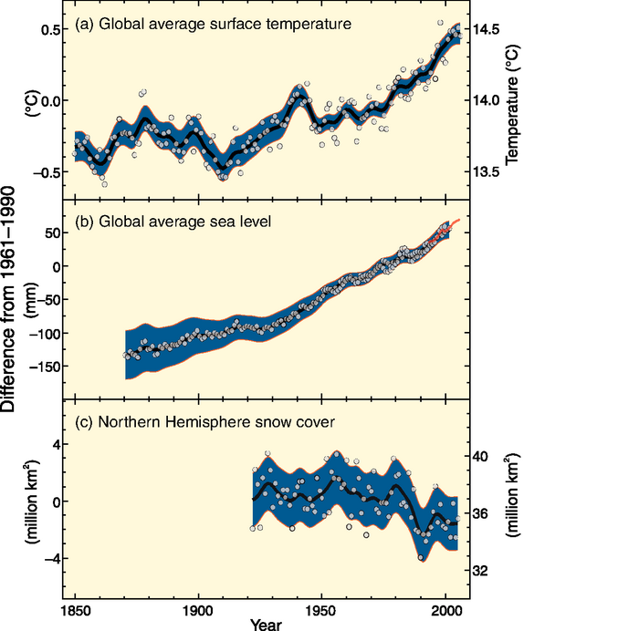
Given the images, write an analysis of the implications of climate change on the environment.

Slide 11
In groups, discuss…
What kind of actions do you see being used in your school that could lead to climate change?
What kind of actions do you see being used in your neighborhood that could lead to climate?
Describe other actions you have seen anywhere else that could cause climate change?
All answers should be written in your writing notebook.

Slide 12
More Evidences
What are the cost associated with climate change?
What are some other environmental factors that can be attributed to climate change?

Slide 13
Step 3
Identify the Causes

Slide 14
Though there are many factors that can contribute to climate change, students will examine the effect that energy production has on climate change.

Slide 15
Complete step 3 of the Public Policy Analyst
http://www2.maxwell.syr.edu/plegal/TIPS/worksheet3.html

Slide 16
Renewable Energy is energy which is generated from natural sources.
Pros
Cons
Renewable sources have low carbon emissions, therefore they are considered as green and environmentally friendly.
Renewable helps in stimulating the economy and creating job opportunities.
You don’t have to rely on any third country for the supply of renewable sources as in case of non-renewable sources.
Renewable sources can cost less than consuming the local electrical supply over time.
It is not easy to set up a plant as the initial costs are quite steep.
Solar energy can be used during the day time and not during night or rainy season.
Hydroelectric provide pure form of energy but building dams across the river which is quite expensive.
To use wind energy, you have to rely on strong winds therefore you have to choose suitable site to operate them. Also, they can affect bird population as they are quite high.

Slide 17
Non-Renewable Energy is the energy which is taken from the sources that are available on the earth in limited quantity.
Pros
Cons
Non-renewable sources are cheap and easy to use. You can easily fill up your car tank and power your motor vehicle.
You can use small amount of nuclear energy to produce large amount of power.
Much easier to produce and use.
Easy to transport and distribute.
Non-renewable sources will expire some day.
Fossil Fuels pollutes the environment
Non-renewable cannot be recycled.
Mining of such fuels leads to irreversible damage to the environment
Burning it produces carbon dioxide, a major cause of climate change.

Slide 18
What are the different kinds of energy source?
Non-Renewable Energy
Renewable Energy
Coal
Natural Gas
Petreoleum
Nuclear Power
Hydropower
Solar Power
Wind Power
Geothermal
Biomass

Slide 19
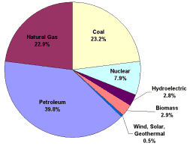
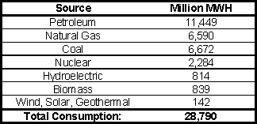
America’s Energy Consumption
Source: U.S. Energy Information Administration

Slide 20
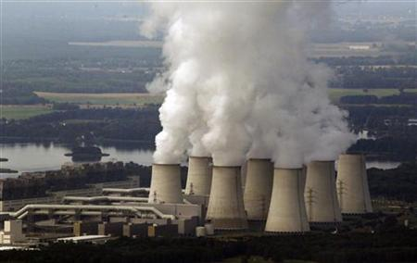
Most people are aware of the effects of renewable (clean) energy on the environment, however…
Why do you believe people continue to use energy sources that are detrimental (damaging) to the environment?
List some possible reasons on why people don’t always use the cleanest energy source?

Slide 21
What are the Causes?
Student Response
Reason 1
Reason 2
Reason 3
Reason 4
Reason 5

Slide 22
Homework
Research the current energy policy, and think about its effectiveness at addressing the issue of climate change.
Identify the advantages and disadvantages.
Decide whether the current policy needs to be revised or replaced.

