Slide 1
Global Child Labor Today
A lesson by:
Mr. DeJoseph
I.S. 52

Slide 2
Global Child Labor Today
Students will be able to perform a public policy analysis on the issue of contemporary global child labor, following the six steps of PPA.
Today we will complete steps 1 and 2.
Define the Problem
Gather the Evidence
Identify the Cause
Evaluate an Existing Policy
Develop Solutions
Select the Best Solution

Slide 3
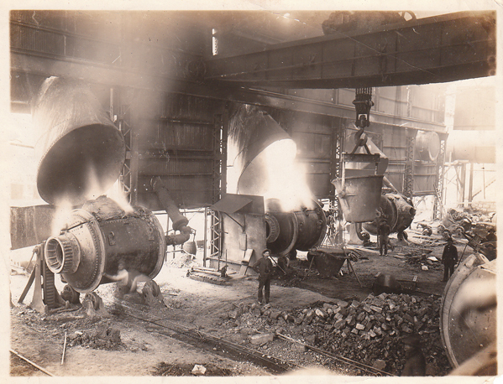
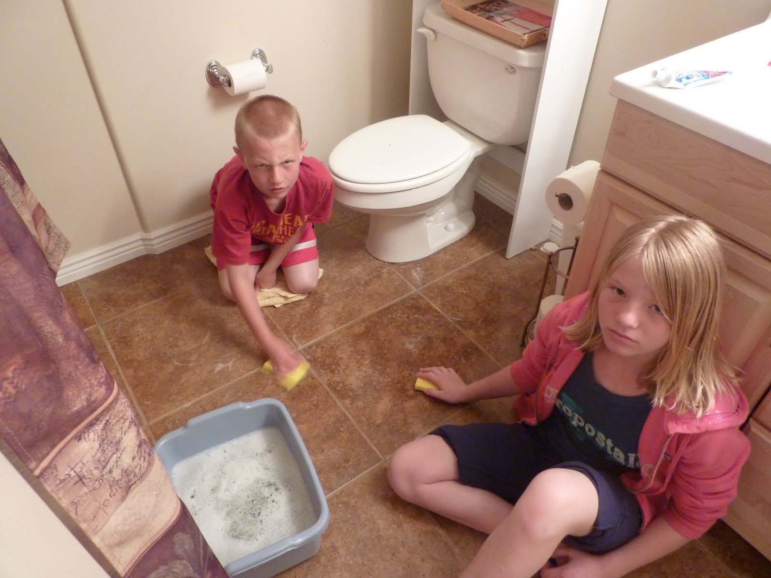
Are YOU a victim of child labor?
(probably not)

Slide 4
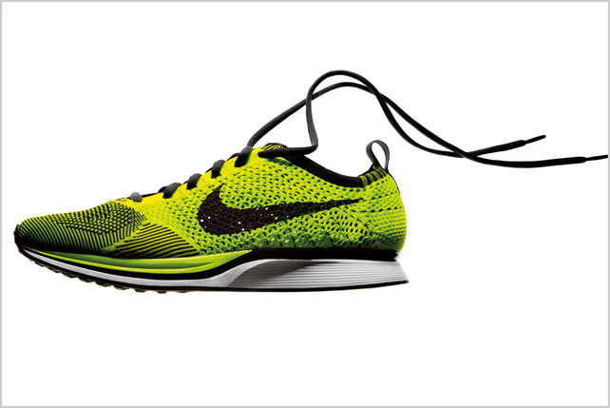
Are YOU a cause of child labor?
(maybe: all of the above products are alleged to be produced using child labor )

Slide 5
Step 1: Define the Problem
Respond: What exactly is child labor?
B. Respond: Where does child labor occur?
C. Respond: What undesirable social conditions result from child labor?
D. Summarize: In a single sentence, what is the problem and where does it occur?

Slide 6
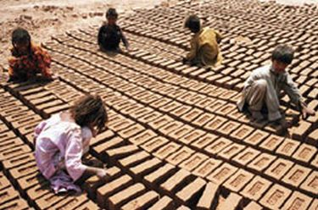
Step 1: Define the Problem
Respond: What exactly is child labor?
B. Respond: Where does child labor occur?
C. Respond: What undesirable social conditions result from child labor?
D. Summarize: In a single sentence, what is the problem and where does it occur?
Child labor is exploitative¹. Which picture shows children being exploited?
¹exploit: to use for profit, without regard for someone’s well-being

Slide 7
Step 1: Define the Problem
Respond: What exactly is child labor?
B. Respond: Where does child labor occur?
C. Respond: What undesirable social conditions result from child labor?
D. Summarize: In a single sentence, what is the problem and where does it occur?
Child labor is the exploitative use of children as a source of labor. It takes advantage of children for profit.
Exploitative or Not?
Choosing to work an after-school job for extra money
Being forced by a parent to take out the garbage
Leaving elementary school to work at a diamond mine
Assembling products using dangerous materials or chemicals without any protection

Slide 8
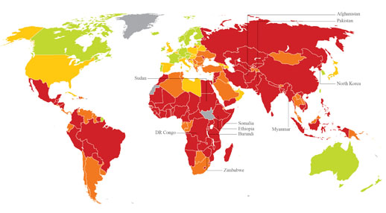
Step 1: Define the Problem
A. Respond: What exactly is child labor?
B. Respond: Where does child labor occur?
C. Respond: What undesirable social conditions result from child labor?
D. Summarize: In a single sentence, what is the problem and where does it occur?
Legend
Extreme risk
High risk
Medium risk
Low risk
No Data

Slide 9
Step 1: Define the Problem
A. Respond: What exactly is child labor?
B. Respond: Where does child labor occur?
C. Respond: What undesirable social conditions result from child labor?
D. Summarize: In a single sentence, what is the problem and where does it occur?
Countries with the Highest Rate of Child Labor
Rank | Country
1 | Myanmar
2 | North Korea
3 | Somalia
4 | Sudan
5 | DR Congo
6 | Zimbabwe
7 | Afghanistan
8 | Burundi
9 | Pakistan
10 | Ethiopia

Slide 10
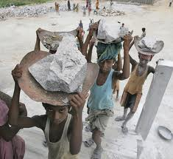
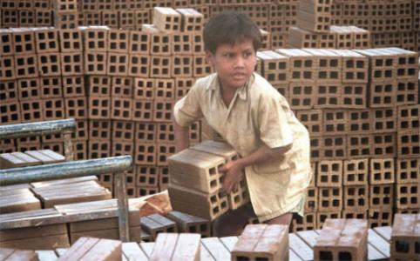
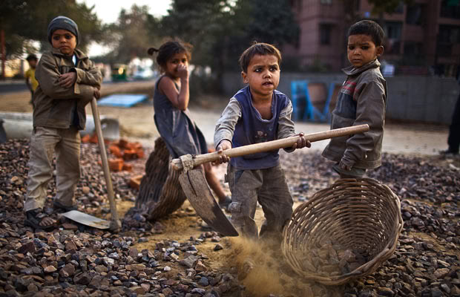
Step 1: Define the Problem
A. Respond: What exactly is child labor?
B. Respond: Where does child labor occur?
C. Respond: What undesirable social conditions result from child labor?
D. Summarize: In a single sentence, what is the problem and where does it occur?
What undesirable social conditions do you think result from what you see in the pictures above?

Slide 11
Step 1: Define the Problem
A. Respond: What exactly is child labor?
B. Respond: Where does child labor occur?
C. Respond: What undesirable social conditions result from child labor?
D. Summarize: In a single sentence, what is the problem and where does it occur?
Child labor is…

Slide 12
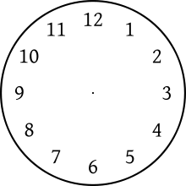
Step 2: Gather the Evidence
Present evidence that a problem exists. Be as specific as possible and cite at least one source of data.
Group Activity: Each group will be assigned one of the four resources below. Using the sheet at the Gather the Evidence link, present evidence that a child labor problem exists.
Resource #1
Resource #2
Resource #3
Resource #4
10 Min

