Slide 1
The Gang’s All Here!
Aim: Why do people join gangs?

Slide 2
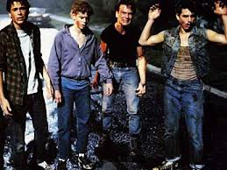
The Outsiders
To Ponyboy, the gang is one of he most important parts of his life
His life is defined by his membership in the gang
But why do young people in cities join gangs?
Picture courtesy of The Outsiders Website

Slide 3
Steps of the PPA
Define the Problem
Gather the Evidence
Identify the Causes
Evaluate a Policy
Develop Solutions
Select the Best Solution

Slide 4
We have already:
Defined the Problem: Young people in New York City joining gangs
Gathered Evidence: Found articles and research about gang membership and violence
Now let’s examine the causes, so we can determine best practices for policy

Slide 5
Gangs are violent:
25,000 gangs and 750,000 active members
Gangs are more prevalent in large cities
Gang violence is responsible for 12% of homicides nationally
This number is higher in large cities: Los Angeles and Chicago are closer to 50%
Gangs are involved with drug trafficking and firearms
Source: www.nationalgangcenter.gov

Slide 6
If there is so much violence associated with gangs, why do people join?
The problem is gangs membership can fulfill needs
of young people. If we want a policy that can address
the problem of young people joining gangs, we must
first understand why people join.

Slide 7
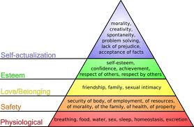
Social Acceptance
A. Maslow describes a hierarchy of needs that everyone has
People have a need to belong to a group
Gangs offer a sense of acceptance or belonging
People who feel alienated or rejected are vulnerable

Slide 8
What role does social acceptance play in your life?
What groups do you belong to?
Family
School
Friends
Church
Team
Gang?
Are these groups important to you?

Slide 9
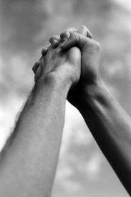
Empowerment
Joining a gang can be empowering
Gangs offer protection in dangerous neighborhood
Being a member of a gang can elevate your place in the social hierarchy
news.eastvillagers.org

Slide 10
What are things that make you feel empowered?
Achievements
Confidence
Team work
Leadership
Developing talent
Developing skills
Autonomy and Independence

Slide 11
Sense of Identity
Gang culture can provide a sense of self
Gangs have clearly defined roles
They are like a “society within a society”
Frequently there is a common way of dressing and use of slang that helps to give one a personal identity

Slide 12
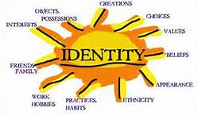
What gives you a sense of Identity?
Fashion choices
Special Talents and skills
Family
School
Church
Teams
Image courtesy of saib91.wordpress.com

Slide 13
Economic Gain
Gangs can provide a method to make quick money
Many gangs are involved in selling drugs
Many communities have limited opportunities for young people to earn money
Courtesy of: Loveofmoney:hurtsthefamily

Slide 14
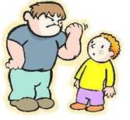
Fear/Protection
Gangs can intimidate people into joining
In neighborhoods with a lot of gang activity, joining a gang can offer a level of protection
Picture courtesy of http:melangenewsletter.wordpress.com/2011/07/01/violent-youths/

Slide 15
Sources
Into the Abyss, http://people.missouristate.edu/MichaelCarlie/what_I_learned_about/gangs/WHYFORM/why_gangs_form.htm
Violence Prevention Institute, http://www.violencepreventioninstitute.com/youngpeople.html
Wikipedia

