Slide 1
Define the Problem Constant surveillance of citizens in our country
Mr. V
Social Studies / Law
Ditmas I.S. 62
ivillota88@gmail.com
Do Now: Describe and Explain what you see in the picture?

Slide 2
Public Policy Analyst
Define the problem
Gather the evidence
Identify the causes
Evaluate an existing policy
Develop solutions
Select the best solution (Feasibility vs. Effectiveness)

Slide 3
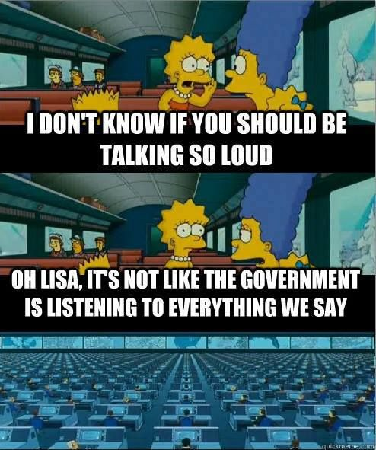
Gather the information Discuss the meaning behind the quote, and discuss what you see in the picture

Slide 4
Gather the Information
“Always eyes watching you and the voice enveloping you. Asleep or awake, indoors or out of doors, in the bath or bed- no escape. Nothing was your own except the few cubic centimeters in your skull.” ― George Orwell, 1984

Slide 5
NSA
NSA – National Security Agency
The National Security Agency is the Nation's cryptologic organization. It coordinates, directs, and performs highly specialized activities to protect U.S. information systems and produce foreign intelligence information. A high technology organization, NSA is on the frontiers of communications and data processing. It is also one of the most important centers of foreign language analysis and research within the government.
http://www.criticalcommons.org/Members/ccManager/clips/DarkKnightMontage.mov/view

Slide 6
Gather the information

Slide 7
Share Pair
Students will discuss the Court case Jewel v. NSA.
They will discuss whether or not the NSA had the right to spy and Jewel. Discuss the Pro’s and Con’s on spying on people to protect National Security.

Slide 8
Gather the Information Jewel v. NSA
This case involves claims by numerous citizens that their constitutional rights were violated by the United States government through unauthorized surveillance of their telephone and internet activity by the National Security Agency (NSA) and other government actors under the "Terrorist Surveillance Program" or TSP. The NSA continued to acquire the content of a significant portion of phone calls, emails, instant messages, text messages, web communications and other communications, both international and domestic, of practically every American who uses the phone system or the internet

Slide 9
Gather the information Analyze the following document
On June 6, 2013, 29-year old computer assistant Edward Snowden made public a collection of classified documents from the government’s National Security Agency (NSA). The documents revealed details about government surveillance of U.S. citizens’ phone records and internet histories. Under a program known as PRISM, which partners government with well-known technology and communications companies such as Verizon, Yahoo, Microsoft, Google, and Facebook, the NSA was able to obtain access to data about citizens' personal communications. Glenn Greenwald, the journalist who broke the story for the British paper The Guardian(link is external), wrote an article on June 7 explaining the scale of the surveillance that Snowden’s leak revealed. He wrote:
The National Security Agency has obtained direct access to the systems of Google, Facebook, Apple and other U.S. internet giants, according to a top secret document obtained by the Guardian. The NSA access is part of a previously undisclosed program called Prism, which allows officials to collect material including search history, the content of emails, file transfers and live chats, the document says.….The NSA access was enabled by changes to U.S. surveillance law introduced under President Bush and renewed under Obama in December 2012. . . . . . . . . . . . . . . . . . . . . . . . . .
The documents will be handed out to the students. . . . .
http://www.morningsidecenter.org/teachable-moment/lessons/nsa-surveillance-politics-whistleblowing

Slide 10
Gather the Information Answer the following questions
According to the reading, what did the information leaked by Edward Snowden reveal about U.S. government activities?
What sacrifices did Snowden make in revealing this information? What does he say his motives for doing this were? Do you think his explanation is credible?
Jeffrey Toobin argues that Snowden should have gone through official channels rather than leaking information to a newspaper. What do you think of this argument?
While some critics have attacked Snowden’s character, his defenders hold him up as a hero. What do you think? Is Snowden’s personal character relevant to the debate?

Slide 11
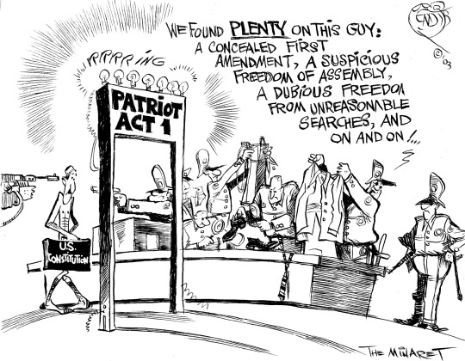
Identify the Causes
9 -11- 2001
United States Patriot Act

