Slide 1
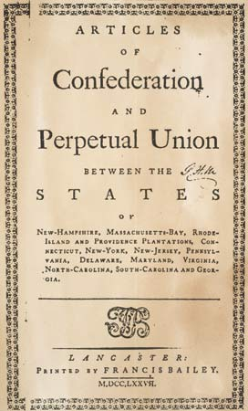
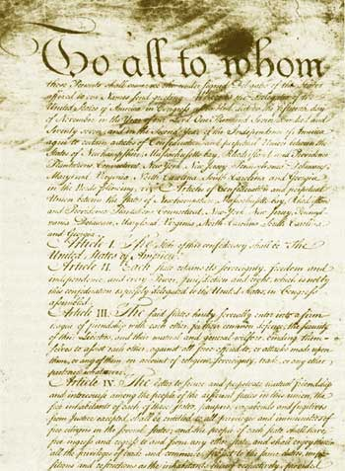
Weakness of the Articles of Confederation
By: Jonathan Suliman-Zada

Slide 2
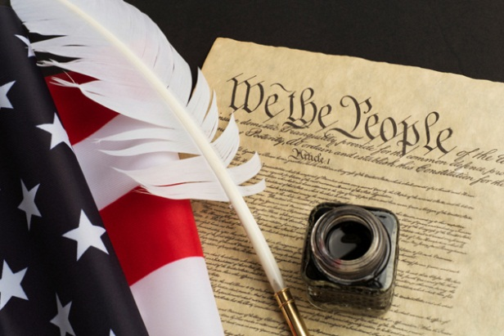
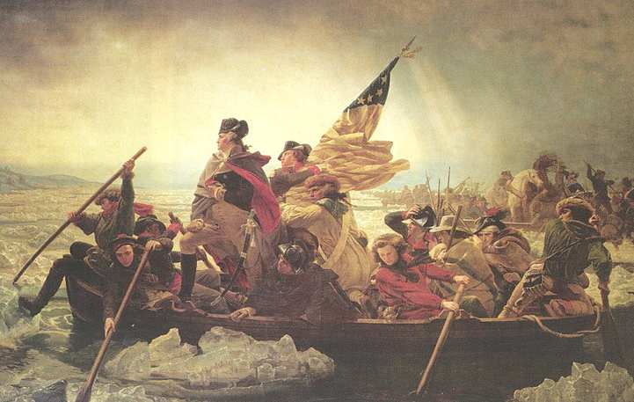
The 4 steps of the american history public policy analyst (ahppa)
Define the problem
Gather the evidence
Identify the causes
Evaluate the policy
(Source:http://flippedtips.com/plegal/ppa/ppasteps.htm)

Slide 3
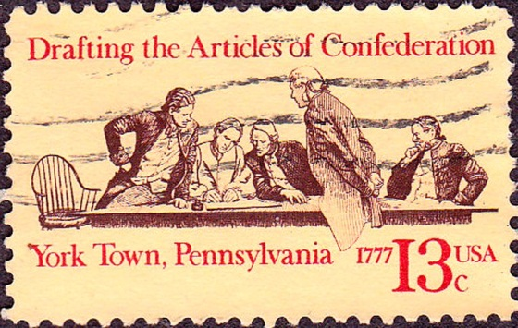
Why was the Articles of Confederation created?
The Articles of Confederation served as the written document that established the functions of the national government of the United States after it declared independence from Great Britain.
It established a weak central government that mostly, but not entirely, prevented the individual states from conducting their own foreign diplomacy.
(Source:https://history.state.gov/milestones/1776-1783/articles)

Slide 4
Problems of the articles of confederation
The Articles of Confederation didn’t balance power between the federal government and the states.
The federal government had no real source of income or financial aid.

Slide 5
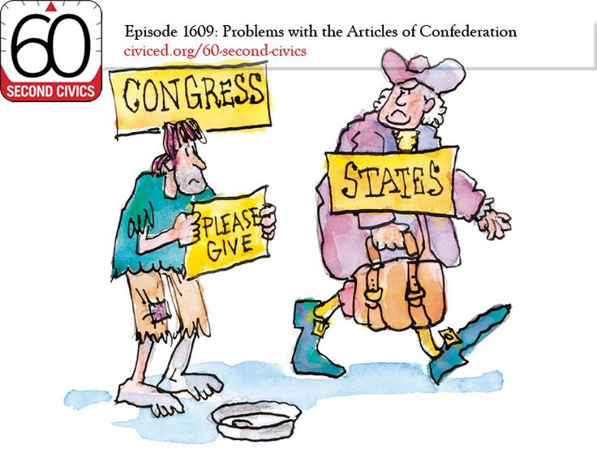
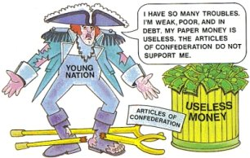
Weaknesses of the articles of confederation
Congress did not have the power to tax.
Congress did not have the power to regulate foreign and interstate commerce.
There was no executive branch to enforce any acts passed by Congress.
There was no national court system.
Each state printed its own money
There was no national army.
(Source:http://www.etownschools.org/cms/lib/PA01000774/Centricity/Domain/629/Articles%20of%20Confederation101.pdf)

Slide 6
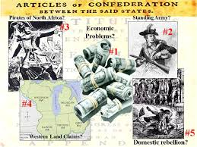
What caused the articles of confederation to be re-designed?
Under the Articles of Confederation, states often argued amongst themselves. They also refused to financially support the national government.
The national government was powerless to enforce any acts it did pass.
There was no stable economy.
(Source:http://americanhistory.about.com/od/governmentandpolitics/f/articles_of_confederation_fails.htm)

Slide 7
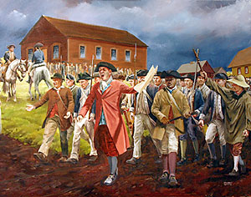
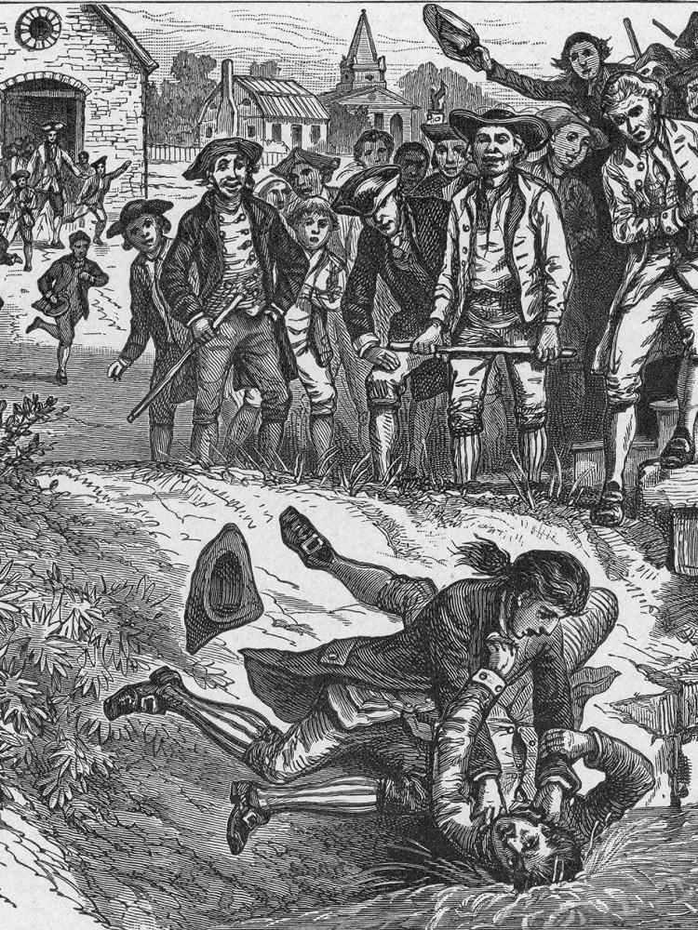
What caused the articles of confederation to be re-designed? (continued)
In 1786, Shays' Rebellion occurred as a protest to rising debt and economic chaos. The national government was unable to gather a combined military force amongst the states to help put down the rebellion.
As the economic and military weaknesses became apparent, individuals began asking for changes to the Articles that would create a stronger national government. As more states became interested in meeting to change the Articles, a meeting was set in Philadelphia on May 25, 1787. This became the Constituntional Convention.
(Source:http://americanhistory.about.com/od/governmentandpolitics/f/articles_of_confederation_fails.htm)

Slide 8
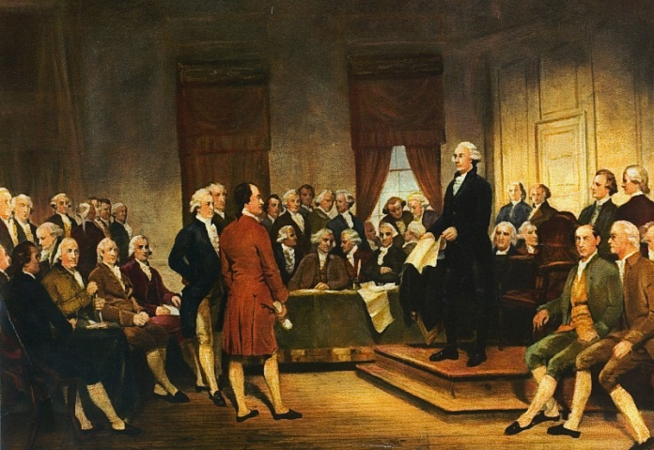
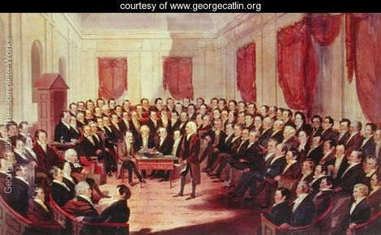
The constitutional convention
On May 25, 1787, delegates convened at Philadelphia's Pennsylvania State House for the Constitutional Convention. The assembly immediately discarded the idea of amending the Articles of Confederation and set about drawing up a new scheme of government.
During three months of debate, the delegates devised a brilliant federal system characterized by an intricate system of checks and balances.
(Source: http://www.history.com/this-day-in-history/constitutional-convention-begins)

Slide 9
The U.S Constitution
On September 17, 1787, the Constitution of the United States of America was signed by 38 of the 41 delegates present at the conclusion of the convention.
The United States Constitution was groundbreaking in numerous ways, establishing a new government, the likes of which the world had never seen.
Indeed, the very features which made it unique have also contributed to its longevity. These features also define the framework of American government and politics, establishing the United States of America, its national government and outlining the relationships between that government, the people and the states.
The most significant features of the U.S. Constitution are the establishment of the rule of law, the creation of a federal system with a supreme national government, the separation of governmental powers into three branches that check and balance each other and its flexibility.
(Source: http://www.thisnation.com/constitution.html)

Slide 10
What do you think?
Think Pair Share: Turn to your partner and discuss the following questions. Make sure to write your responses down so that you can share your thoughts.
Do you think the U.S Constitution “repaired” the problems the Articles of Confederation had?
What would you add or delete from the U.S Constitution?
Why?

