Slide 1
Immigration Problems in the United States
Ditmas IS 62
Ms. Shaw
sshaw7@schools.nyc.gov

Slide 2
Public Policy Analyst
Define the Problem
Gather the Evidence
Identify the Causes
Evaluate an Existing Policy
Develop Solutions
Select the Best Solution (Feasibility vs. Effectiveness)

Slide 3
Social Problem
America has always been the land of “opportunity”. However, the increase of immigration has caused major debates over how to deal with this issue.
Step 1 of the PPA: Define the Problem

Slide 4
What are some of the problems and consequences of illegal immigration?
Problems
High Birth Rates and Overpopulation
Crime/Violence/Robbery
Terrorism
Drugs
Gangs
Language barriers
Undocumented/Identity Theft
Poverty
Homelessness
Off- book jobs
Uneducated/Lack of Education
Consequences
Closed and Overcrowded Hospitals and Emergency Rooms
Overcrowding and Construction of more Jails and Detention Centers
Increase Border Patrols and Law Enforcement Agents
Cost to pay for Translators
Increase need for Food Pantries and Welfare Funding
Overcrowding Shelters
High Unemployment rate
Untaxed Wages
Overcrowded Classrooms, Schools/Libraries, etc…
Step 1 of the PPA: Define the Problem
Notes:
Class Activity: Cover-up the Consequences and show students only the Problems and have them determine what will be the consequence or outcome of each problem.

Slide 5
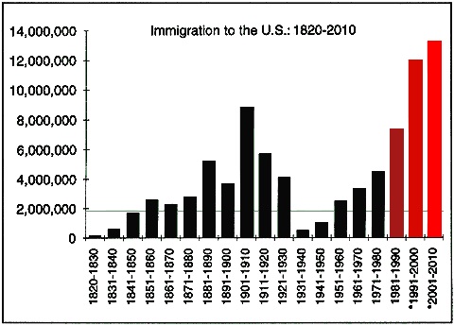
Gather the Evidence
http://www.cairco.org/reference/us-population-data
Step 2 of the PPA: Gather the Evidence

Slide 6
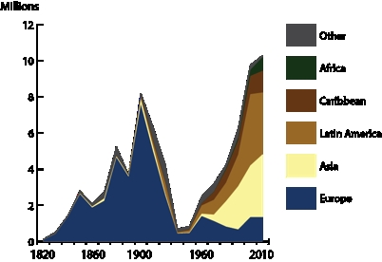
Gather the Evidence
http://ucrtoday.ucr.edu/12835
Step 2 of the PPA: Gather the Evidence

Slide 7
Identify the Causes
Throughout history, the United States has been a safe haven for immigrants enter and establish a better life for themselves and their families. However with the increase of immigration come issues that we all as Americans must address. Let’s now focus on some of the causes of illegal immigration and why it is considered a major problem for us here in the U.S.A. Some undocumented immigrants entered the country illegally and others entered illegally but overstayed the number of days permitted on their visa or violated the terms of their permanent resident card or refugee permit.
Step 3 of the PPA: Identify the Causes

Slide 8
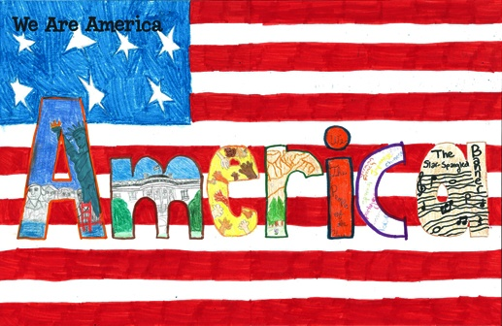
Identify the Causes
Why do people come to the United States?
● Political Freedom
● Religious Tolerance
● Economic Opportunity - People want a better life - better job - more money
● Political Refugees fear for their lives
● Some want free atmosphere
● Forced Immigration (Slavery)
● Family Reunification
Step 3 of the PPA: Identify the Causes

Slide 9
Identify the Causes
Let’s now focus on some of the causes of illegal immigration and why it is considered a major problem for us here in the U.S.A. Some undocumented immigrants entered the country illegally and others entered illegally but overstayed the number of days permitted on their visa or violated the terms of their permanent resident card or refugee permit.
Throughout history, the United States has been a safe haven for immigrants enter and establish a better life for themselves and their families.
Step 3 of the PPA: Identify the Causes

Slide 10
What are the existing laws/ policies for illegal immigration?
Each year the Border Patrol apprehends hundreds of thousands of aliens who flagrantly violate our nation's laws by unlawfully crossing U.S. borders. Such illegal entry is a misdemeanor, and, if repeated after being deported, becomes punishable as a felony.
The illegal alien population is composed of those who illegally enter the country (referred to as "entry without inspection — EWI") in violation of the immigration law, and others enter legally and then sty illegally (referred to as overstayers). The immigration authorities currently estimate that two-thirds to three-fifths of all illegal immigrants are EWIs and the remainder is overstayers. Both types of illegal immigrants are deportable under
Immigration and Nationality Act Section 237 (a)(1)(B) which says: "Any alien who is present in the United States in violation of this Act or any other law of the United States is deportable."
Step 4 of the PPA: Examine the Existing Policy

Slide 11
What are the current policies for illegal immigration?
In June 2012, President Obama issued a memorandum instructing officers of
the federal government to defer deporting young illegal immigrants who had been
brought here to the U.S. as children. Obama’s new non-deportation policy allows
1.7 million illegal immigrants to apply for the temporary right to live and work in
the United States.
Beginning March 04, 2013, illegal immigrants who can show that time apart
from a U.S. spouse, child or parent would create “extreme hardship” can apply
for legal visas without leaving the U.S
Currently, President Obama is in process of establishing new immigration reforms that would allow illegal immigrants in the United states to obtain legal status and “get right with the law” as a means of address the issue of increased immigration.
Step 4 of the PPA: Examine the Existing Policy

Slide 12
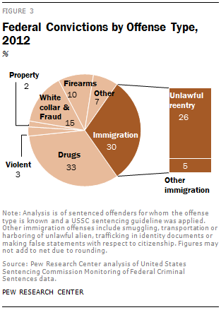
Effects of illegal immigration?
Dramatic growth over the past two decades in the number of offenders sentenced in federal courts has been driven primarily by enforcement of a particular immigration offense—unlawful reentry into the United States—according to an analysis of data from the United States Sentencing Commission (USSC) by the Pew Research Center.
The rising number of convictions for unlawful reentry has altered the offense composition of federal offenders. In 2012, immigration offenses—of which unlawful reentry is the largest category—represented 30% of offenders, up from 5% in 1992.

Slide 13
What are some solutions to correct illegal immigration?
Students will brainstorm in small groups on possible solutions to help address the issue of illegal immigration in the United States followed a class discussion on their findings.
Increasing Border Control Security – by increasing border control agents, adding more fencing along the U.S. –Mexico border, install more cameras, etc…
Improving Worksite Enforcements – by increasing fines for hiring illegal immigrants, all workers must hold legal status.
Guest Workers Programs – by reforming the agricultural & non-agricultural seasonal workers program, extend the work visa eligibility to 3 years
Improve the Current Immigration System – by streamlining the background checks conducted by the FBI, make sure social security credits are not earned
The Naturalization Process – by revising naturalization test, increasing training of immigration coaches, developing web-based learning tools
Step 5 of the PPA: Develop New Solutions

