Slide 1
Child Obesity in NYC Impacting Academics
Frances Schiro
Ditmas IS 62
fschiro@schools.nyc.gov

Slide 2
PUBLIC POLICY ANALYST MODEL
L.O: Students will be able read about obesity in the U.S.A and identify the problem.
C.O: Students will be able to sustain the problem by giving supporting evidence.

Slide 3
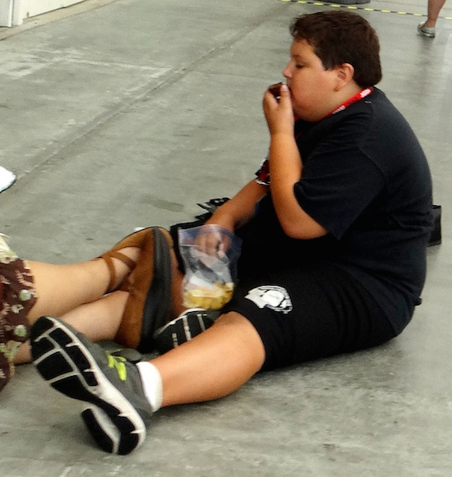
What social issues do you think these children are dealing with?
Discuss in your group your thoughts on each of these pictures

Slide 4
SIX STEPS OF PPA (PUBLIC POLICY ANALYST)
Define the problem
Gather the evidence
Identify the causes
Evaluate an existing policy
Develop solutions
Select the best solution (feasibility & effectiveness)

Slide 5
DEFINING THE PROBLEM
What physical problems arise from childhood obesity?
What emotional problems arise from childhood obesity?
What is the social problem?
Where is the social problem located (school, city, state, country)?
What are some of the bad consequences of your social problem?
Write a short phrase summarizing your problem and its location?

Slide 6
GATHER THE EVIDENCE
In New York City, obesity is epidemic: more than half of adult New Yorkers are overweight (34%) or obese (22%). Data show that obesity begins early in life: nearly half of all elementary school children and Head Start children are not a healthy weight. In New York City, 1 in 5 kindergarten students, and 1 in 4 Head Start children, is obese.
http://www.nyc.gov/html/doh/html/living/obesity.shtml

Slide 7
GATHER THE EVIDENCE
TASK:
Work with your partner by reading the attached article. After reading the article:
1 - decide on a way to incorporate educating children on BMI in the classroom
2 – develop an engaging activity/project for students to participate in regarding BMI
http://www.greatschools.org/parenting/health-nutrition/7019-childhood-obesity-epidemic.gs?page=all

Slide 8
IDENTIFYING THE CAUSE
Childhood obesity: how the numbers add up…..
25 percent of American teens drink an average of four sodas a day, the caloric equivalent of an extra meal
Of the approximately 15 TV commercials children see a day for food products (about 5,500 per year), 98 percent of those are for foods high in fat, sugar, and/or salt with scant nutritional value
15 percent of vegetables children eat are potato chips or French fries
In 1969, 42 percent of children walked or biked to school. Today, more than 80 percent are driven to school
http://www.greatschools.org/parenting/health-nutrition/7019-childhood-obesity-epidemic.gs?page=all

Slide 9
EVALUATE AN EXISTING POLICY
http://flippedtips.com/plegal/tips/worksheet4.html
Please refer to the above link for homework. We will share in class tomorrow.

Slide 10
DEVELOPING SOLUTIONS
http://www.nyc.gov/html/om/pdf/2012/otf_report.pdf
Please refer to the article in the above link. There are 26 initiatives listed. Each of you will be assigned an initiative to further investigate as viable solutions to assist in the fight against childhood obesity in our city. We will discuss as a class which initiatives/suggested solutions are most effective and/or feasible.

Slide 11
EXIT TICKET/ASSESSMENT
http://flippedtips.com/plegal/tips/worksheet5.html

