Slide 1
A Global Concern
Olivene McIntosh
Ditmas Jr. High School

Slide 2
Convenient Wreaking Handy Havoc

Slide 3
Small Groups 3 Minutes
Think about your daily lives. What are the many ways in which you use plastic bags?
What do you think life would be like without plastic bags? Why?
Working in your groups, select a:
Time Keeper
Facilitator
Record Keeper
Reporter
Discuss the questions listed on the right.
Record your responses on chart paper.
Select two group members to share out

Slide 4
A Brief History Plastic Bags

Slide 5
1977 Yeah Plastic!
Plastic bags were introduced to shoppers in 1977. At the time, they seemed like a better alternative over paper bags. They were cheaper to produce, required less energy, less water, the finished bags took up less space, was more durable for customers, and cost about 1/3 the cost of paper bags.

Slide 6
At That Time Save the Environment
Plastic bags seemed better than paper bags for the environment.

Slide 7
End of 1985
75 percent of U.S. grocery stores carried plastic bags.

Slide 8
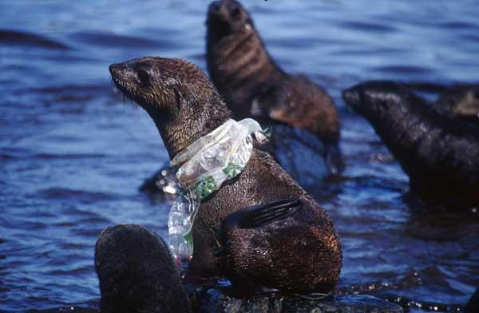
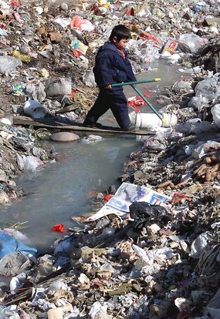
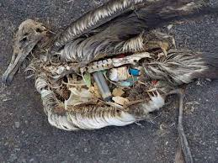
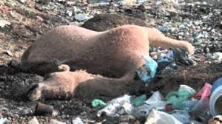
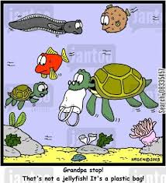
Early 2000’s
However, by the early 2000s, the world recognized that plastic bags were creating huge issues for marine life, wild life and the environment.

Slide 9
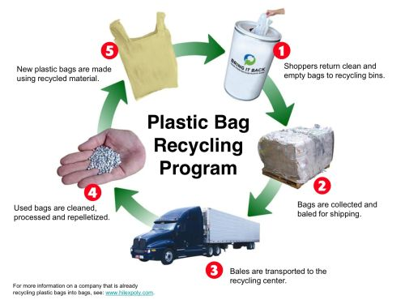
Mid-2000s
An infrastructure was developed for recycling plastic bags, which had the potential to be a great solution to the plastic bag problem.

Slide 10
Today
Several governments worldwide have begun placing restrictions on or have outright banned plastic bag use. What once started out as a good intention has turned into a global environmental issue of current times.

Slide 11
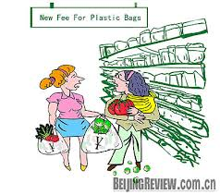
Small Group 3 Minutes
What may the reasons be why governments around the world are placing restrictions on or banning plastic bags?
Discuss the question listed on the right.
Words to Know
Ba n –To prohibit (an action) or forbid the use of (something), especially by official ruling
Restriction – The action of limiting or the state of being restricted
Record your responses on chart paper.
All group members must prepare to participate in Whole Group Discussion

Slide 12
We will use the six step Public Policy Analyst (PPA) to research, evaluate and create a PowerPoint presentation of the global use of plastic bags
Define the problem
Gather the Evidence
Identify the Causes
Evaluate an Existing Policy
Develop Solutions
Select the Best Solution

Slide 13
Define the Problem Identifying the problem (Worksheet #1)
1
What are the problems associated with using plastic bags
2
Identify the location of the problem
3
What are the undesirable social condition that result from using plastic bags

Slide 14
Gather the Evidence It’s Research Time Gathering Evidence (Worksheet #2)
(Be precise, present evidence to support you claim)
begin research by visiting Google, Yahoo, Ask, etc.
develop and conduct surveys
read magazines and journals
note case studies
use statistics
conduct interviews

Slide 15
Identify the Causes Identifying Causes of the problem (Worksheet #3)
What are the problems associated with using plastic bags?
Can you show evidence to
support your facts?

Slide 16
Evaluate an existing policy Evaluate the Policy (Worksheet #4)
2
What are the advantages and disadvantages of this policy?
3
Should this policy be replaced? Strengthened? Improved?
1
What is one current policy dealing with the use of plastic bags?

Slide 17
Develop Solution Develop a Solution to the problem (Worksheet #5)
What are original public policy alternatives?
*Propose at least 3 new policies
Are all the public policy alternatives at the same geographical level?
*Be specific, specify the government agencies that
will carry out the proposal
Which proposal is the most promising
*Use you group to decide
which proposal is most promising

Slide 18
Select the Best Solution Selecting the Best Solution (Worksheet #6)
1
What are three ways to reduce or prevent the negative effects of plastic bag use?
2
Where does your policy falls on the matrix of feasibility?
3
Is it highly achievable or not very adequate?

Slide 19
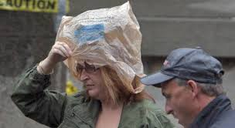
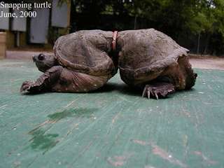
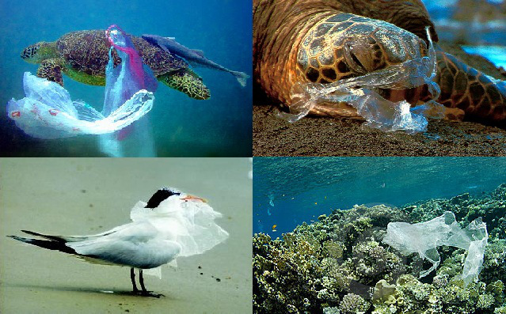
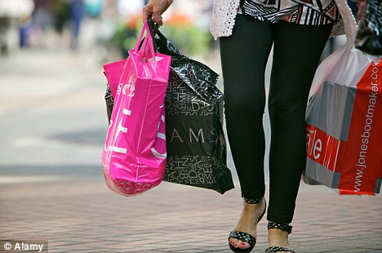
Plastic Bags
Helpful
Convenient & Handy
Harmful
Wreaking Havoc

Slide 20
Think Share Pair Turn and Talk 2 Minutes
Why should we care?
Discuss the question listed on the right.
All members must prepare to participate in Whole Group Discussion

