Slide 1
Children are being hurt developmentally Ms. Matassa smatassa@schools.nyc.gov Ditmas IS 62
PROBLEM

Slide 2
Public Policy Analyst
Define the problem
Gather the evidence
Identify the causes
Evaluate an existing policy
Develop solutions
Select the best solution (Feasibility vs. Effectiveness)

Slide 3
Gather the evidence
How do we know they are being hurt developmentally?
Step 1: Read the excerpt on the next slide from
Step 2: Within your groups, try to list 5 ways children are being hurt developmentally.

Slide 4
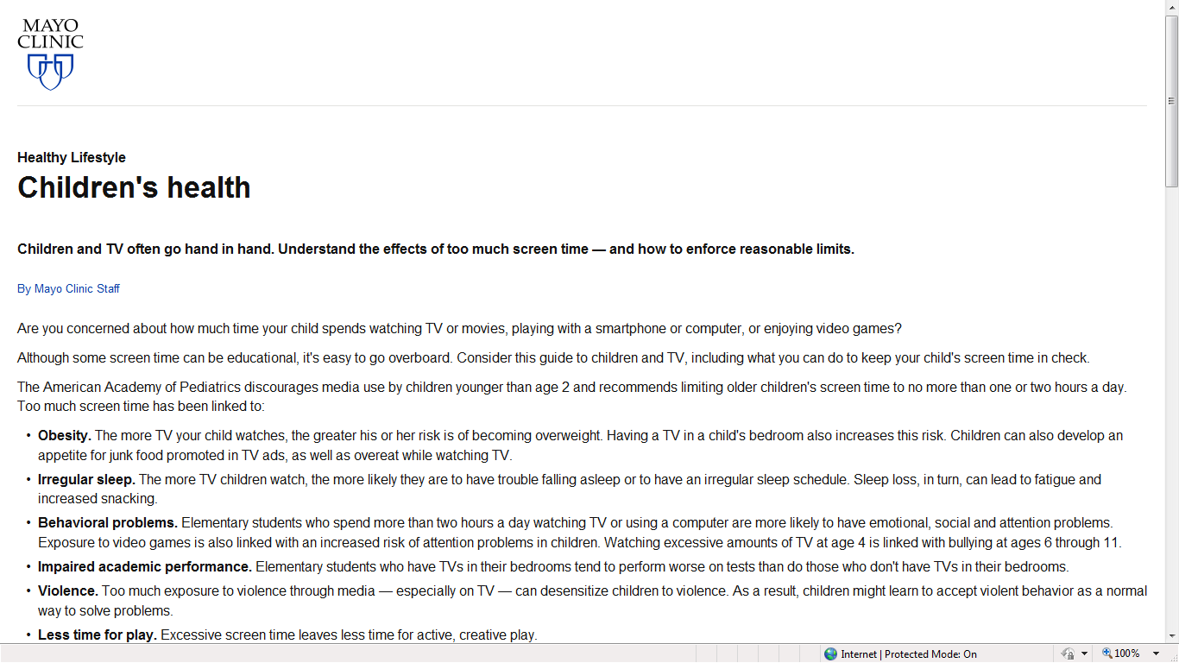

Slide 5
Too much screen time has been linked to …
1.
2.
3.
4.
5.

Slide 6
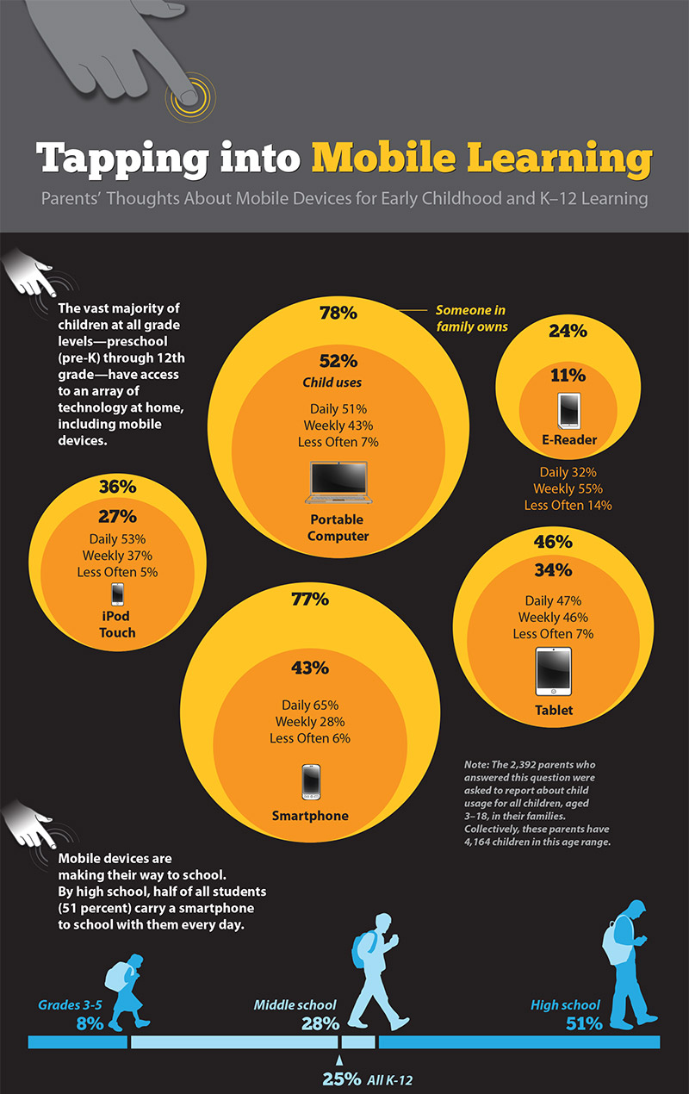

Slide 7
Identify the causes of the problem
Do you think that media use is causing this problem?
Before you say no…
Let us review excerpts from
these various sources together.

Slide 8
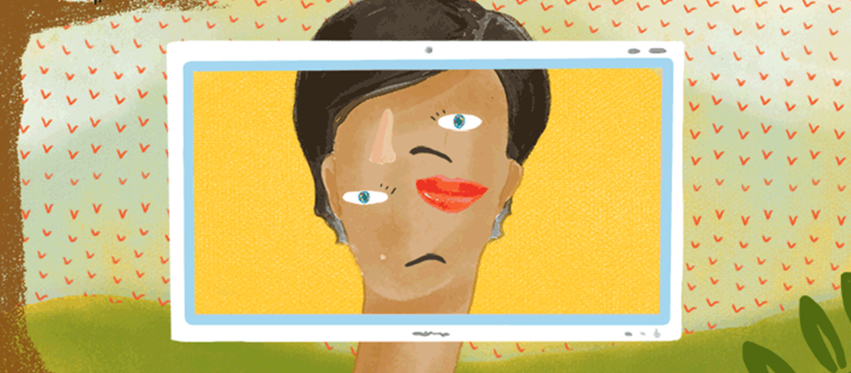
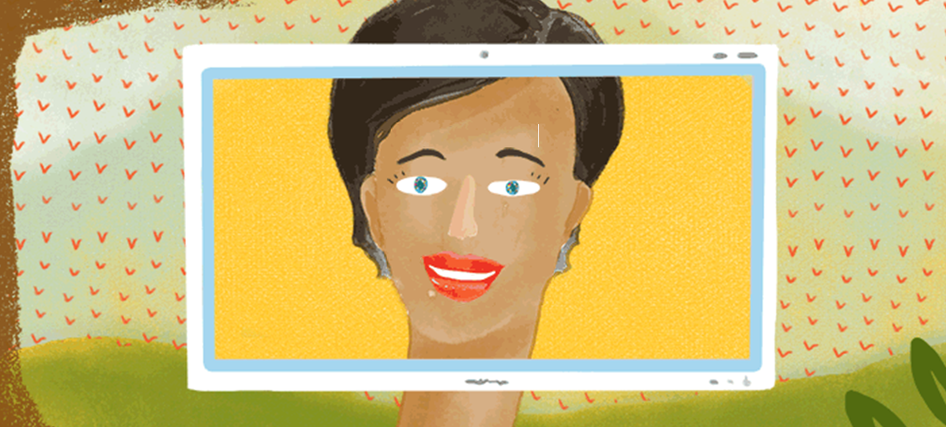
Kids And Screen Time: What Does The Research Say?

Slide 9
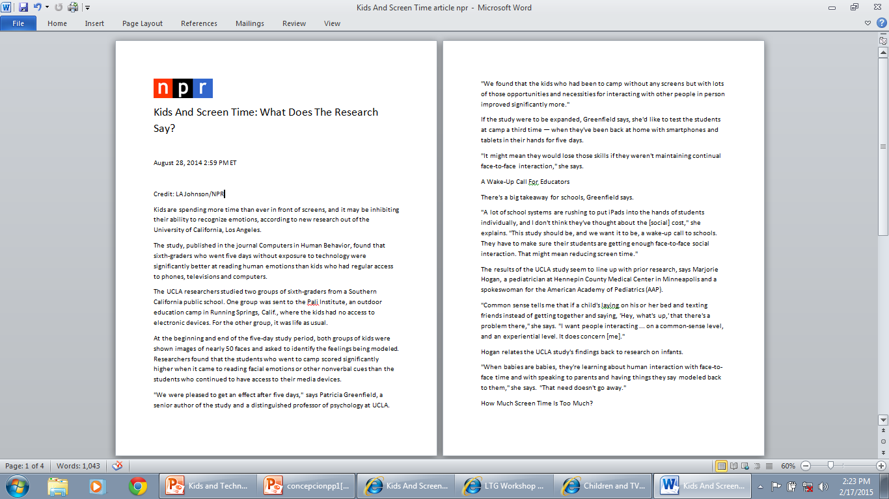

Slide 10
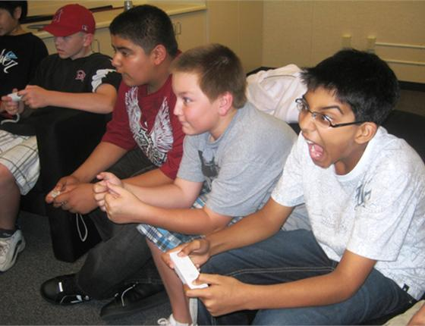
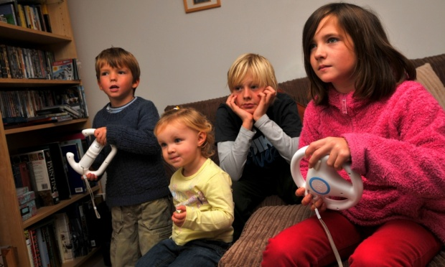
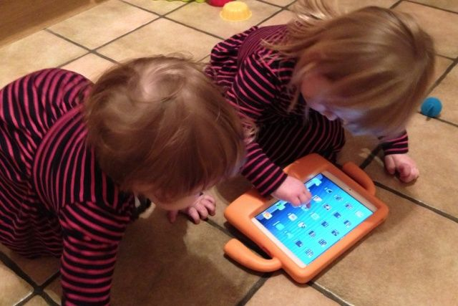
What is the problem with using media devices for an extended amount of time?

Slide 11
Evaluate an existing Policy
Check out some ways you can limit your media use by listening and/or reading the article below
How to make a family media use plan

Slide 12
Develop Solutions
With your group members, develop 3 solutions for fixing this problem.
Possible Solutions
#1
#2
#3

Slide 13
Select the best solution (Feasibility vs. Effectiveness)

