Slide 1
Poor Academic Performance in Middle Schools
By: AnnMarie Kennedy
I.S. 62 – Ditmas Middle School LTG Project – Professional Development

Slide 2
What is PPA?
Public Policy Analyst, or PPA, is a government action that is put into place in order to deal with a social problem.
It consists of 6 main steps:
Define the Problem
Gathering Evidence of the Problem
Identifying the Causes of the Problem
Evaluating Existing Public Policy Solutions
Developing Public Policy Solutions
Selecting the Best Public Policy Solution

Slide 3
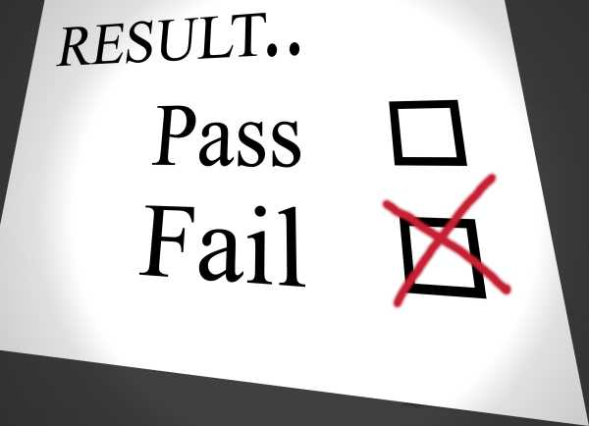
Step 1: Defining the Social Problem
As children progress from elementary school to middle school it has been proven that grades drop dramatically (Association, 2015).
TURN – and – TALK
Talk about WHY performing poorly in schools is a problem.
After group discussions, complete the worksheet in the following link: http://flippedtips.com/plegal/tips/worksheet1.html

Slide 4
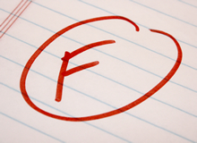
Review Step 1: Whole Group Discussion
As a whole group, have students share their thoughts about why poor academic performance is a problem.
Possible Answers from students:
Fail classes
Fail state exams
Get left-behind
Summer school
Less Knowledgeable
Being Unprepared

Slide 5
Step 2: Gathering Evidence of the Problem
Now it is time to find evidence to back up the statements you have made about the problem.
You must complete the following worksheet by using the given worksheets.
http://flippedtips.com/plegal/tips/worksheet2.html
The following websites offer an abundance of information about poor academic performance in middle schools.
http://www.apa.org/helpcenter/middle-school.aspx
http://www.huffingtonpost.com/2013/01/08/nyc-targets-17-schools-for-closure_n_2431644.html
http://www.albany.edu/edfin/StiefelCR.PDF

Slide 6
Review Step 2: Whole Group Discussion
As a whole group, have students share their findings and evidence about poor academic performance in middle schools.
Possible Answers from groups:
Low In-Class Test Grades
Low State-Tests Scores & Results
Low Attendance Rates
Missing Homework’s

Slide 7
Step 3: Identifying the Causes of the Problem
As a group, complete the following worksheet by listing several underlying factors that contribute to poor academic performance.
http://flippedtips.com/plegal/tips/worksheet3.html
Use these websites to find evidence that backs up your causes.
http://accg.net/Pooraca.htm
http://www.ascd.org/publications/books/109074/chapters/How-Poverty-Affects-Behavior-and-Academic-Performance.aspx

Slide 8
Review Step 3: Whole Group Discussion
As a whole group, have students share what they believe are the causes of poor academic performance in middle schools, making sure to back up their statements with evidence.
Possible Answers from groups:
Low economic status
Lack of resources
Environmental Factors
Bullying
Unsupportive Parents
No consequences
Puberty

Slide 9
Step 4: Evaluating Existing Public Policies
There are a few existing policies in Ditmas Middle School that have been put into place to help students who are performing poorly.
Parent Contact
When students are in danger of failing
When students are showing signs of negative patterns in behavior and work
After-School Programs
Exclusion from trips
Summer School

Slide 10
Step 5: Developing Public Policy Solutions
Students will discuss strategies and use the following websites to come up with new policies that they think will help to improve academic performance.
http://www.sacpo.co.za/downloads/conference%20papers/Intervention%20Strategies%20To%20improve%20Student%20Performance.pdf
Possible answers:
More after–school programs
Peer–tutoring

Slide 11
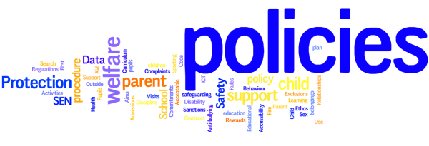
Conclusion - Step 6: Selecting the Best Public Policy Solutions
Students will select which policy they feel is most effective and use all of data collected during class to support their decision.

Slide 12
Works Cited
http://flippedtips.com/plegal/ppa/intro.html
http://www.huffingtonpost.com/2013/01/08/nyc-targets-17-schools-for-closure_n_2431644.html
http://www.apa.org/helpcenter/middle-school.aspx
http://www.albany.edu/edfin/StiefelCR.PDF
http://accg.net/Pooraca.htm
http://www.ascd.org/publications/books/109074/chapters/How-Poverty-Affects-Behavior-and-Academic-Performance.aspx
http://www.sacpo.co.za/downloads/conference%20papers/Intervention%20Strategies%20To%20improve%20Student%20Performance.pdf

