Slide 1
The Trouble with Waste
Cynthia Thomas
Ditmas IS 62
Cthomas21@schools.nyc.gov

Slide 2
Public Policy Analysis
Define the Problem
Gather Evidence
Identify the Causes
Evaluate an Existing Policy
Develop Solutions
Select the Best Solution

Slide 3
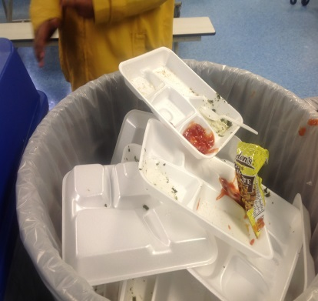
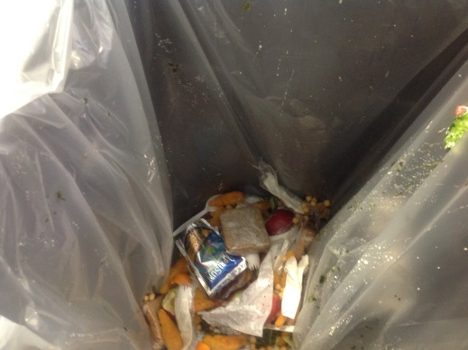
The Problem
Ditmas IS 62 produces too much waste that contributes to NYC’s production of greenhouse gases.
Schools contribute to the solid waste that is disposed of in landfills
Non-biodegradable waste contributes to greenhouse gases in the atmosphere

Slide 4
Whose problem is it anyway?
You have learned that matter is neither created or lost.
Waste is usually a stinky kind of matter that everyone would like to toss and forget
Waste doesn’t go away, it just goes “somewhere” else
If we do not change how we get rid of our waste we’ll have “nowhere” to put it.

Slide 5
How Big a Deal is This?
NYC generates over 12,000 tons of garbage per year
It costs NYC over $300 million dollars to transport it out of state to be dumped in landfills
Co2, is released from the trucks making these deliveries
When food waste is disposed of with plastic and other
non-biodegradable ideal conditions are set up for, methane
producing bacteria to thrive
Carbon dioxide and methane are greenhouses gases
http://blogs.ei.columbia.edu/2014/01/15/public-schools-lead-charge-for-environmental-reform/
http://blogs.ei.columbia.edu/2014/01/15/public-schools-lead-charge-for-environmental-reform/

Slide 6
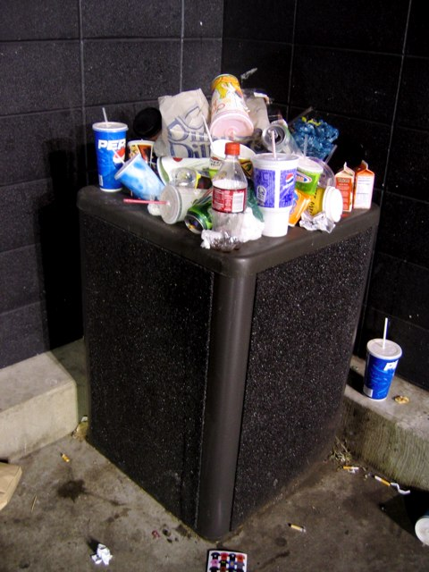
Gather Evidence
Look around and notice how many items are in the trash.
In the cafeteria food waste is mixed in with recyclable and non-recyclable items
How big is the problem? These sites will give you information.
http://www.epa.gov/region2/webinars/pdfs/Cafeteria_Waste_Webinar.pdf
http://www.biocycle.net/2013/12/20/new-nyc-food-waste-recycling-law-will-have-a-national-impact-say-american-biogas-and-composting-groups/
http://www.grownyc.org/recycling/facts

Slide 7
Identify the Causes
What factors contribute to the waste at Ditmas?
Create a survey to determine what students and staff know about the waste at Ditmas.
Include 3-5 questions that might help you determine what is contributing to this problem.

Slide 8
Evaluate Existing Policy
What is the existing policy for recycling in NYC public schools?
Determine what is required by the various individuals.
Determine how the existing policy is supposed to be implemented.
This website gives detailed information
http://www.grownyc.org/recyclingchampions

Slide 9
Composting
Ditmas IS 62 is part of a pilot program to recycle organic waste. Food waste from the cafeteria is disposed of in a brown bin and each night a DSNY truck picks up our food waste.
Success with initiative requires all members of the school community to “pitch in”
Go to video

Slide 10
Develop Solutions
Using the information you and your partners have obtained about the existing policy and the factors contributing to waste generation at Ditmas, come up with three possible solutions.
Find out what other schools are doing to recycle, decide on what you will work best for Ditmas
https://vimeo.com/41960276

Slide 11
Select the Best Policy
The best solution will be the most effective and feasible (one that is easiest to carry out)
Organize your possible solutions in this worksheet, rank choices 1, 2 and 3
Worksheet6.doc

