Slide 1
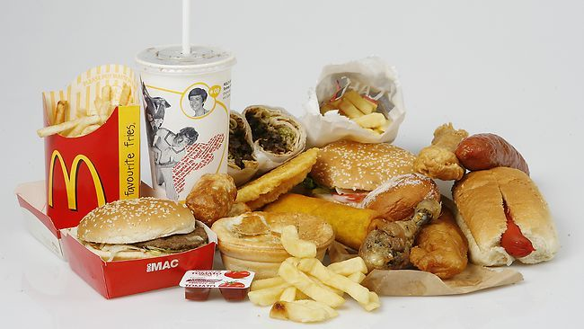
Disadvantages of Poor Nutrition
Mrs. Somerville
Science Grade 6
I.S. 62
JDonnelly4@schools.nyc.gov

Slide 2
Ppa Steps http://flippedtips.com/plegal/ppa/intro.html
1) Define the problem
2) Gather the evidence
3) Identify the causes
4) Evaluate an existing policy
5) Develop solutions
6) Select the best solution

Slide 3
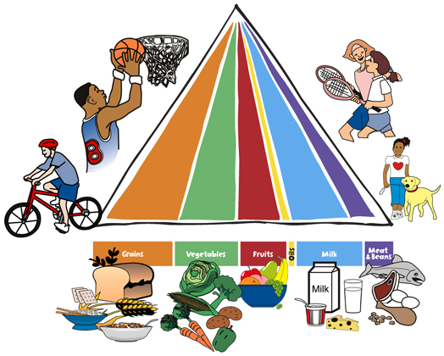
Good versus bad nutrition
Good nutrition is essential to staying healthy and being active.
Eating healthy foods and drinking enough water can lead to a healthy lifestyle.

Slide 4
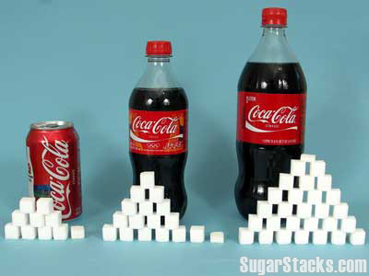
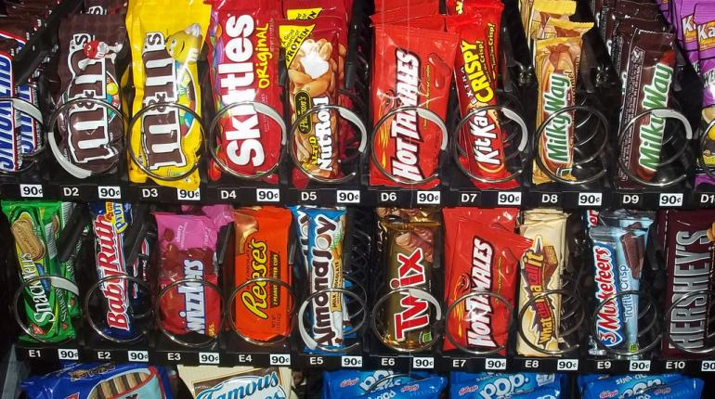
Bad nutrition
Bad nutrition is when you are overeating or under eating certain foods.
When you eat a good amount of one type of food or drink.
This usually includes foods that are high in fat and sugar.
Step 1: Define the Problem

Slide 5
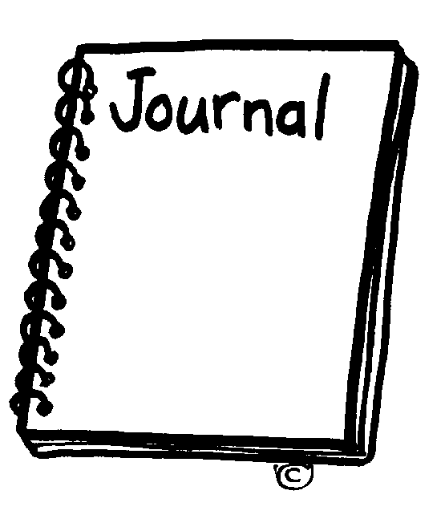
Journal entry
Create a list of the foods you ate yesterday. Next to the food that you ate, draw a happy face for good food and a sad face for bad food.
After the list is created, write a reflection piece on the foods that you ate. Do you consider yourself a healthy eater or a unhealthy eater?
Step 2: Gather the Evidence

Slide 6
What are the causes of bad nutrition?
Click on the following link. In groups discuss the causes of poor nutrition. Pick two that apply to you or someone you know.
http://healthyeating.sfgate.com/leading-causes-bad-nutrition-3333.html
Step 3: Identify the Causes

Slide 7
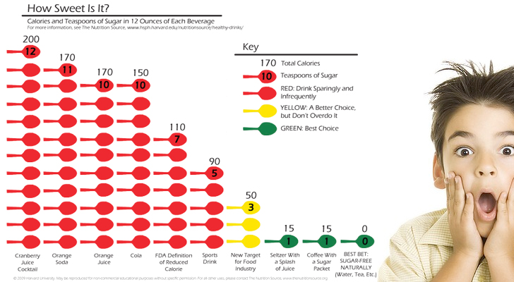
BLOOMBERG’S SODA POLICY
New York City's Board of Health recently approved Mayor Bloomberg's proposal to limit the sizes of sweetened beverages. The regulation restricts the sale of sugary drinks larger than 16 ounces in restaurants, movie theaters, sports arenas and delis.
Step 4: Examine an Existing Policy

Slide 8
What are your thoughts?
Do you agree or disagree with this policy?
Debate in your groups whether agree or disagree with this policy.
Share their ideas.

