Slide 1
BULLYING
Marilyn David IVDU School
Using Public Policy Analyst (PPA) Approach for social problems
Created by:
Joseph Shimonov
Joe.Shimonov@gmail.com

Slide 2

Outline of Public Policy Analyst Six Steps:
1. Define The Problem
2. Gather evidence
3. Identify causes
4. Evaluate a policy
5. Develop solutions
6. Select best solution

Slide 3
STEP # 1
Define the problem

Slide 4
Discuss with a partner what you think bullying is.

Slide 5
- What is Bullying?
Definition:
Bullying is intentional aggressive behavior. It can take the form of physical or verbal harassment and involves an imbalance of power (a group of children can gang up on a victim or someone who is physically bigger or more aggressive can intimidate someone else, for instance).
Source: http://childparenting.about.com/od/schoollearning/g/bullying-definition.htm

Slide 6
- What is Bullying?
Definition:
Bullying behavior can include teasing, insulting someone (particularly about their weight or height, race, sexuality, religion or other personal traits), shoving, hitting, excluding someone, or gossiping about someone.
Source: http://childparenting.about.com/od/schoollearning/g/bullying-definition.htm

Slide 7
- What is Bullying?
Definition:
Bullying can cause a victim to feel upset, afraid, ashamed, embarrassed, and anxious about going to school. It can involve children of any age, including younger elementary grade-schoolers and even kindergarteners. Bullying behavior is frequently repeated unless there is intervention.
Source: http://childparenting.about.com/od/schoollearning/g/bullying-definition.htm

Slide 8
STEP #2
Gather the Evidence

Slide 9

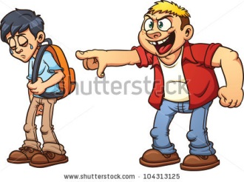

Have you ever felt bullied before?

Slide 10
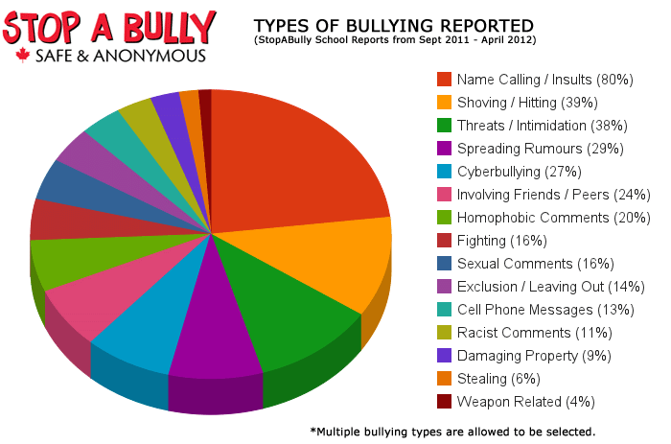
Visual Graphing of Bullying
Source: http://forfreepsychology.wordpress.com/2013/08/02/new-link-between-bullying-adverse-legal-consequences/

Slide 11

STEP #3
Identify the Causes

Slide 12
Now that we know what bullying is, how can we identify it?
Why are certain students targeted and bullied?
What causes someone to be a bully?

Slide 13
STEP #4
Evaluate an Existing Policy

Slide 14
How can we prevent BULLYING at our school.
Explain and define our existing policy of bullying at our school.

Slide 15


STEP #5
Develop Solutions

Slide 16

Developing Solutions
The best way to develop solutions for any issue, is to put yourself in their place.
How would you feel if
you were being bullied?
What would you do to
bully?
What would you do to
the one who is being
bullied?

Slide 17

STEP #6
Select the Best Solution

Slide 18
Feasibility vs. Effectiveness
Feasibility
 | High | Medium | Low
High
Medium
Low
Effectiveness

