Slide 1
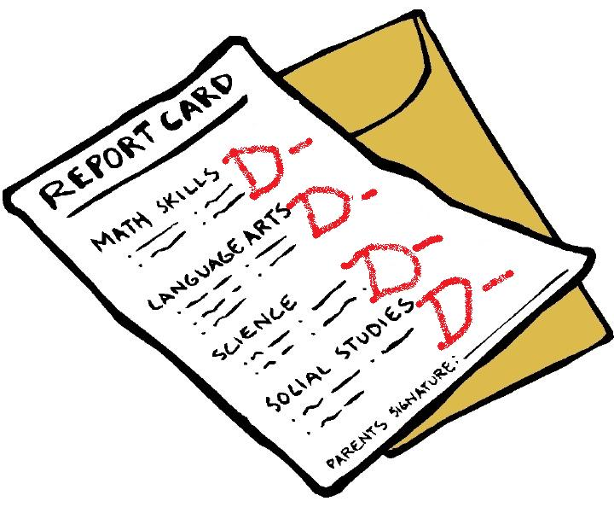
Poor Academic Performance in Middle Schools
Mrs. Polito
Ditmas I.S. 62
gpolito3@schools.nyc.gov

Slide 2
What’s the problem?
On average, children's grades drop dramatically during the first year of middle school compared to their grades in elementary school.
More children fail classes, miss homework assignments and are unprepared for class. http://www.apa.org/helpcenter/middle-school.aspx
Step1: Define the Problem

Slide 3
Public Policy Analyst (PPA) http://flippedtips.com/plegal/ppa/intro.html
Define the Problem
Gather the Evidence
Identify the Causes
Evaluate an Existing Policy
Develop Solutions
Select Best Solution

Slide 4
Think * Pair * Share
Think about how you’re performing this year as opposed to elementary school.
Have you missed more homework?
Failed tests?
Been unprepared?
Next find a partner and pair up.
Share your thoughts.

Slide 5
Don’t Believe Me? Take a look at the stats!
72 | 3.5 | 2 | 2 | 27 | 2 | 2 | E | 2
Cornelius Baptiste | 228290557 | 72 | 4 | 2 | 2 | 47 | 2 | 2 | 2 | 0
Hans Bazard | 215482274 | 60 | 0 | 2 | 2 | E | 0 | 2 | 2 | 2
Tamya Caesar Lashley | 215266073 | 80 | 4 | 2 | 2 | 80 | 2 | 2 | 2 | 2
Danielle Cazeau | 202913679 | 80 | 3.8 | 0 | 0 | 67 | 2 | 2 | 2 | 3
Blanca Corona | 213179609 | 60 | 2 | 2 | 2 | 73 | 2 | 2 | 2 | 0
Selena Enriquez | 216580225 | 78 | 3.5 | 2 | 2 | 47 | 2 | 2 | 2 | 2.5
Kelsey Espinal | 215334681 | 48 | 4 | 2 | 2 | 73 | 2 | 2 | 2 | 0
Tyler Felix | 215406653 | 69 | 0 | 2 | 2 | E | 2 | 2 | 2 | 0
Robin Geune | 214806499 | 72 | 4 | 2 | 2 | E | 2 | 2 | 2 | 0
Ashley Johnson | 215277393 | 65 | 3.5 | 2 | 2 | 33 | 2 | 2 | 0 | 0
Lawrence Joseph | 214738387 | 42 | 0 | 2 | 2 | 20 | 0 | 2 | 2 | 2
David Lopez | 214937054 | 47 | 0 | 2 | 2 | E | 0 | 2 | 2 | 0
Vegeta Pierre | 216111757 | 59 | 4 | 2 | 2 | 53 | 2 | 0 | 2 | 0
Matthew Raposo | 209121342 | 53 | 0 | 0 | 0 | 87 | 2 | 2 | 2 | 0
Samya Reid | 216355511 | 54 | 3.8 | 0 | 0 | 53 | 2 | 2 | 2 | E
Tenzin Tamdingstang | 215848458 | 82 | 4 | 2 | 2 | 67 | 2 | 2 | 2 | 3
Shamare Turner | 214853731 | 72 | 0 | 2 | 2 | 80 | 2 | 2 | 2 | 3.5
Kamille Welch | 215090374 | 67 | 3.5 | 0 | 0 | 100 | 0 | 2 | 0 | 0
samiyah knight | 222222222 | 72 | 4 | 2 | 2 | 47 | 0 | 2 | 2 | 0
john rivera | 333333333 | 54 | 0 | 0 | 0 | 67 | 2 | 0 | 2 | 0
Marlene Hernandez | 209201540 | 84 | 4 | 2 | 2 | 73 | 2 | 2 | 2 | 2
Santiago Santos | 208524447 | 58 | 4 | 2 | 2 | 73 | 2 | 2 | 2 | 0
Dalia Crespo | 208984849 | 72 | 2 | 2 | 2 | 53 | 2 | 2 | 2 | 1.5
Brian Cuate | 215827346 | 77 | E | 2 | 2 | E | 0 | 2 | 2 | 2.5
Kainaat Sultan | 215325424 | 50 | 3 | 2 | 2 | 40 | 0 | 0 | 2 | 0
Shoaib Sohail | 213475494 | 73 | 3 | 2 | 2 | 60 | 2 | 2 | 2 | 1.5
Tyreque Layne | 208490609 | 61 | 3 | 0 | 0 | 100 | 2 | 2 | 0 | 0
AVERAGE |  |  | 2.6/4 | 1.6/2 | 1.6/2 | 61.7/100 | 1.5/2 | 1.8/2 | 1.8/2

Slide 6
Lets Analyze the Evidence
12 out of 28 students received a failing grade last marking period.
Nearly 95% of students have missed a homework assignments
Over 75% have missed more than 3 homework assignments
7 out of 28 students did not complete the most recent project.
Step2: Gather the Evidence

Slide 7
What Causes Poor Academic Performance in Middle School?
TASK: Visit the following website and identify at least two causes. Then use your personal experience to add one additional cause.
http://www.apa.org/helpcenter/middle-school.aspx
Step 3: Identify the Causes

Slide 8
Causes Poor Academic Performance in Middle School?
Lets share our findings.
1.
2.
3.
4.
5.

Slide 9
Academic Policies
Lets examine our existing policy on student academic performance.
Teachers must contact parent if child is in danger of failing.
If student is failing a class they may be excluded from field trips.
If student is failing and is in a Principal or Superintendent class they may be removed from that class.
If a student fails a state exam they must attend summer school.
Step 4: Examine and Existing Policy

Slide 10
Evaluate the Policies
Policy | Not Effective | Effective
Teachers must contact parent if child is in danger of failing.
If student is failing a class they may be excluded from field trips.
If student is failing and is in a Principal or Superintendent class they may be removed from that class.
If a student fails a state exam they must attend summer school.

Slide 11
What’s the Solution?
TASK:
With a partner come up with three solutions for this problem. Your solution may be original or an improvement on an existing policy.
Next place your problems on the feasibility vs. effectiveness chart.
Decide on the best solution.
Step 5: Develop Solutions

Slide 12
Solutions
Lets Share our Findings
2.
3.
4.
5.

Slide 13
 | FEASIBILITY
EFFECTIVENESS |  | HIGH | MEDIUM | LOW
 | HIGH
 | MEDIUM
 | LOW
Step 6: Select the Best Solution

