Slide 1
Asian and African Genocide
Mr. Nolan
I.S. 62

Slide 2
Genocide has existed in history as early as empires were created. However, the Holocaust during WW II, brought this social issue to the global stage

Slide 3
Steps of the IPPA
Define the Problem
Gather the Evidence
Identify the Causes
Examine Existing Policy
Develop Solutions
Select the Best Solution
Effectiveness vs. Feasibility

Slide 4
Gathering Evidence
Although most world leaders vowed to never let anything like the Holocaust happen anywhere, it has reared its ugly head time and time again.
Cambodia, Rwanda, Burundi

Slide 5
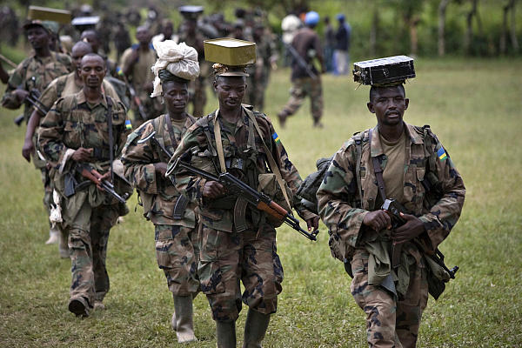

Slide 6
Genocide Watch has labeled the issue in 8 stages
Classification, symbolization, dehumanization, organization, polarization, preparation, extermination, denial

Slide 7
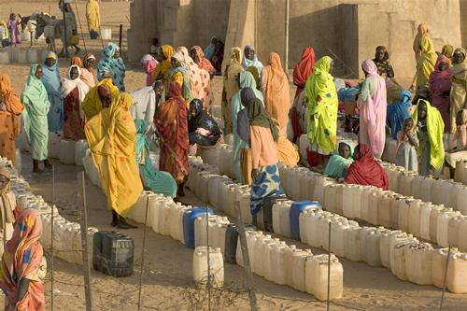

Slide 8
United Nations Current Policies
As an international organization it has transferred jurisdiction to national courts. Making them ineffective.

Slide 10
Possible Solutions
There are a variety of options ranging from promotion of a common language to an international criminal court.

Slide 11
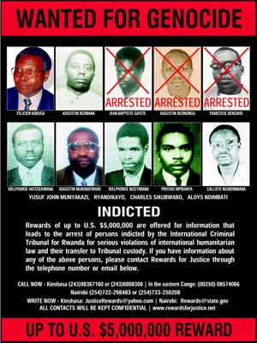

Slide 12
Feasibility vs. Effectiveness
After you have selected an Asian or African nation on the Genocide Watch list, identify what stage you think the country is in and offer a possible solution using the F & E Matrix

Slide 13
Feasibility vs. Effectiveness
EFFECTIVENESS | FEASIBILITY
 |  | HIGH | MEDIUM | LOW
 | HIGH
 | MEDIUM
 | LOW

