Slide 1
The Boy’s Bathroom
A Hygiene Catastrophe
By Damoon Nikaiyn
IVDU High School

Slide 2
Public Policy Analyst (PPA)
Step 1: Define the problem
Step 2: Gather the evidence
Step 3: Identify the causes
Step 4: Evaluate an existing policy
Step 5: Develop Solutions
Step 6: Select the best solution
(Feasibility vs. Effectiveness)

Slide 3
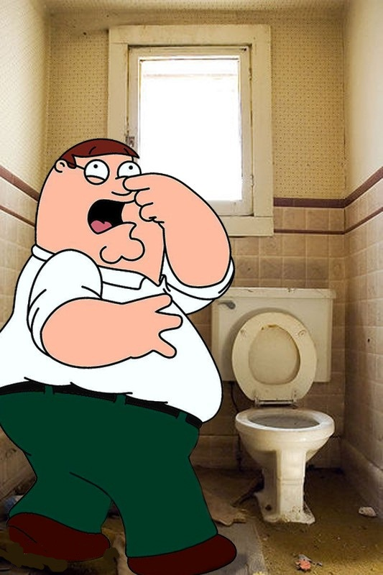
Define the Problem: The bathroom !
Waste paper is littered all along the floor
Offensive odors
Remnants from the improper use of the facilities
Worksheet 1

Slide 4
Why is this a problem?
Students are exposed to potentially harmful bacteria
A large amount of waste is produced, increasing expenses for the school
Students are less likely to use the bathroom when they need it, creating general unhappiness
What negative effects occur as a result of our issue?

Slide 5
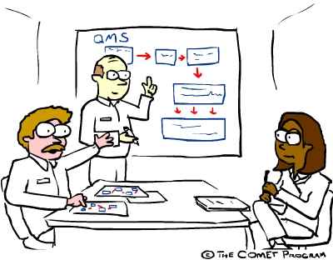
Gathering the Evidence:
What are some indicators that this problem really exists?

Slide 6
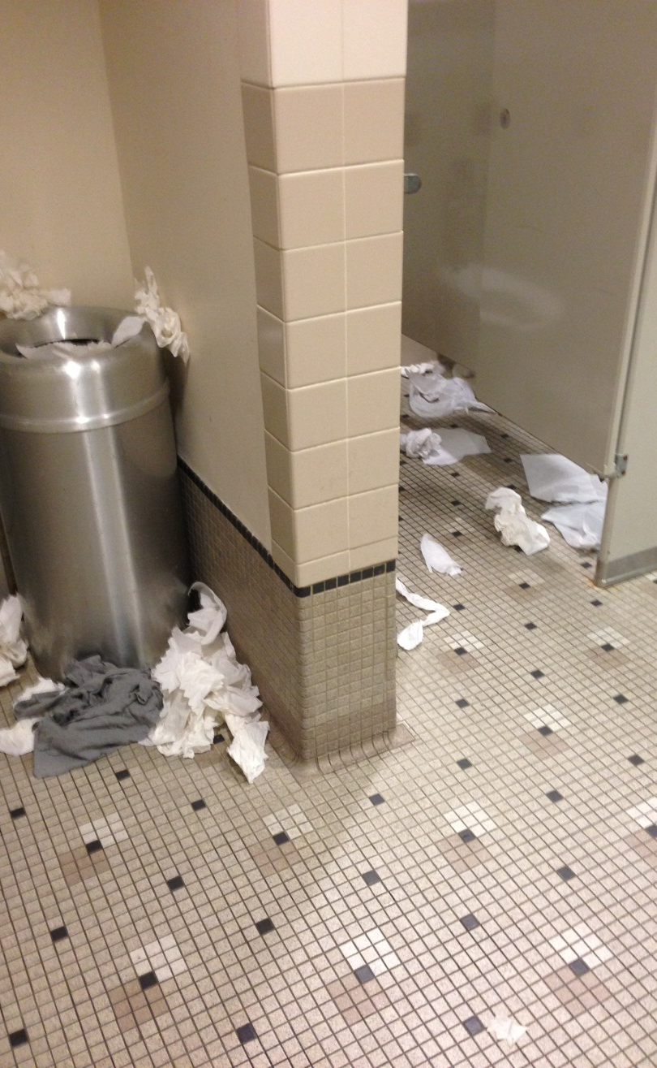
EVIDENCE
Worksheet 2

Slide 7
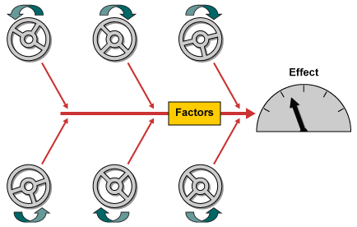
Identify the Causes:
Why is this occurring at IVDU High school, specifically in the boy’s bathroom?
Worksheet 3

Slide 8
Causes
Garbage is not properly being disposed of
The facilities are not being properly used
Toiletries are being abused, which create excess refuse
These are the possible reasons why the bathroom has poor hygiene

Slide 9
How do we fix it?
Possible Solutions

Slide 10
Evaluate the Existing Policy:
We have trashcans in the bathroom which are emptied regularly
Toiletries are restocked often
Worksheet 4

Slide 11
Develop Solutions:
Toilet education training
Hire sanitary workers
Students are no longer allowed access to the bathroom
Worksheet 5

Slide 12
Solution Matrix
Worksheet 6
Feasibility
 | High | Medium | Low
High |  | Hire sanitary workers | Students are no longer allowed access to the bathroom
Medium | Toilet education training
Low
Effectiveness

Slide 13
Best Solution
A combination of student education as well as sanitary workers to help clean the restrooms

