Slide 1
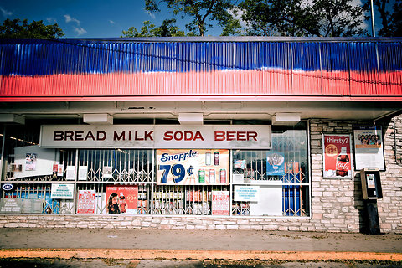
Lack of Access to Nutritious Food
Eileen McManus
EMcManus2@schools.nyc.gov

Slide 2
How can our school influence policies that can help students access affordable nutritious food?
Problem: Certain communities lack access to affordable and
nutritious food. This is especially true for those living in low-income communities of color and rural areas with limited access to grocery stores. These areas are often called “food deserts.”
Location of the problem:
United States
Three undesirable social conditions :
Diseases (diabetes, heart disease, high blood pressure, high cholesterol.
Low productivity
Low self esteem
Step 1 of the PPA: Identify the Problem

Slide 3
Steps of the Public Policy Analyst (PPA)
Define the Problem
Gather the Evidence
Identify the Causes
Examine Existing Policy
Develop New Solutions
Select the Best Solution

Slide 4
Identifying the causes of lack of access
Healthy options are less available- Instead of supermarkets or grocery stores, these poorer communities often have lots of fast-food restaurants and convenience stores. In addition, stores in low-income communities may stock fewer and lower quality healthy foods.
Lack of available transportation- Public transportation to supermarkets is often unavailable. It is often a far distance to get to supermarkets from low income communities. This makes it hard for some people to maintain a healthy weight for themselves and their families
Low household income - When available, the cost of fresh foods in low-income areas can be high. Too often, unhealthy foods cost less money.
Step 3 of the PPA: Identify the Causes
Notes:
Source: “Solving the Problem of Childhood Obesity”, Task Force on Childhood Obesity, Action Plan, May 2010.

Slide 5
Examining the current situation
The following signs are posted throughout the room: Strongly Agree, Agree, Disagree, Strongly Disagree—in separate corners of the room.
Walk to the sign that most strongly represents your feelings or beliefs about the following statement:
“It’s easy to eat healthy food”
Talk with the other students who chose to stand by the same sign and discuss your position. Choose a recorder to write down the thoughts of the group members.

Slide 6
After 5 minutes, one group at a time, share your group’s position with the class. If you agree more with another group after hearing their position, feel free to switch corners. If you switch corners, be ready to defend your choice.

Slide 7
Examining the current situation continued
Now, Walk to the sign that most strongly represents your feelings or beliefs about the following statement:
“Supermarket chains should be forced to build in urban and rural areas, not just suburban areas”
Talk with the other students who chose to stand by the same sign and discuss your position. Choose a recorder to write down the thoughts of the group members.

Slide 8
After 5 minutes, one group at a time, share your group’s position with the class. If you agree more with another group after hearing their position, feel free to switch corners. If you switch corners, be ready to defend your choice.

Slide 9
What can be done to resolve this problem?
Brainstorm ideas with your elbow partner on what can be done to resolve this issue of lack of access to affordable nutritious food.
In your HOME
In your SCHOOL
In your NEIGHBORHOOD
In the UNITED STATES
Step 5 of the PPA: Develop Solutions

Slide 10
Develop Policy
Group 1
Design a presentation to a large grocery chain that would persuade them to build a supermarket closer a food desert you have selected. Information could be about the community itself, including the number of children; general health/wellness statistics; the benefits to the supermarket of building here; and common good that a supermarket can bring to a community.
Notes:
Students may be broken into predetermined groups based on learning styles or will pick a random number from a jar (1, 2, 3). Students will complete the task assigned to their number.

Slide 11
Develop Policy
Group 2
Develop an idea, other than a standard grocery store/supermarket, that could give those in a food desert access to healthy and affordable food. Design a poster describing your idea, then write a one page proposal describing what would have to happen to make the idea a reality, any related costs and why you think it would work in this community.

Slide 12
Develop Policy
Group 3
Design an education campaign (poster, video, etc.) to help those who live in a food desert understand the importance of eating healthy foods and tips for accessing healthy foods and selecting affordable healthy foods when on a budget.
Notes:
Source of activities: http://www.tolerance.org/lesson/food-deserts-causes-consequences-and-solutions

