Slide 1
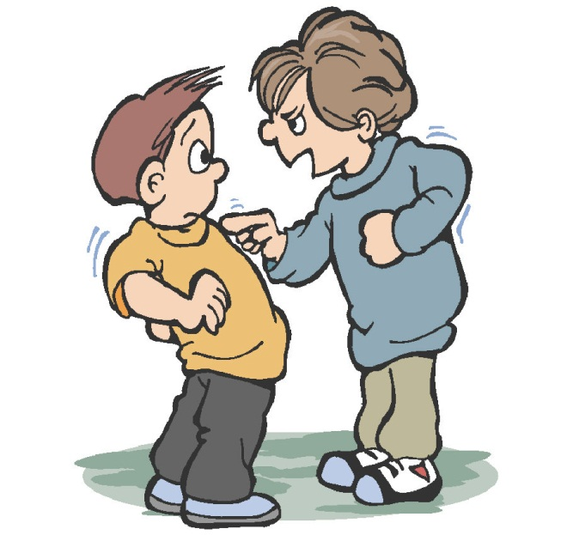
Bullying in the Classroom
A Public Policy Analysis
By Nicole Mastrantonio
NMastrantonio@nyc.schools.gov

Slide 2
Steps of the PPA:
Define the Problem
Gather the Evidence
Identify the Causes
Evaluate Existing Policy
Develop Solutions
Select the Best Solution

Slide 3
What is Bullying?
Bullying involves unwanted and aggressive behavior that may be repeated over time. Such behaviors include…
spitting
hurting one’s reputation/relationships
pushing
teasing
saying/writing mean things
name calling
threatening
hitting
taunting
inappropriate sexual comments
leaving someone out
embarrassing in public
tripping
kicking
spreading rumors
telling someone who to be friends with
pinching
harassment through texts, social media, the internet, etc.

Slide 4
The Problem with Bullying…
Children who are bullied are more likely to…
experience lose of appetite
experience loneliness
experience sadness
miss/skip/dropout of school
be depressed
have anxiety
lose interest in hobbies/activities
lose sleep
Children who are bullies are more likely to…
vandalize property
engage in criminal activity
get into fights
abuse drugs/alcohol
miss/skip/dropout of school
get traffic violations
engage in sexual activity at an early age
abuse their spouse/children as an adult

Slide 5
Surprised?!
Bullying can, and does, happen anywhere; in school, on the playground,
on the internet, and through texting/social media.
The Stats…
1 in 4 children are bullied
1 in 5 children admits to being a bully
A child is bullied on the playground every 7 minutes
43% of American students fear being bullied in the bathrooms
100,000 students admit to carrying a gun to school

Slide 6
Have you ever bullied someone?
Check Yourself Here!
What do you think are some
causes of bullying?

Slide 7
Bully has been bullied himself and wants to “pass it on”
Seeking power
Seeking attention
Causes of
Bullying
Seeking revenge
Mimic behavior seen in movies/TV
Bully thinks it’s “cool” or “funny”

Slide 8
New York State
Bullying Policies
Unfortunately, bullying is a serious problem in our schools. The recent rise in number of issues related to bullying leaves both parents and teachers wondering what they can do to stop bullying. The complete policies and guidelines regarding bullying can be found here. Among the current guidelines, New York State law requires:
A school environment free of bullying & harassment
Teachers, parents, & students to be able to identify
the person to whom they should report bullying to
Employees/students who witness harassment to report it immediately
Serious issues to be reported to the local law enforcement authorities
Each school to provide parents, students,
& faculty with a copy of such guidelines
Use these guidelines during teacher training

Slide 9
What Can We Do??
“Not in Our School” is a campaign that highlights the impact of bullying, and works to put an end to all forms of bullying. Some of their solutions to bullying include:
Identifying & monitoring places where bullying is known to frequently occur.
Having children role-play to practice what to say to a bully.
Having children sign a pledge against bullying.
Educating parents & teachers on bullying

Slide 10
The Best Defense …
I often remind my students that “Everyone has been bullied at least once, and everyone has bullied someone else at least once.” Unfortunately, bullying is becoming somewhat of a definitive part of childhood. Therefore, I believe that having children prepare themselves for some sort of eventual bullying is important.
Children can prepare themselves by role playing, and coming up with
a plan. If children are prepared, perhaps when the time comes that they
actually are being bullied, it won’t be as harmful to them. For example,
if the child is has a response already prepared, their confidence is likely to
not waver. Additionally, if they are able to stand up for themselves
without hesitating, the bully is likely to step down and leave them alone.
… Is a Good Offense!!

