Slide 1
Plastic Bags in New York City
T. Hammel
Thammel@schools.nyc.gov
Ditmas Middle School

Slide 2
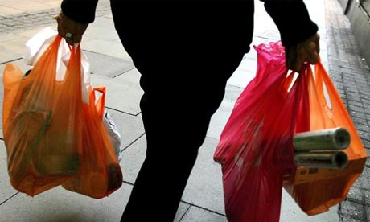
How do you use plastic bags?
http://www.theguardian.com/environment/2013/sep/14/shoppers-england-5p-charge-plastic-bags

Slide 3
What do you do with your plastic bags when you are finished using them?

Slide 4
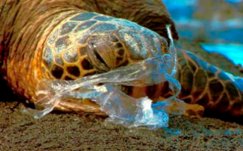
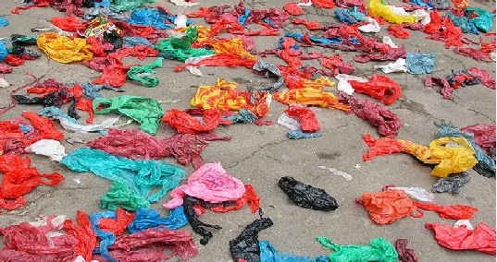
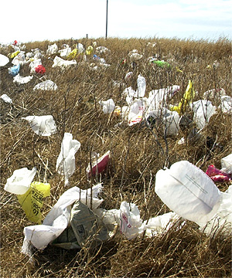
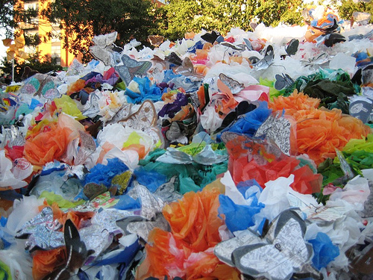
What do you notice?
http://malawibeat.wordpress.com/2010/10/19/problems-with-plastics-how-plastic-bags-are-destroying-our-world/
http://inhabitat.com/los-angeles-bans-plastic-bags/
http://www.cfm-online.com/state-lobbying-blog/2011/5/2/plastic-bag-ban-bottle-bill-get-last-minute-green-lights.html
http://www.urbantreefrog.com/?p=1398

Slide 5
Public Policy Analysis Steps
Define the problem
Gather evidence
Identify Causes
Evaluate an Existing Policy
Develop Solution
Select the Best Solution

Slide 6
Why is this a problem?
http://malawibeat.wordpress.com/2010/10/19/problems-with-plastics-how-plastic-bags-are-destroying-our-world/

Slide 7
Why is this a problem?
http://malawibeat.wordpress.com/2010/10/19/problems-with-plastics-how-plastic-bags-are-destroying-our-world/

Slide 8
Why is this a problem?
http://www.urbantreefrog.com/?p=1398

Slide 9
Why is this a problem?
http://www.cfm-online.com/state-lobbying-blog/2011/5/2/plastic-bag-ban-bottle-bill-get-last-minute-green-lights.html

Slide 10
Gather evidence Plastic bags as a national issue
US residents use 70 – 100 billion plastic bags each year
It takes 1,000 years for plastic bags to break down in Landfills
More than a million animals and birds are killed each year because of eating or getting trapped in plastic bags

Slide 11
Gather Evidence Plastic bags in New York City
In NYC, plastic bags account for 7.5% of residential waste
New Yorkers use 5.2 billion plastic bags per year
The plastic bags equal 100 tons of yearly waste and costs $10 million each year to transport to other states
When compared to Seattle, another major city, New York garbage consists of 8.7% of plastic bags and plastic wraps compared to Seattle’s 4.7% of plastic bags and wraps

Slide 12
What should New York City do about plastic bags?

Slide 13
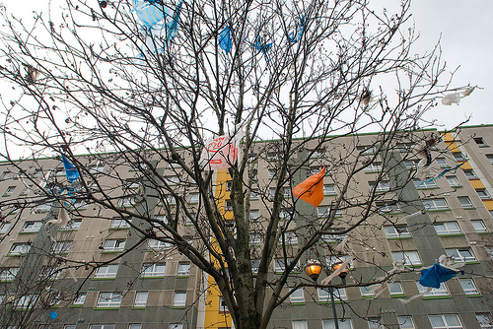
Identify the Causes
What are the factors that are causing the problems related to plastic bags?
For example: why are the landfills filling up with so many plastic bags?
http://blog.envirosax.com/wp-content/uploads/2009/05/2335141565_35e539f041.jpg

Slide 14
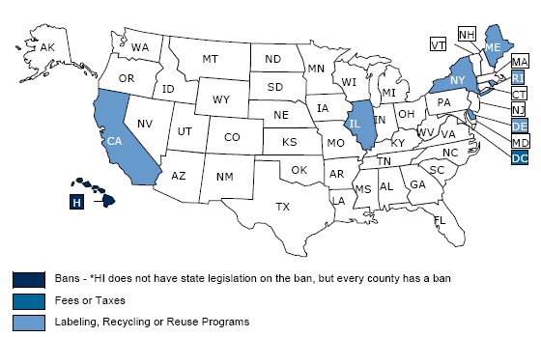
Evaluate an Existing Policy
Some state policies include:
Banning plastic bags
Charging fees or taxing plastic bags
Enacting recycling programs
http://www.ncsl.org/research/environment-and-natural-resources/plastic-bag-legislation.aspx

Slide 15
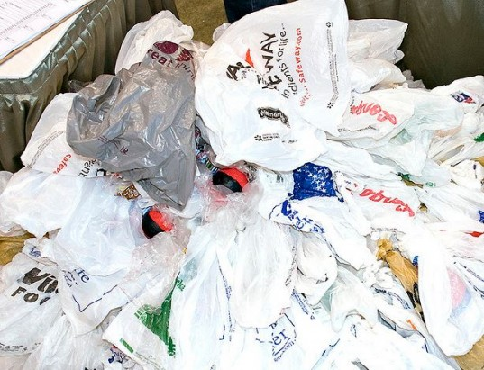
Develop a Solution
Determine various solutions that can be enacted to help with the problem of plastic bags
Think about what other cities, and states have done
Think about other new solutions
Complete the attached worksheet to record your solutions
Develop Solutions Worksheet
http://inhabitat.com/nyc/wp-content/blogs.dir/2/files/2013/08/plastic-bag-litter-2-537x411.jpg

Slide 16
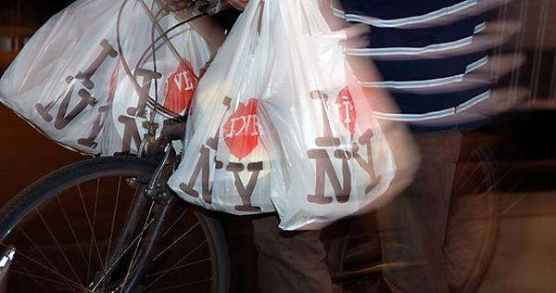
Select the Best Solution
Your best policy should be effective and feasible
This means that it can be done and that it is likely to be accepted by others
Record your work on the attached
Worksheet:
Best Solution Worksheet
http://www.csmonitor.com/var/archive/storage/images/media/images/2008/1107/new-york-mayor-proposes-plastic-bag-surcharge/picture1.jpg/5447731-1-eng-US/picture1.jpg_full_600.jpg

Slide 17
Resources
http://www.nyc.gov/html/nycwasteless/html/stuff/takeback_plasticbaglaw.shtml
http://gothamist.com/2013/08/20/bag_ban_photos.php#photo-1
http://www.nyc.gov/html/nycwasteless/downloads/pdf/wastecharreports/wcsfinal/highlights/wcs_14_rh_seattlecomparison.pdf
http://www.ncsl.org/research/environment-and-natural-resources/plastic-bag-legislation.aspx
. English 3D Issues. 1st. New York, NY: Scholastic, 2011. 40. Print.

