Slide 1
Pedestrian Safety in NYC
A Public Policy Analysis:
A problem that we all must face as residents and pedestrians in NYC

Slide 2
Class Questions
Who has felt in danger while crossing at the intersection of Coney Island Avenue and Cortelyou Rd?
Is the intersection properly designed?
Do people often cross against the light?
Do cars and trucks always yield to pedestrians (which is a NYC law)?

Slide 3
What is Public Policy?
As residents and citizens of Brooklyn and New York City we share public space, are subject to the city’s rules and regulations, and have the power to shape its future by participating in public policy making.
By expressing your opinion, with your voice , your pen, and eventually through your vote you have the power to bring about change.

Slide 4
Public Policy Analyst (PPA)
1. Define the problem
2. Gather the Evidence
3. Identify the Causes
4. Evaluate an Existing Policy
5. Develop Solutions
6. Select the Best Solution
(Feasibility vs. Effectiveness)

Slide 5
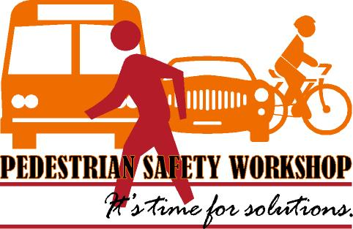
Define the problem
What forces converge/come together at the corner of Coney Island Avenue and
Cortelyou Rd? When is it busiest?
What problems have you witnessed, as a result of its current design? (Be specific)

Slide 6
Gather the Evidence
Online Resources
Newspaper /Online articles
Statistics
NYC Department of Transportation (MTA.org)
Police Precinct Data (70th Precinct)
Transportation Alternative.org

Slide 7
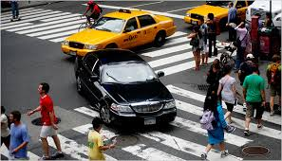
Identify the Causes
Make a list of all of the forces (of movement) that meet at Coney Island and Cortelyou Rd.

Slide 8
Evaluate an Existing Policy
Examine NYC traffic rules and regulations for cars, trucks, cabs, public transportation, pedestrians ,bicyclists and deliveries
http://www.nyc.gov/html/dot/downloads/pdf/trafrule.pdf

Slide 9
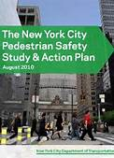
Develop 3 Workable Solutions
How could this intersection be changed?
In design:
Cross walks moved
Penalties for offenders
DOT Staffing

Slide 10
Select the Best Solutions
Feasibility vs. Effectiveness:
Rate Each Idea - High / Medium / Low
Discuss how best to solve the problem, conduct surveys (in the neighborhood), measure which of the suggestions are most realistic, which political officials need to cooperate with your plan, and how your plan would be put in to place .

