Slide 1
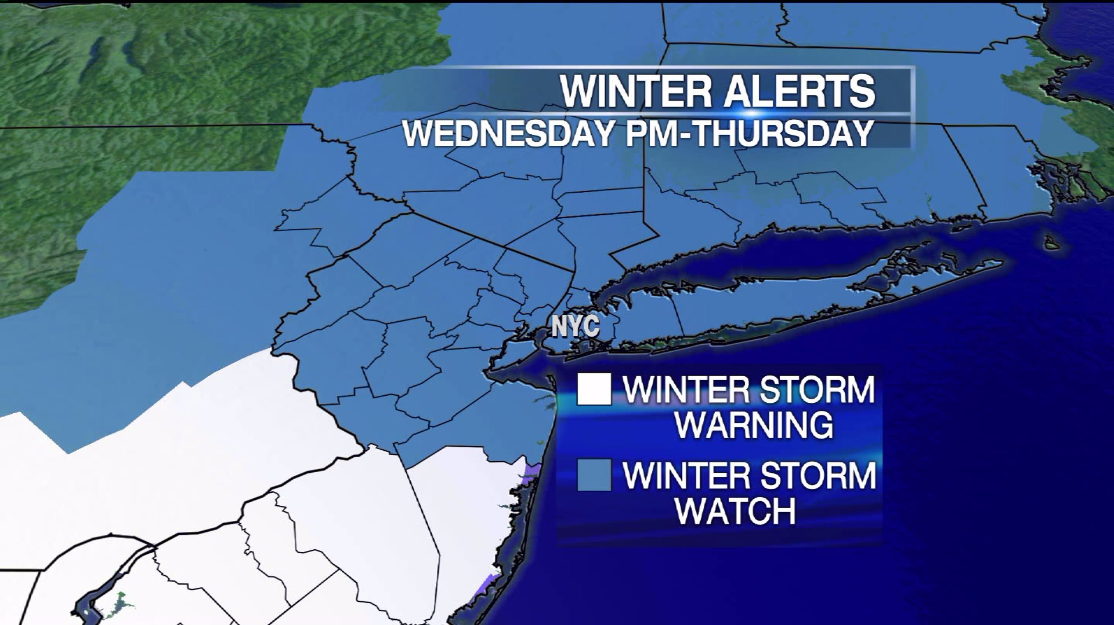
Students and Staff in Danger!
NYC Schools Remain Open Despite Dangerous Weather Conditions
Mrs. Grady --- Ditmas IS 62

Slide 2
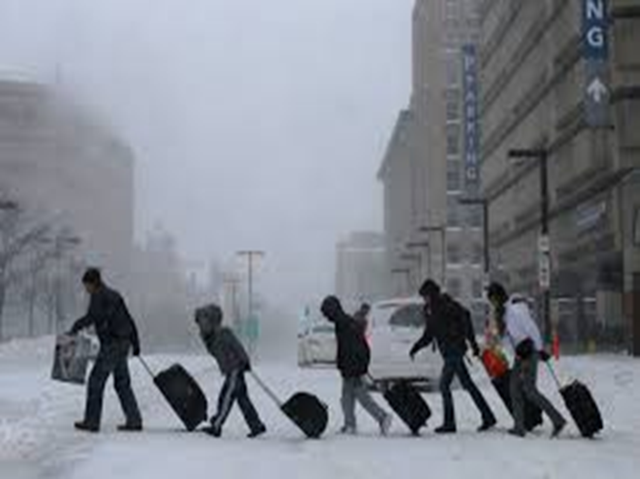
Examining a Public Policy:
Introduction
You and your classmates will learn the policy skill steps to analyze a problem that is affecting our school community
What is the problem?
Where is the evidence?
What are the causes?
What is the existing policy?
What policies can you create to correct the problem?
What is the best policy to correct the problem?

Slide 3
Step 1: Define the Problem
The problem we will examine is that NYC public Schools remain open despite severe and dangerous weather conditions.
As a result, the lives of students and staff are in danger because they are forced to come to school.
Student attendance is very poor on these “snow days.”
Teachers are reluctant to teach new content when a large number of their students are absent.
Students who do come to school do not want to work – they expect to be entertained.

Slide 4
Step 2: Find the Evidence
Evidence to support the public policy problem is below:
Students and staff saw hours added to their morning commute in dangerous conditions despite a hazardous travel advisory.
The NYC Department of Education had record low attendance during the last three storms.
Teachers and students were very vocal on social media sites regarding whether teaching and learning were actually happening.

Slide 5
Step 3: Identify the Causes
This problem is ongoing. It is caused by the NYC Mayor and the Schools Chancellor’s reluctance to close the schools.
They argue that poor students will not get a hot meal at home in some cases.
They argue that students are safer in school than at home in some cases.

Slide 6
They do not mention the financial ripple effect that closing schools will have on businesses.
If schools are closed, some parents will have no one to care for their children if they have to go to work.
Business owners will complain if large numbers of employees are out because of child care issues.
Some businesses may not be able to open if they do not have staff.
The city will lose revenue if large numbers of businesses are closed.

Slide 7
Step 4: Identify the Existing Policy
The current policy regarding closure of NYC Schools during emergencies is unclear. It is not published on the DOE website.
http://www.wnyc.org/story/nonstop-winter-weather-brings-repeated-watch-snow-day/
Politicians and enraged citizens alike are calling for a re-examination of this arbitrary policy and changes to be made.

Slide 8
Step 5: Identify and create a policy to correct the problem
Students will engage in a web quest to identify the current policy and brainstorms solutions to the problem
Next, we will work in groups to create several policies to correct the arbitrary nature of the school closings.
We will then make recommendations to Mayor DeBlasio and Schools Chancellor Farina.

Slide 9
Step 6: Choose the Best Policy to Correct the Problem
How do we choose from among the policies we created?
Two factors must be considered:
1) is the policy effective(likely to solve the problem)?
2) Is the policy feasible (easy to implement)?
We will rate each policy with a matrix that judges the efficacy and feasibility of each policy using a worksheet like the one below:
http://www2.maxwell.syr.edu/plegal/ppae/step6c.html

Slide 10
http://www.nydailynews.com/new-york/education/close-nyc-schools-snow-emergencies-facebook-page-32k-likes-article-1.1614272

