Slide 1
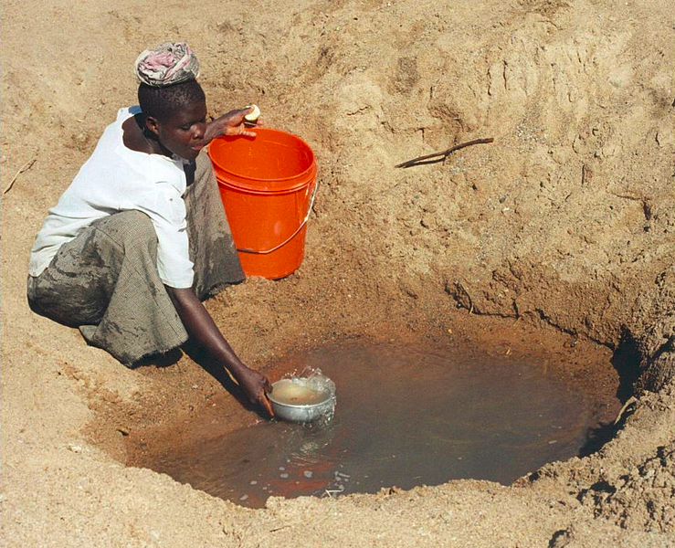
Water Scarcity in Tanzania
Presented by Fatima Fernandez
IS 62-Ditmas JHS

Slide 2
PPA-Policy Steps
Define the problem
Gather the evidence
Identify the cause
Evaluate the policy
Develop solution
Select the best solution

Slide 3
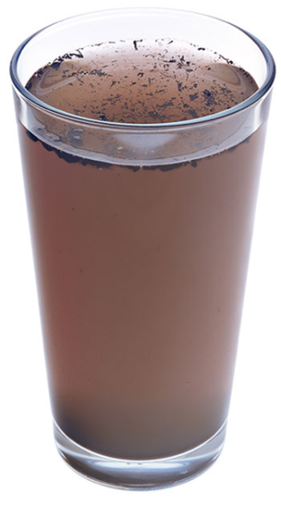
What is water Scarcity
Water scarcity or lack of safe drinking water is one of the world's leading problems affecting more than 1.1 billion people globally, meaning that one in every six people lacks access to safe drinking water

Slide 4
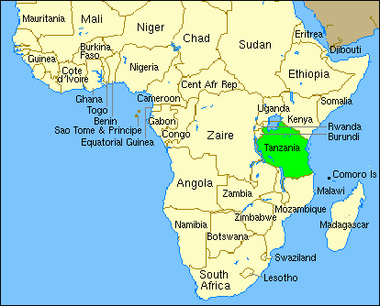
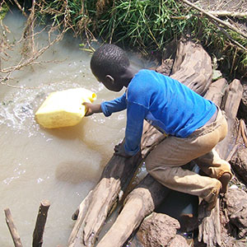
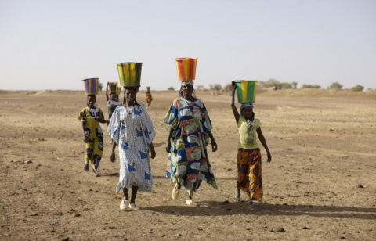
Defining the Problem
Fact about TANZANIA
Population: 47,780,000
47% lack access to water
88% lack access to sanitation
33.4% live below poverty line
Every year about 200,000 children after contracting waterborne disease.

Slide 5
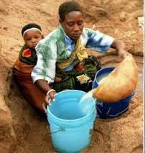
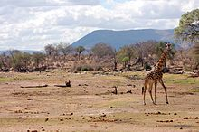
Identify the Cause
What are some of the problem that affect the water supply in Tanzania?
Dry Great Ruaha River
-
50 % of the city’s population is already un-served by the water company.
Most of the country is too dry and
scarce of water to support agriculture

Slide 6
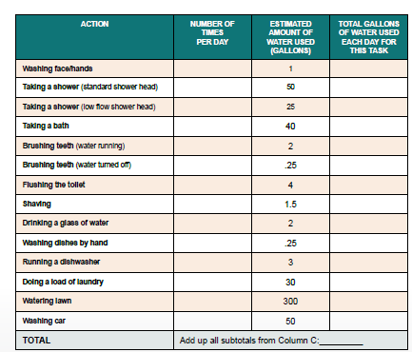
Activity Calculate Personal Water Use
Have students use the below chart to estimate their daily water use.
Directions: Fill out column A with the number of times you do each action in one day. Then, multiply
columns A and B to determine the estimated gallons of water you use per day for each activity.

Slide 7
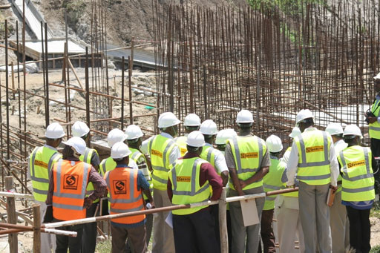
EVALUATE POLICY
Written Response : Use the Evaluate Poli cy worksheet
Several trans-national organizations, including the United Nations and The World Bank, are currently addressing the water crisis. Select one to research and report out on how they are tackling this is

Slide 8
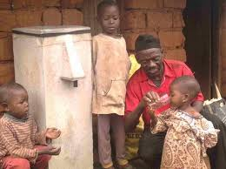
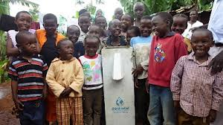
Develop Solutions
Look up recent articles on water filtrations systems and other water innovations currently being developed and used in the Tanzania.
What new systems and innovations seem the most promising, and most practical, to be used in the nations currently suffering the water crisis? Use the select best solution worksheet .

Slide 9
Select best solution
 | FEASIBILITY
 |  | HIGH | MEDIUM | LOW
 | HIGH
 | MEDIUM
 | LOW
Effectiveness

Slide 10
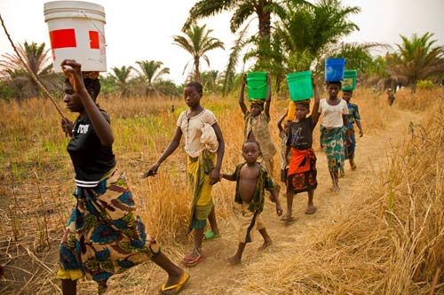
The Water Walk Class Activity-
Explain to students that they will participate in an activity to learn how the water crisis affectswomen and children around the world.

Slide 11
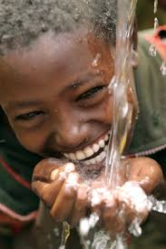
Reflection:
http://www.teachertube.com/viewVideo.php?video_id=242134

