Slide 1
To Sag or Not to Sag: Impact of Sagging Pants in the Ditmas Classroom
N. Charles

Slide 2
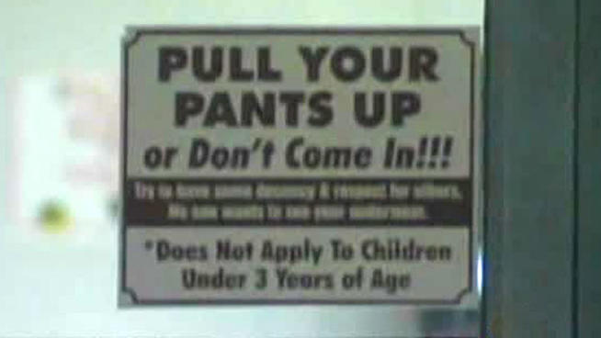
Step #1: What’s The problem with Sagging (Your pants in Public?)
Sign outside of a McDonalds restaurant in Houston, Texas.

Slide 3
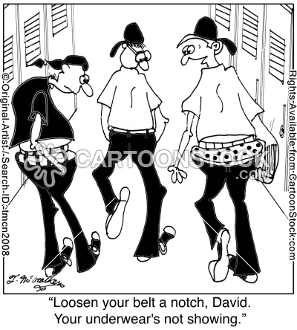
Sagging in Ditmas I.S. 62
What’s the Problem?
Is offensive to other students who have to look at other students “saggin” pants
Business owners and other students may feel that sagging pants pose a health risk.
Teachers and students find it distracting during classroom instruction as sagging students move around the classroom

Slide 4
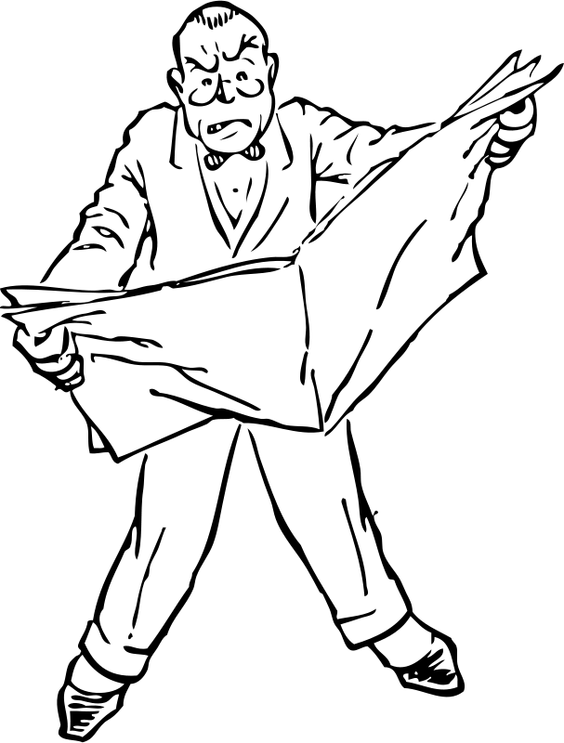
Step #2: Where is the Evidence that this is a problem?
Louisiana Town Seeks to ban Sagging.
"Appearing in public view while exposing one's skin or undergarments below the waist is contrary to safety, health, peace and good order of the parish and the general welfare," the ordinance reads
New York Daily News,
April 13, 2013 - http://www.nydailynews.com/news/national/louisiana-town-bans-sagging-pants-article-1.1315857

Slide 5
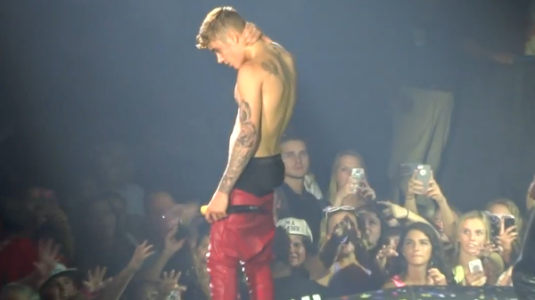
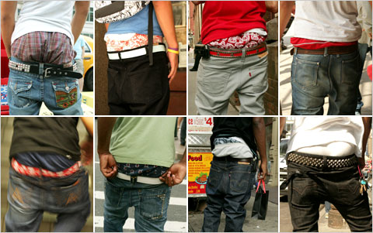
Step #3:What Caused Sagging? Brief Timeline of Sagging
Sagging began in prison. Prisoners were not allowed to have belts for fear that they would use them as a weapon. As a result, their pants would droop or sag.
Celebrities then popularized the way prisoners wore their pants.
Now it’s a fashion trend, everybody’s doing it!

Slide 6
How do you feel about sagging? Class Survey
Complete the survey on your feelings about sagging. Click the icon to the right.

Slide 7
Results of Survey
Reasons
Impact

Slide 8
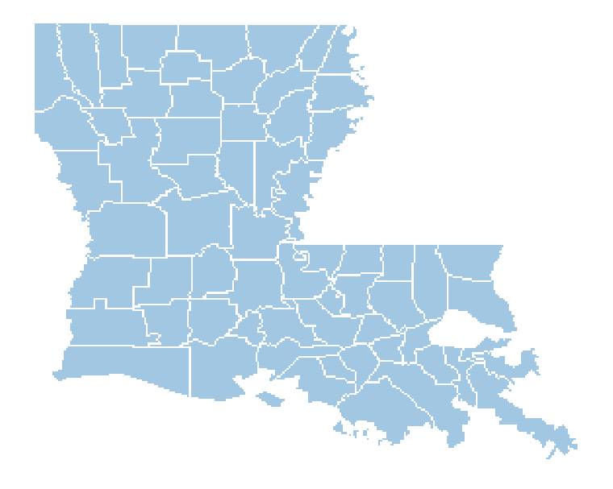
Step #4: What is the Policy about Sagging?
There is no National policy on the issue of sagging. Each state or municipality has to decide what the legal consideration or fine should be for this public behavior. There are two sides to this story:
Jefferson Davis Paris, La. became the latest locale to spark debate after passing an ordinance last week that institutes a fine for individuals caught wearing their pants too low.
But civil liberties advocates warn the ban, and others like it, go too far.

Slide 9
Step #5: Develop a Solution
Those states which seek to ban the act of sagging seek legislation which makes it illegal to “publicly expose” yourself and to exact a fine:
The bill, which seeks to add sagging pants to existing bans on indecent or lewd acts, had its first reading on Friday. – St Louis, MO

Slide 10
Reasons for a Sagging Policy
Wearing sagging pants has been linked to erectile dysfunction, hip problems and lower back issues
Sagging pants, restricts the wearers flexibility their full range of motion
The “look” is unfortunately, but generally associated with a public perception of deviant behaviors.
Public exposure is still considered in some parts of the country obscene and offensive

Slide 11
Step #6: Suggested Policy
Public display of sagging can not be legislated BUT…should be regulated:
In private businesses
Public transportation
Public school common areas

