Slide 1
Born to Be Bullied
What can you do to protect yourself from bullying in your school?

Slide 2
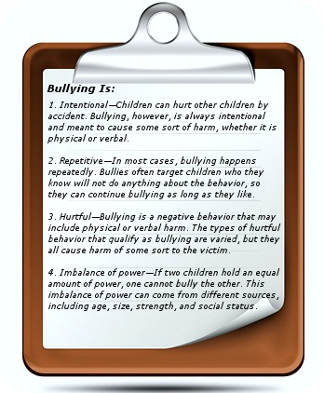
What is bullying?

Slide 3
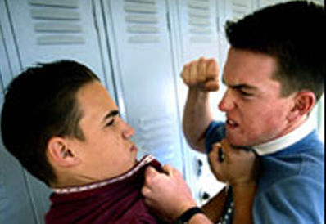
Define the Problem
Is bullying an issue at your school?
Who gets bullied?
Who are the bullies?
What does bullying look like?
What does bullying sound like?

Slide 4
Gather Your Evidence
Have you or anyone you know been a victim of bullying?
Was it face to face or through social media?
How often does bullying occur in middle school?
http://www.stopbullying.gov/news/media/facts/#listing

Slide 5
Identify Causes
What makes a bully a bully?
http://www.nasponline.org/resources/factsheets/bullying_fs.aspx
http://www.rsd.edu/schools/carmichael/bullying/cause.html

Slide 6
Evaluate Existing Policy
What are the consequences for bullying in your school?
Does NYS have any laws against bullying?
http://schools.nyc.gov/NR/rdonlyres/188AF3E2-F12B-4754-8471-F2EFB344AE2B/0/DiscCodebooklet2013final.pdf
http://www.stopbullying.gov/laws/new-york.html

Slide 7
Stop Bullying
What can you do to stop bullying in your school?
Where do you begin?

