Slide 1
Hygiene: It’s All in Your Hands
Randee Sultanik
Marilyn David IVDU Upper School
Randeesultanik@yahoo.com

Slide 2
Public Policy Analyst (PPA)
Graphic Version
Step 1- Define the Problem
Step 2- Gather the Evidence
Step 3- Identify the Causes
Step 4- Evaluate an Existing Policy
Step 5- Develop Solutions
Step 6- Select the Best Solution

Slide 3
Step 1: Define the Problem
What is the problem?
Has anyone ever forgotten to wash their hands ?
Worksheet
Notes:
Ask question to students
Activate prior knowledge
Discussion (5 minutes)

Slide 4
Step 2: Gather the Evidence
Is this issue relevant?
Where is the evidence?
Worksheet

Slide 5
Instructional Strategy: Think-Pair-Share
Discuss with your partner…
Has there been a time when you forgot to wash your hands after using the bathroom?
Where did it take place?
How did you realize?

Slide 6
Reflective Discussion
What did we come up with?
Student’s thought/response
Student’s thought/response
Student’s thought/response
Student’s thought/response
Student’s thought/response
Notes:
Students will sit in a “U” without their desks facing the Blackboard (more inviting environment).
Reflective discussions encourage students to think and talk about what they have heard. Purpose of this strategy is for students to share personal thoughts and feelings evokes from the Think-Pair-Share exercise.

Slide 7
Step 3: Identify the Causes
Why do we forget to wash our hands?
Student Questionnaire

Slide 8
What did we discover…
Students do not wash their hands after the bathroom because…
They are lazy.
They see other people in the bathroom who do not wash their hands.
The soap dispensers do not have soap.
They do not like the smell of the soap.
They forget because they are in a rush.
Not enough sinks in the bathroom and students to not want to wait in line to wash their hands.

Slide 9
Step 4: Evaluating an Existing Policy
At Home:
Who washes their hands?
When does one wash their hands?
In School:
Who washes their hands?
When does one wash their hands?

Slide 10
Step 5: Developing Solutions
Put on Your Thinking Caps…
It is Time to Think!!
WHAT CAN WE DO?

Slide 11
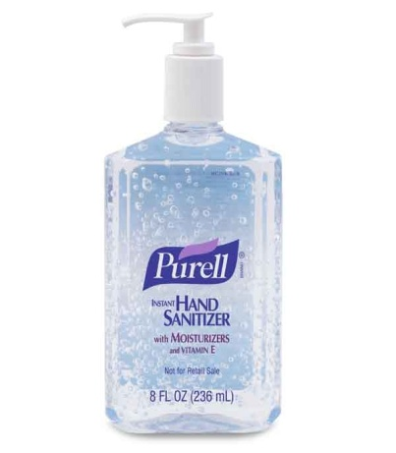
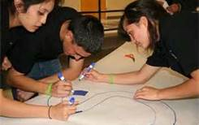
Possible Solutions
Build more sinks in the bathrooms
Create posters to serve as reminders
Buy soap that smells good
Weekly Job-making sure each soap dispenser has soap
Instead of soap, use hand sanitizer

Slide 12
Step 6: Select the Best Solution
Discussion: What are the top 3 solutions?
a) Create posters to serve as reminders
b) Weekly Job-making sure each soap dispenser has soap
c) Hand Sanitizer
Notes:
Students will vote.
Tally marks will be used on the board.

Slide 13
Feasibility vs. Effectiveness
Feasibility – Is it easy to put our solution into action?
Effectiveness – Will our solution be helpful in solving out problem?

Slide 14
Matrix
Is our solution easy to put into place?
What do you think?
Create posters to serve as reminders Weekly Job-making sure each soap dispenser has soap c) Instead of soap, use hand sanitizer
Effectiveness
Feasibility
a
b
c

Slide 15
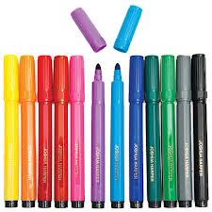
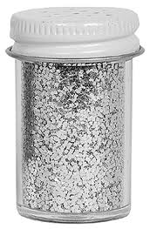
Best Solution…
Create Posters
Posters will be displayed
in the school’s bathrooms
to remind students to wash
their hands.

Slide 16
Citations
Disease Control and Prevention. (n.d.). When Should You Wash Your Hands. Handwashing: Clean Hands Save Lives. Retrieved February 20, 2013, from www.cdc.gov/handwashing/
Defining the social problem . (n.d.).Project Legal's Public Policy Analyst. Retrieved February 12, 2013, from www2.maxwell.syr.edu/plegal/TIPS/select.
Graphic Version . (n.d.). Select the version below you want to use. Retrieved March 18, 2013, from http://www2.maxwell.syr.edu/plegal/ppae/p

