Slide 1
Hygiene
Beauty,
Inside and Outside
BY: Ruchy Schwarzmer
Marilyn David IVDU Upper School
ohmyrs@gmail.com

Slide 2

The Public Policy Analyst (PPA)
1. Define the problem
2. Gather the evidence
3. Identify the causes
4. Evaluate existing policy
5. Develop solutions
6. Select the best solution
Together,
we can make a difference!
PPA Website
Notes:
Bracha: make hyperlink to ppa website

Slide 3
Step 1: Define the problem
What is the issue?
Worksheet 1

Slide 4

Your Hair and You: Step 1: Define the problem
Notes:
Discussion with class. Has anyone ever commented about or taken you aside to discuss you hair? Students give personal accounts or experiences.

Slide 5
Step 2: Gather Evidence
Is this issue really relevant?
Worksheet 2

Slide 6
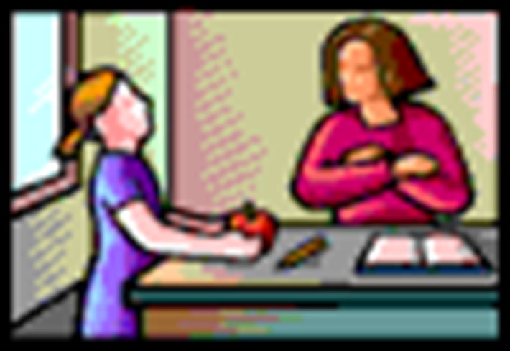
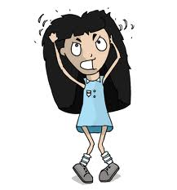
Your Hair and You: Step 2: Gather Evidence
Notes:
Discussion with class. Share experiences about hair. Has anyone mentioned the state of your hair? Does your hair often feel unmanageable, itchy, or look dull?

Slide 7
Step 3: Identify Causes
What has made this issue a concern?
Worksheet 3

Slide 8
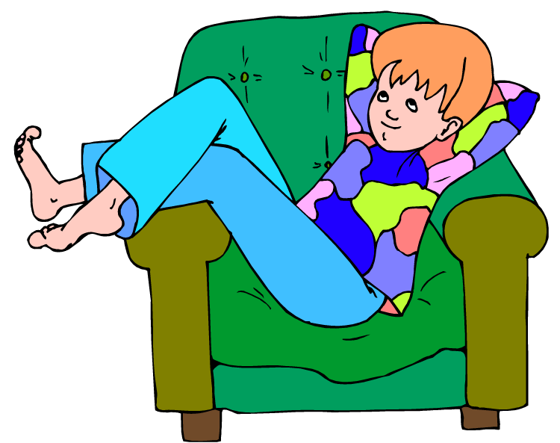

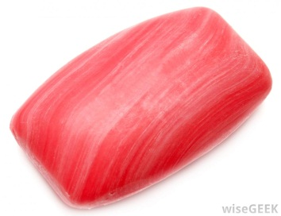

Your hair and you: Step 3: Identify the Causes
Child is not interested in completing task
Child never learned proper use of relevant products
Child does not own necessary products
Child does not understand the purpose and/or need for this task
Notes:
Students will share their opinion and ideas based on their experiences to discuss the reason for lack of attention to hair care. Some examples are above. Teacher will add additional comments as students share.

Slide 9
Step 4-5: Evaluate Existing Policies and Create Solutions
What can we do to correct the situation?
Worksheet 4
Worksheet 5

Slide 10

Your hair and You: Step 5: develop solutions
What can be done to help?
Make a tracking chart to record number of washes per week
Talk to the students individually
Create a class health lesson series to help students understand the need and the process of maintaining healthy hair.
Notes:
Students give ideas and suggestions. Teacher types as students share.

Slide 11
Which idea should we choose?
Which idea will help us reach our goal in the simplest way?

Slide 12
Feasibility VS. Effectiveness
Feasibility:
How easy is it to put it into action?
Effectiveness:
How well will this policy work?
?!
?

Slide 13
Choosing the Best Solution
feasibility
Our ideas:
Make a tracking record of hair washes
Talk to students individually
Create a class health lesson on hair care and its importance
1
2
3
1
a
effectiveness
2
c
3
b
Notes:
Students will discuss their feelings on each idea and where it should be on the chart.

Slide 14
Step 6: Select the Best Solution
Option 3: Create a class health lesson series to help students understand the need and the process of maintaining healthy hair.
Let’s make the change!!
Worksheet 6

Slide 15

Things we should know:
Why? How?
What?
Why must we care about our hygiene?
How do we properly care for our hygiene?
What products are important to use?
Notes:
Student discussion and link to visual aids and explanations. For the last question, students will go to a pharmacy and look at different products after discussion.

Slide 16
Find out more: Research Project
Using the internet, each student will be in charge of the three different components discussed on previous slides.
Students will find information and pictures and create a presentation about their topic.
Students will share the information with their peers and information will be displayed for viewing.

Slide 17
Follow- up!
Students keep a record of regular showering schedule.
Depending on individual students’ needs, specific modifications will be applied to help reach goals

Slide 18
Beautiful,
inside and outside
Because you are worth it!!

