Slide 1
Poor Academic Progress
Ditmas I.S. 62
Mrs. Hennelly

Slide 2
Problem -What is an obstacle?
Turn and talk with your partner
Define obstacle
Something that obstructs progress
Dictionary.com

Slide 3
Have you ever felt like this?
I can’t take it anymore!
There’s just too much work!
Do you feel like there are too many things standing in your way?

Slide 4
Evidence- test scores
Consequences of the problem
Not motivated
Homework is not completed
Students come to school late
Fighting with friends
Peer pressure

Slide 5
Causes – What are some obstacles faced by students?
Live in shelters
Faced with bullying
English is not spoken at home
No consequences at school or home for behavior

Slide 6
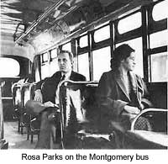
Solutions – Who else has faced obstacles?
What obstacles were standing in her way?

Slide 7
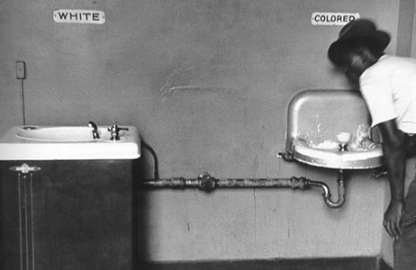
What obstacle is he facing?

Slide 8
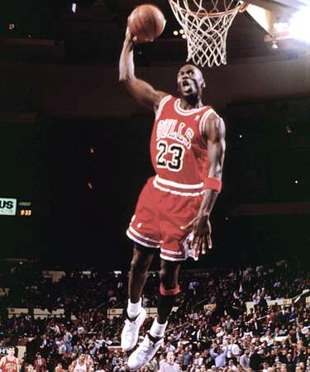
And him?

Slide 9
Or her?

Slide 10
Solutions – How do people overcome obstacles?
Read the nonfiction article on an influential African American.
Complete the worksheet with your group to identify the obstacles and solutions.

Slide 11
Name_____________________________________ Date_________
Overcoming Obstacles Worksheet
Title of Article___________________________________________
What obstacles did he/she face? How was he she able to overcome this?

Slide 12
Solution – Complete a Venn Diagram comparing your obstacles with those of your research topic
___________
___________

Slide 13
New Policies
How can our school help students to deal with obstacles facing students in order to improve test scores?

