Slide 1
Keeping Language Clean
By: Bracha (Grace) Einhorn
Marilyn David IVDU Upper School
BrachaEinhorn@gmail.com

Slide 2
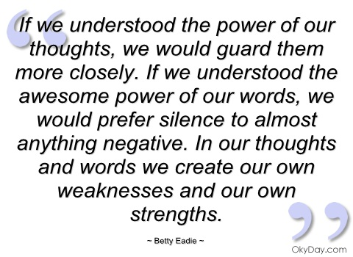

Slide 3
The Public Policy Analyst (PPA)
Define the problem
Gather the evidence
Identify the causes
Evaluate the existing policy
Develop solutions
Select the best solution

Slide 4
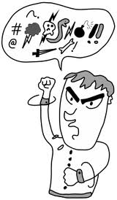
Step 1: Define the Problem
What is profanity?
Wikipedia Definition:
Profanity, also called swearing, cursing, coarse language, foul speech, strong language, dirty words, 'cussing', bad words, bad language vulgar language, inappropriate language, and simply language, is language that is considered by some to be strongly impolite or offensive. It can show a desecration or debasement of someone or something, or show strong or intense emotion. Profanity can take the form of words, expressions, gestures, or other social behaviours that are construed or interpreted as insulting, rude, vulgar, obscene, obnoxious, foul, desecrating, or other forms.

Slide 5
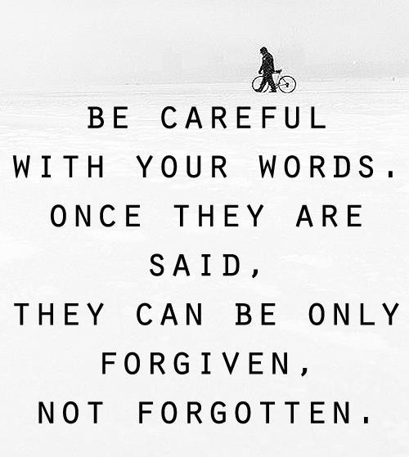
Step 1: Define the Problem
What’s wrong with profanity?

Slide 6
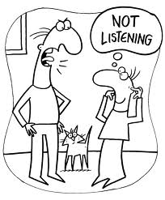
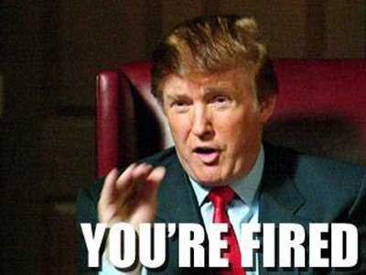
Step 1: Define the Problem
What areas of life can profanity affect?
How are people affected by profanity?

Slide 7
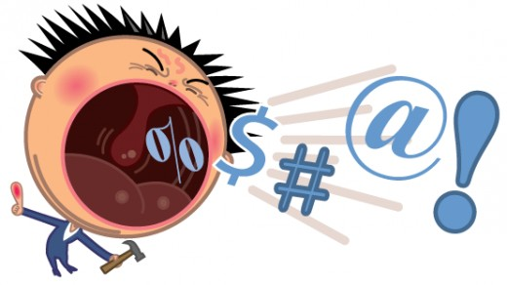
Step 1: Define the Problem
How is a school affected by the use of profanity?

Slide 8
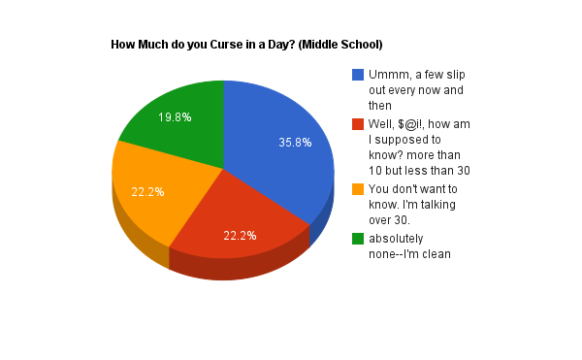
Step 2: Gather Evidence
How often to students use profanity?
Take a poll- count how many times you hear profanity in one school day

Slide 9
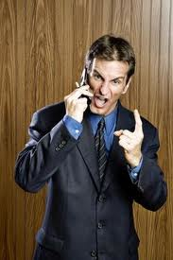
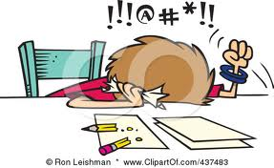
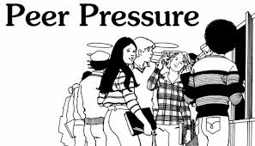
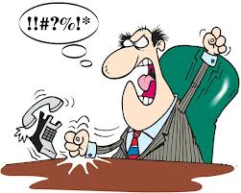
Step 3: Identify Causes
What causes people to use profanity?

Slide 10
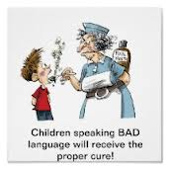
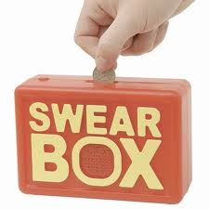
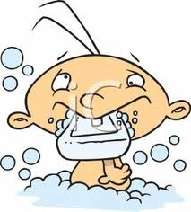
Step 4: Evaluate Existing Policies
What are some policies that exist regarding the use of profanity?

Slide 11
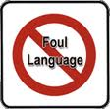
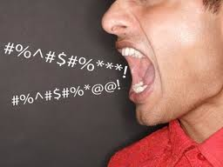
Step 5: Create Solutions
What can we do to prevent future use of profanity in school?

Slide 12
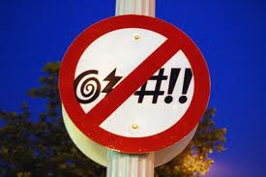
Step 6: Choosing the Best Solution
What do we think would work best?

Slide 13
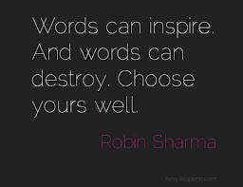
Power of Words- Video

